Slide 1

a case against automation
Robin Gilijamse
@interestingtraffic@noc.social
Notes:
1.
Day job

Slide 2
My definition of an expert in any field is a person who knows enough about what's really going on to be scared.
P. J. Plauger, Computer Language, March 1983
Notes:
2.
Book

Slide 3
automation maturity
4
Autonomous systems
3
Infra as Code
2
Shared tools and processes
1
Scripting
0
Manual work
Notes:
3.
Explain. Talking to customers

Slide 4
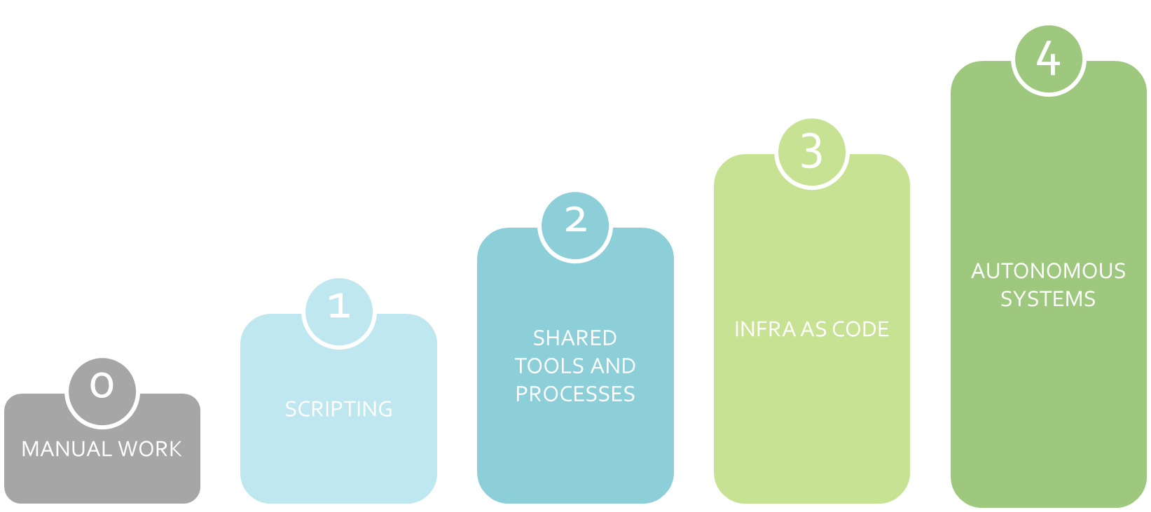
removing human error
human in the loop
magic
Notes:
4.
As our teams become more sophisticated.

Slide 5

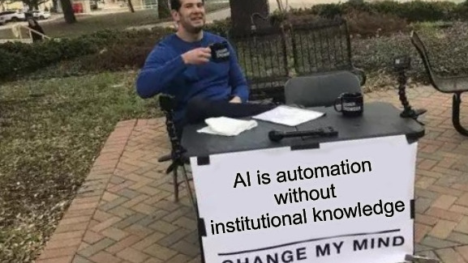
Notes:
5.
AI = Automation. Easier to write, harder to debug.

Slide 6
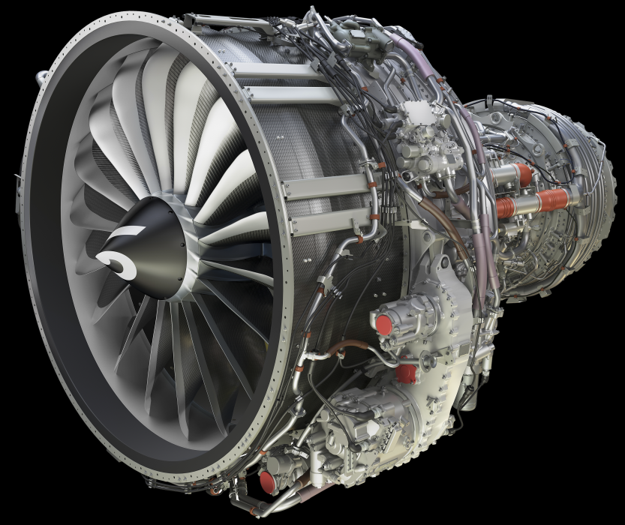
a more efficient engine a way to save money
©SAFRAN, All rights reserved
Notes:
6. | 5:00
Safran LEAP-1B
Lower emitions, less noise. And also: less fuel.
Just a little bit larger & heavier.

Slide 7
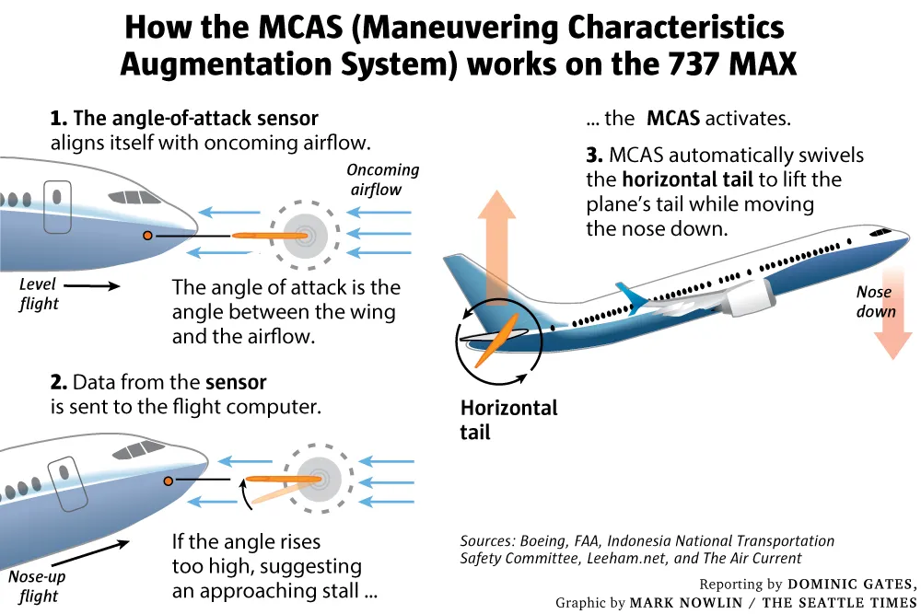
Notes:
7.
Control system = automation

Slide 8
Automation Surprise
An automation surprise can then be defined as the end result of a deviation between expectation and actual system behavior that is only discovered after the crew notices strange or unexpected behavior and that may already have led to serious consequences by that time.
Notes:
8. | 7:00
First concept
Automation does something other than expected.
-> Operator fighting automation

Slide 9
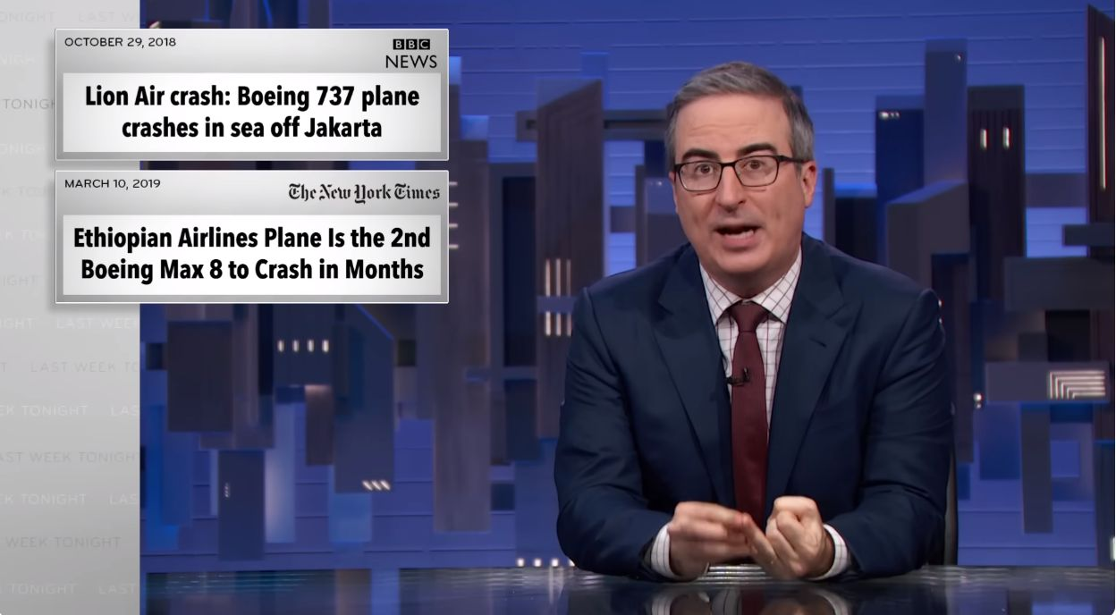
Notes:
9.
And the result….
John Oliver explaining on national television what a shitty company you are.

Slide 10
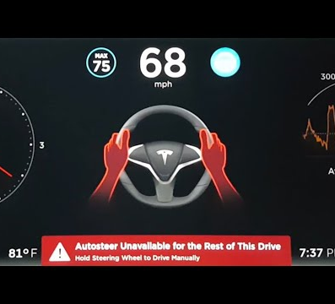
just keep an eye on the system
Notes:
10.
Solution: humans must pay more attention.
Ref: Tesla ‘self driving’

Slide 11
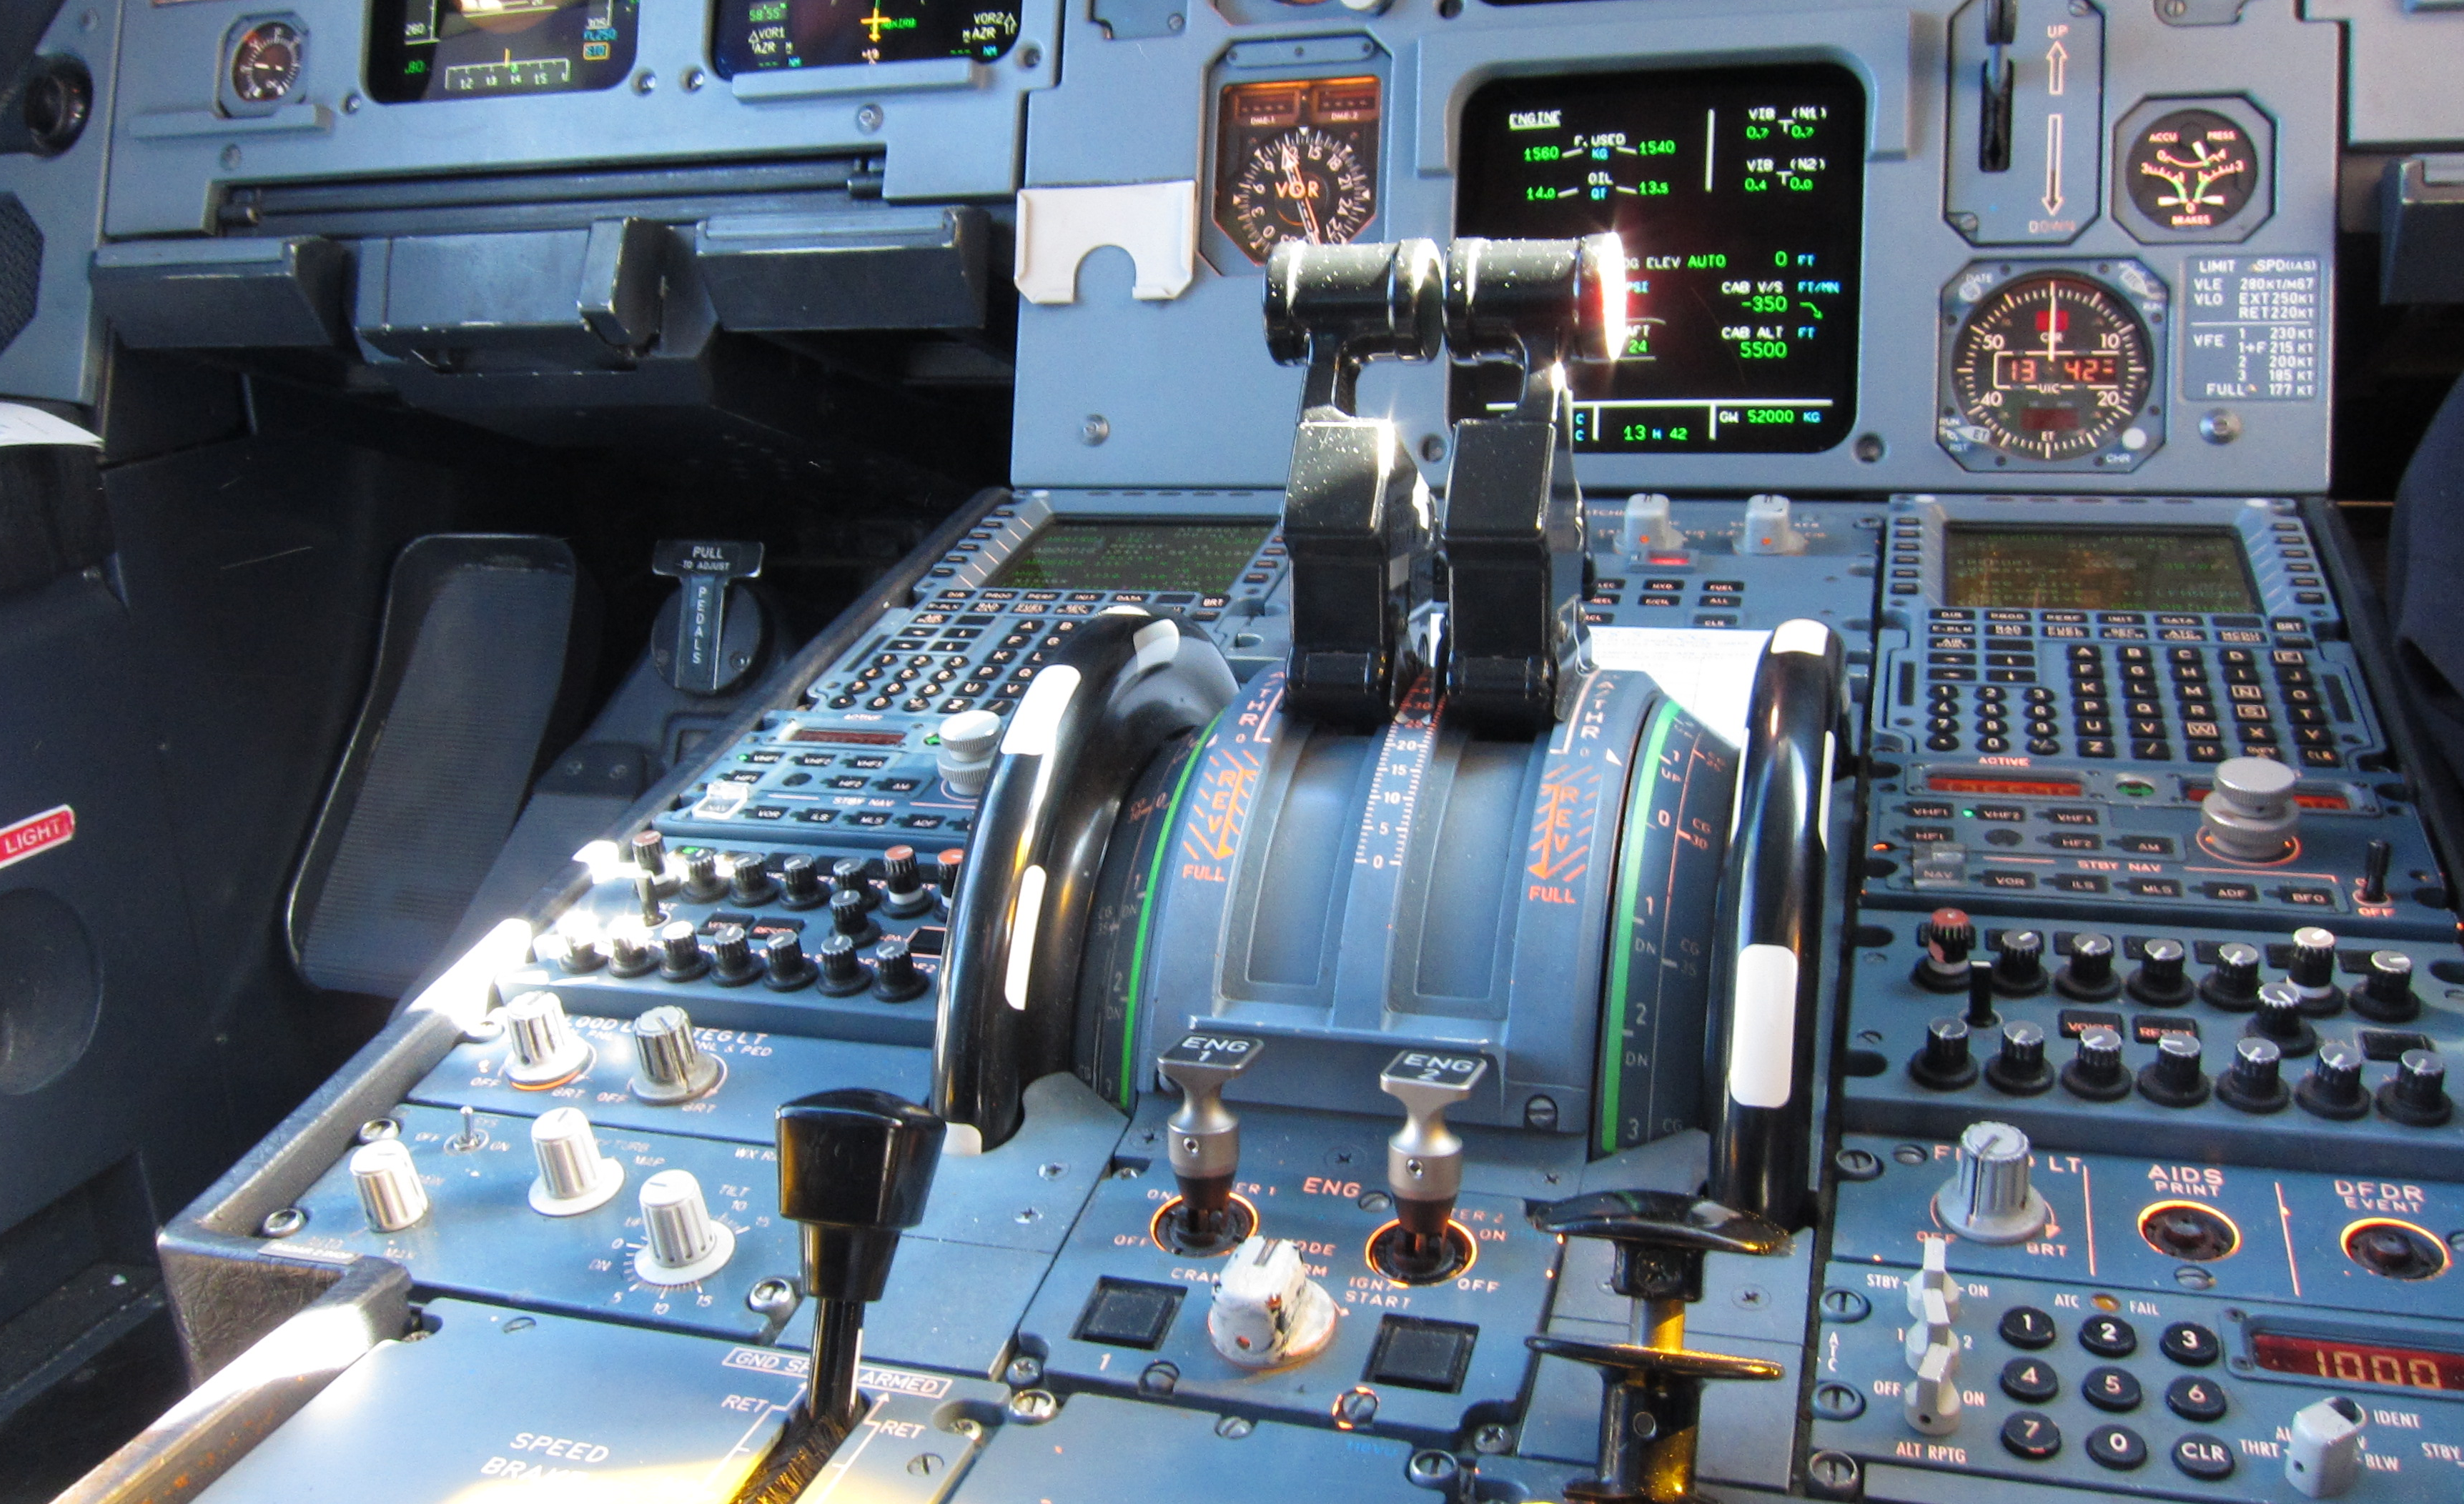
autothrottle
©Olivier Cleynen, CC BY-SA 3.0
Notes:
11. | 9:00
Autothrottle = simple automation
Visible feedback
Proven, reliable

Slide 12
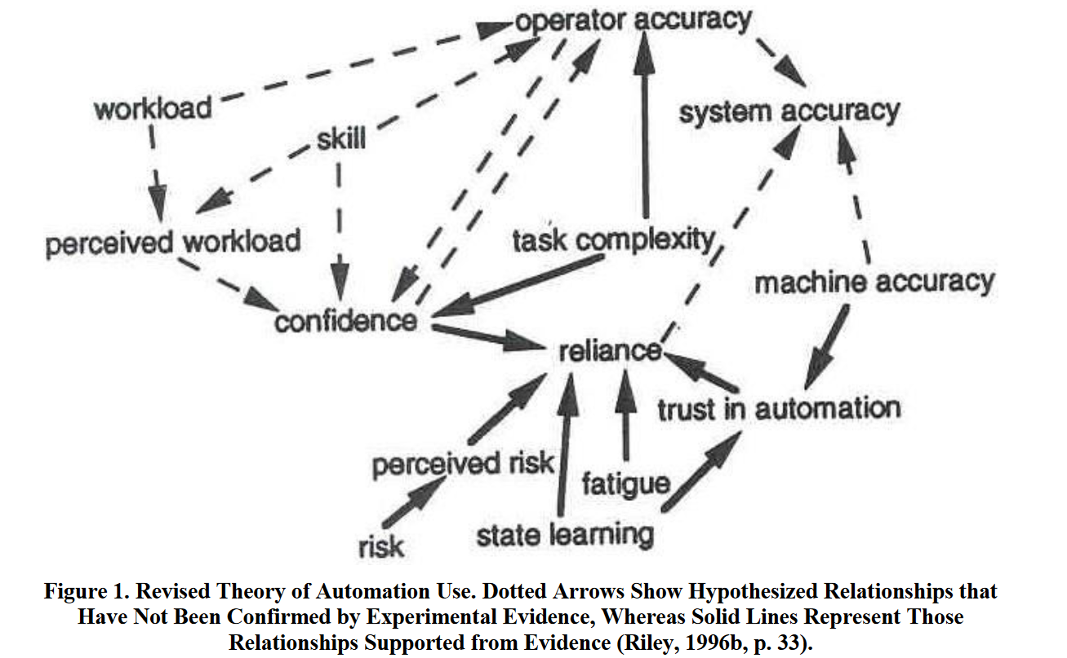
Automation-Induced Complacency
Notes:
12.
Second concept.
If it is reliable, you stop paying attention.

Slide 13
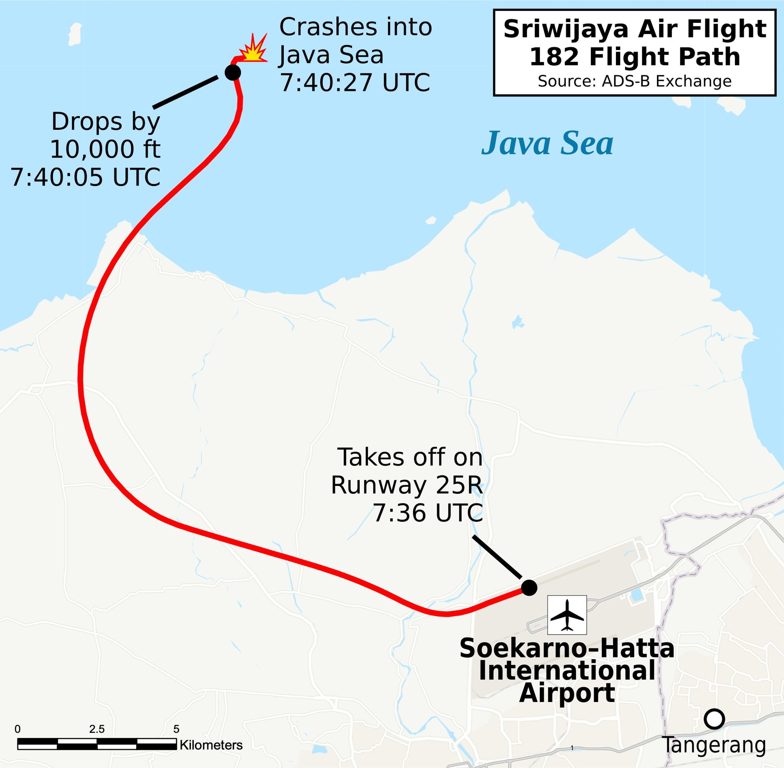
Map by Isochrone, CC BY-SA 4.0
Notes:
13. | 11:00
One of the levers got stuck -> assymmetric power
Automation compensating
.. Until it doesn’t

Slide 14
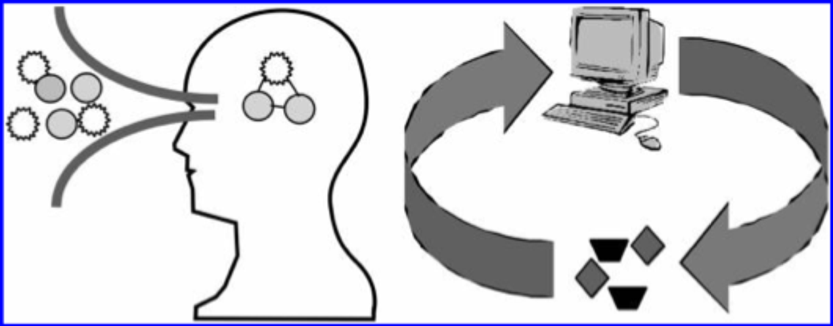
what if we keep a human in the loop?
Endsley, MR & Jones, DG 2012, ‘SA demons: the enemies of situational awareness’
Notes:
14
Keep paying attention.
Minimum automation

Slide 15
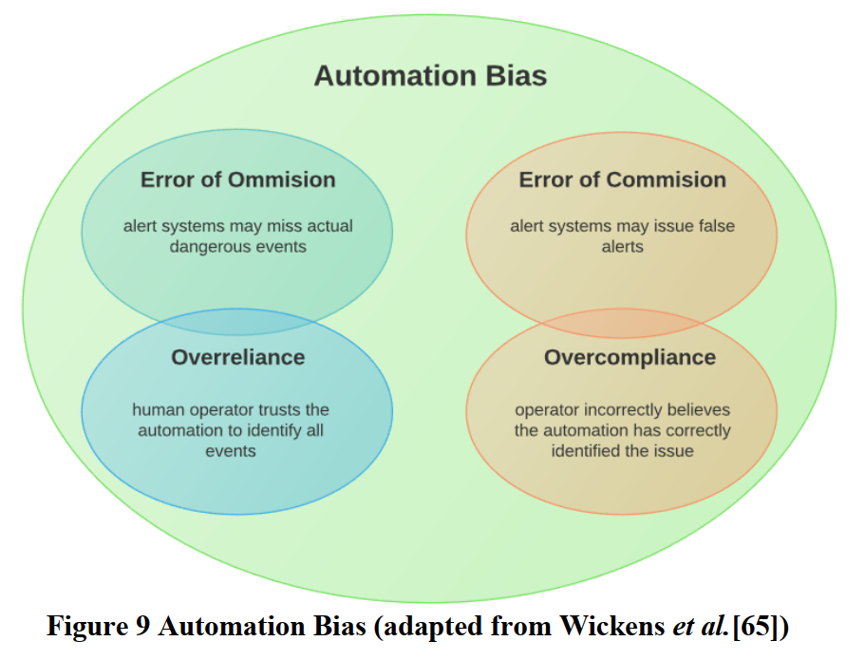
Automation Bias
Wickens, CD, Clegg, BA, Vieane, AZ, & Sebok, AL 2015,
‘Complacency and automation bias in the use of imperfect automation’, Human Factors, vol. 57, no. 5, pp. 728-739.
Notes:
15. | 12:30
Third and final
Computer says no.
Ref: benefits scandal.

Slide 16
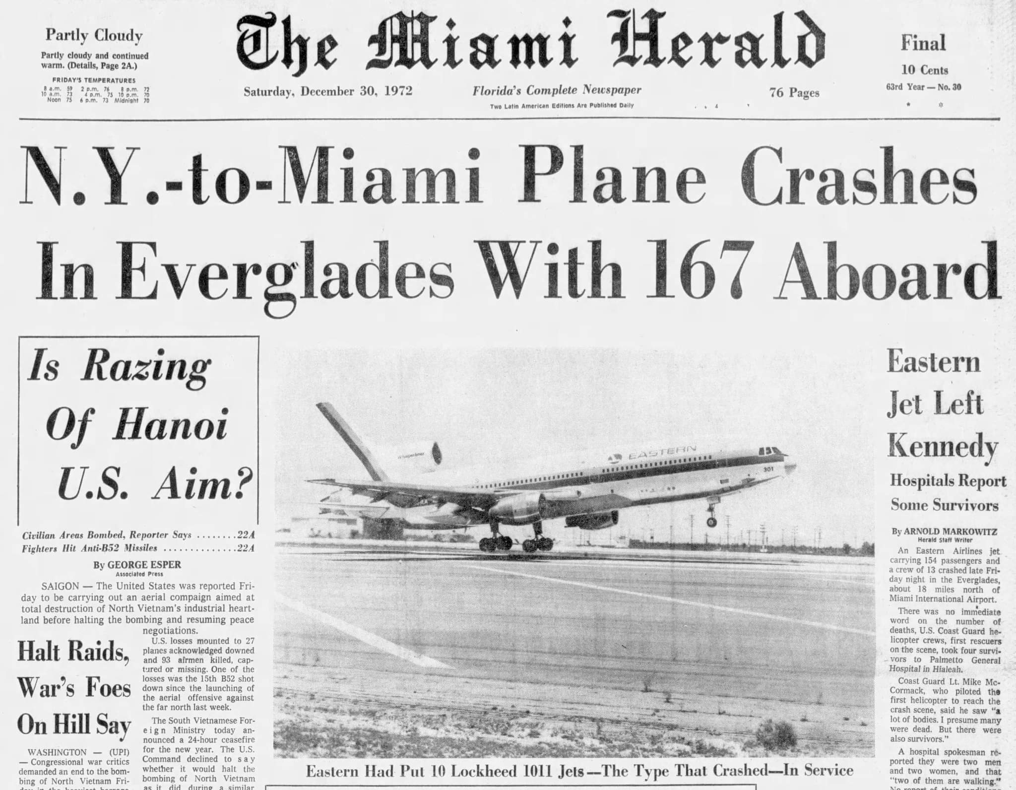
Notes:
16.
The event that started this field, 1972
Simplest automation system: autopilot maintains altitude.
Autopilot disabled, gradual descent
Crew debated altitude indicator (autopilot maintains altitude, right?)

Slide 17
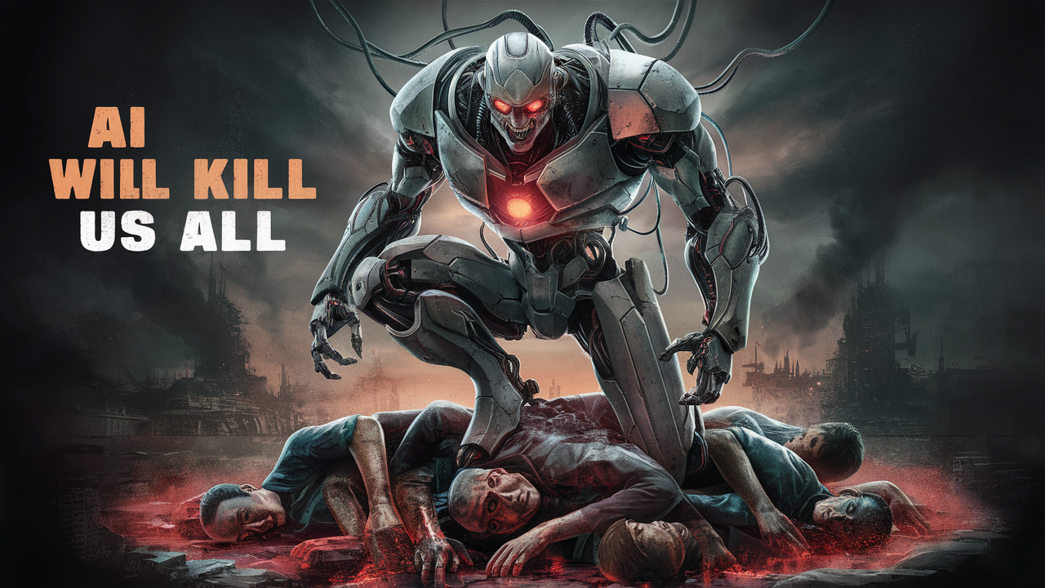
Notes:
17.
Or not.

Slide 18
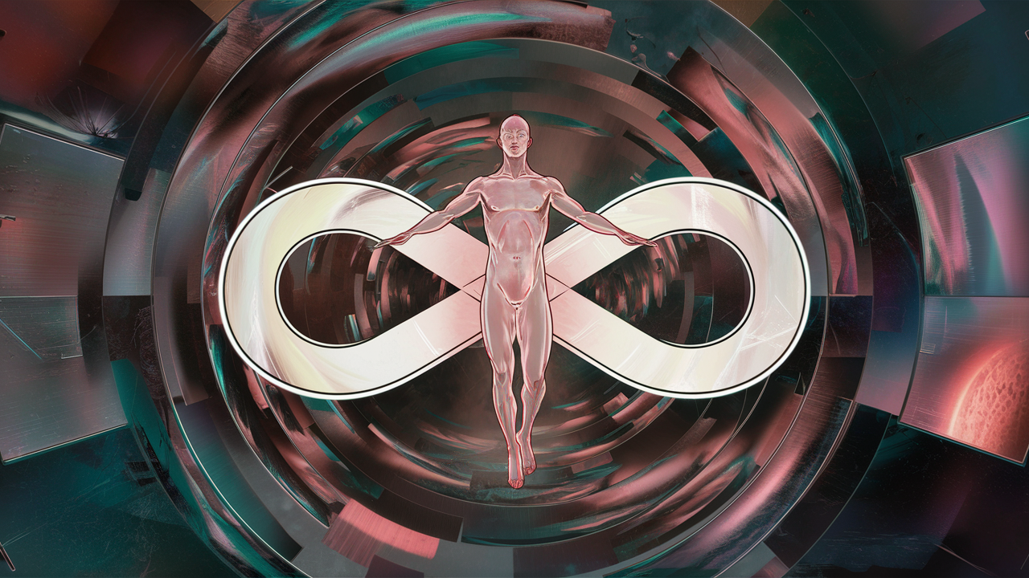
Situational Awareness
Notes:
18. | 14:00
Trained operators
that know the system
and understand the automation.
CRM

Slide 19
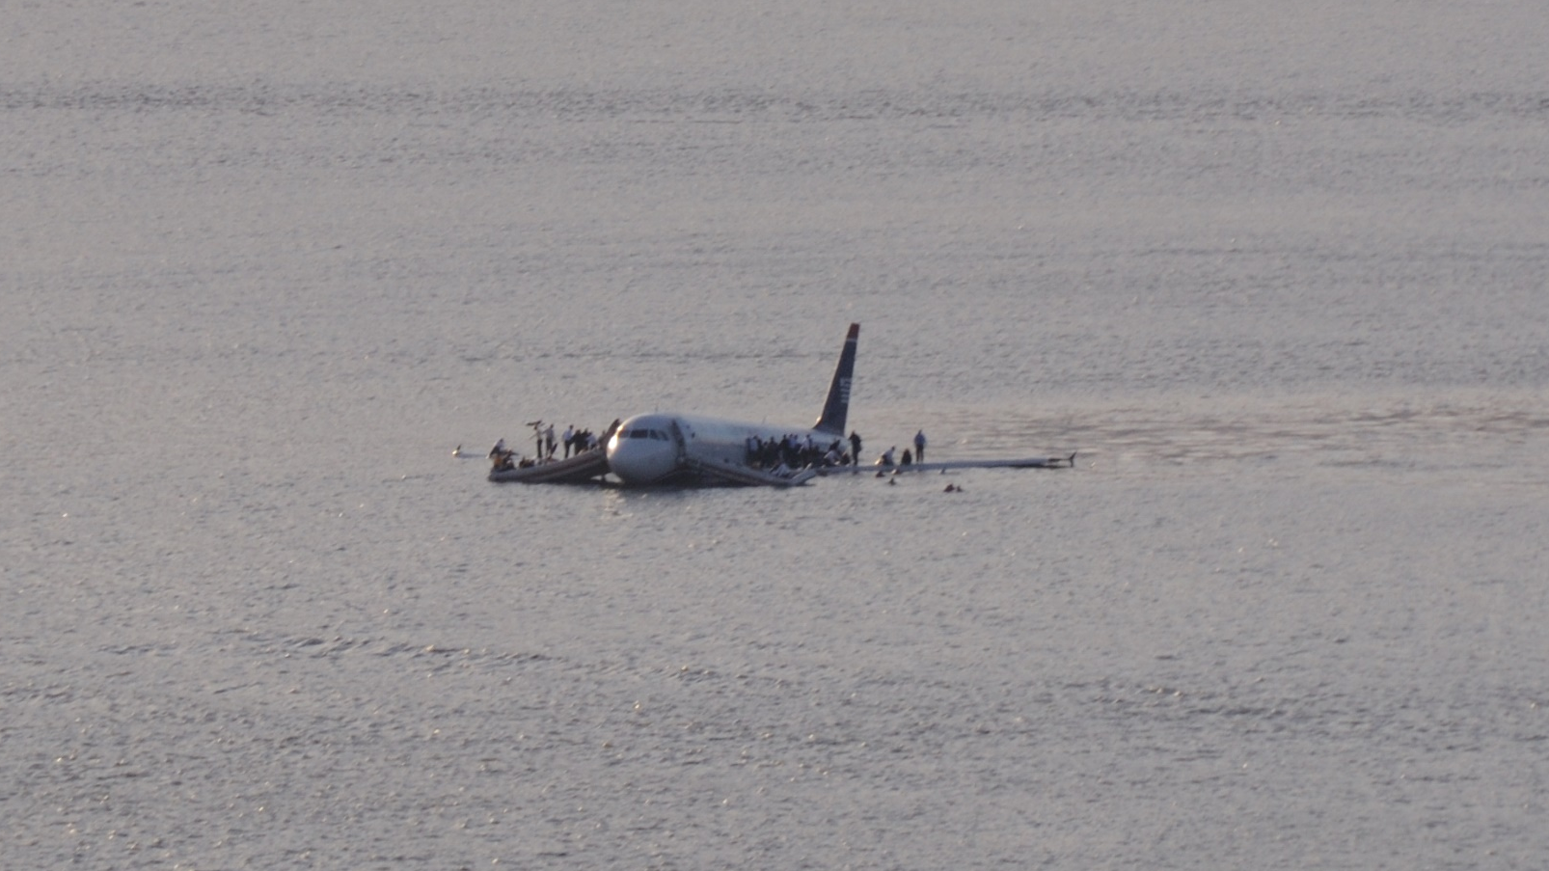
Don’t undervalue the human
© Steven Day—AP/REX/Shutterstock.com
© Greg L – CC BY 2.0
Notes:
19.
AI might not have pulled this off
(Hudson not classified as airfield)

Slide 20
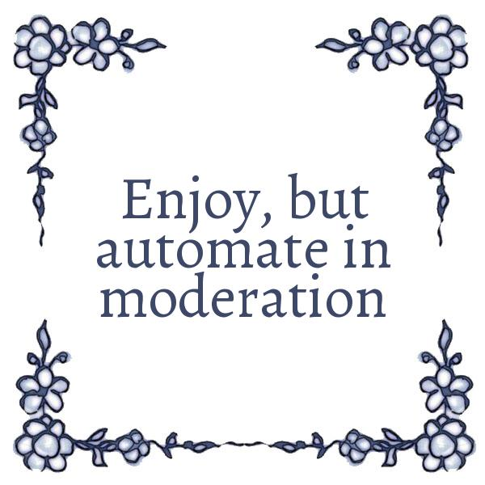
Notes:
20. | 15:00
After a famous Dutch slogan.

