Slide 1
Networking at LVNL
Air Traffic Control The Nederlands

Slide 2
Agenda
Intro
  Speaker
  Air Traffic Control the Nederlands
  Networks in ATC
Technical environment
  Networks @LVNL
  Applications
How do we do it
  Requirements / choices / tradeoffs
  Evolution vs revolution
Future
  Next steps

Slide 3
Intro spreaker

Slide 4
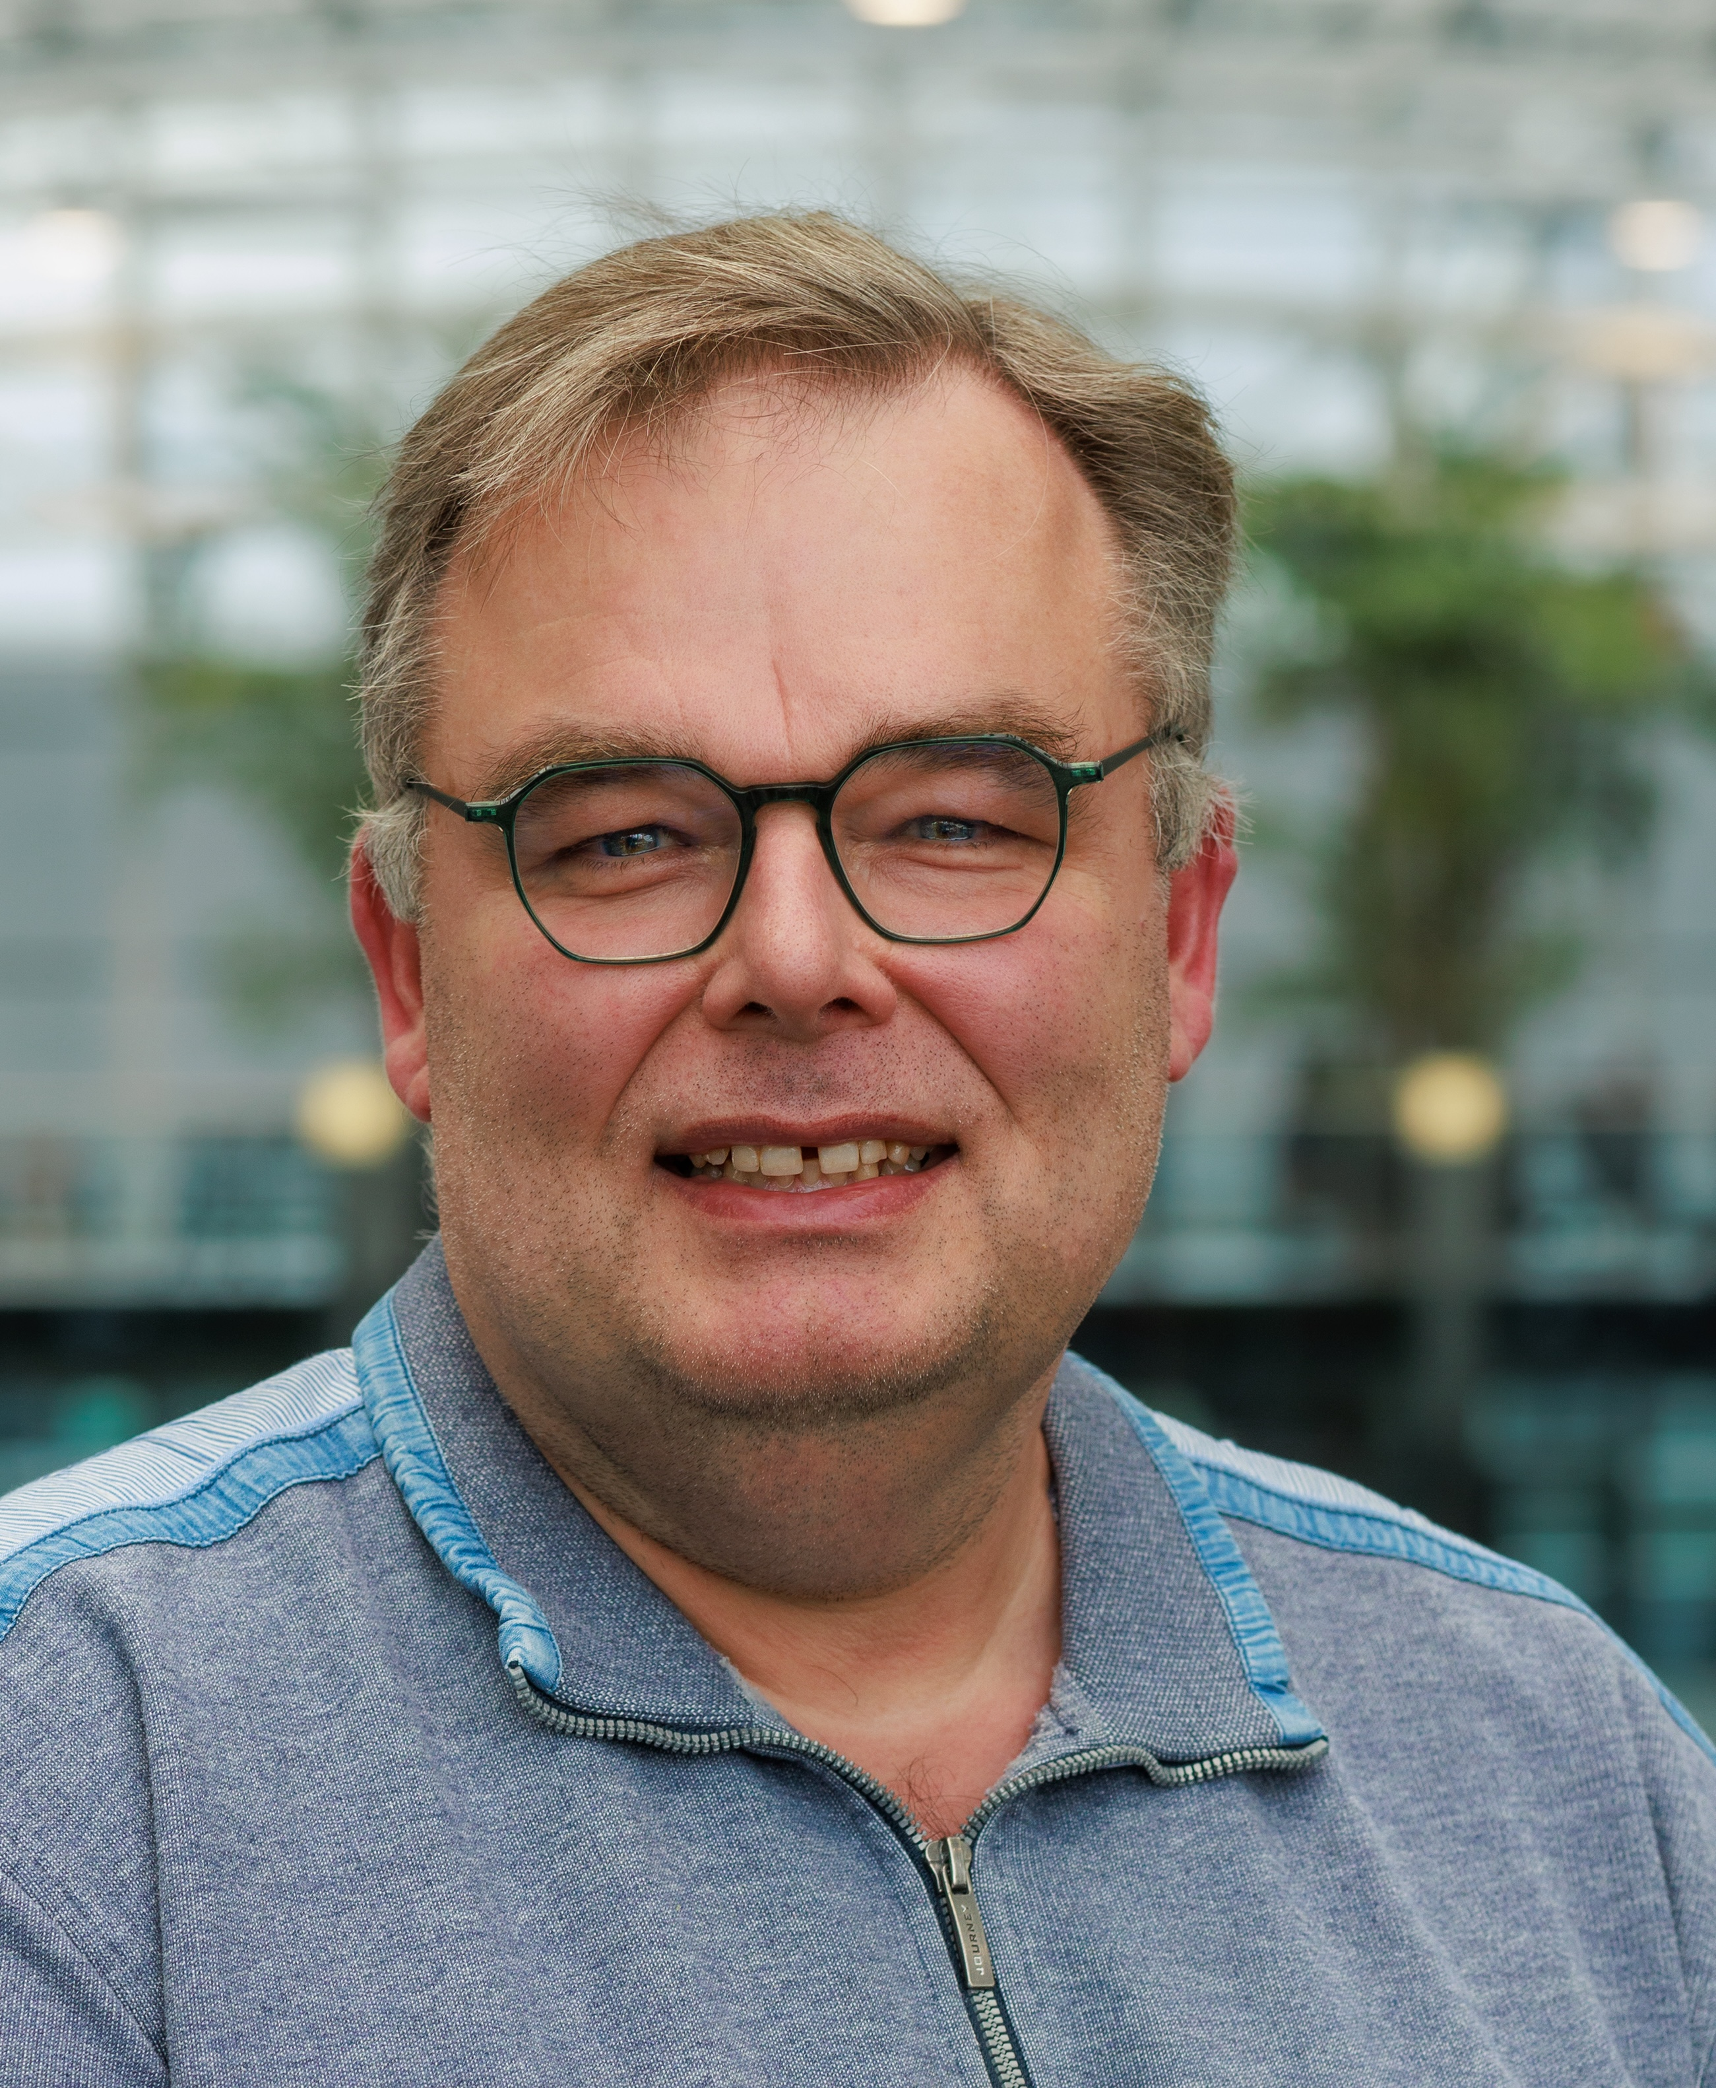
Speaker
Rudi van Drunen
Network Engineer
1.5 yrs of LVNL history
Hardware – Systems – Software – Networking
Loves the lower parts of the stack
NLUUG Chairman of the Board, Ham radio, photography

Slide 5
Air Traffic Control the Nederlands

Slide 6
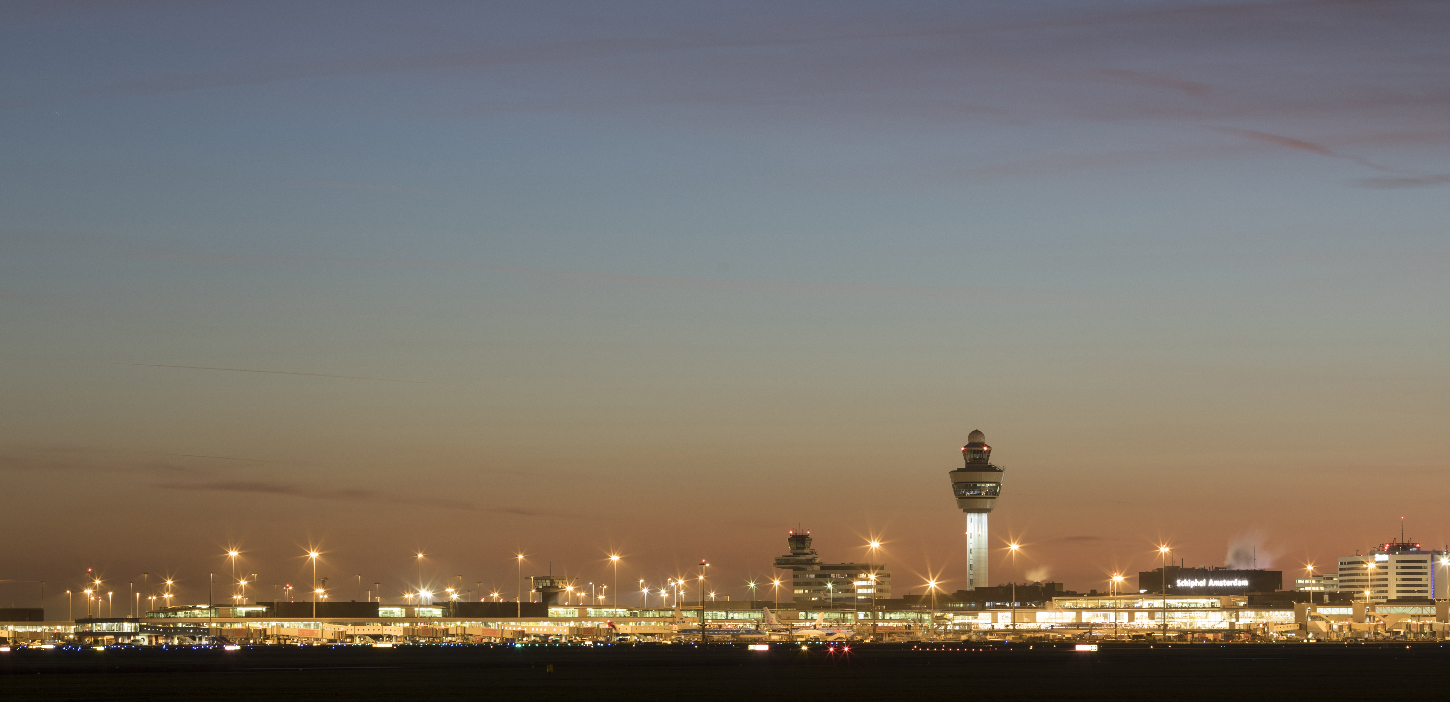

Organization
“Zelfstandig Bestuursorgaan” (sinds 1993)
Income from levies
1000
350
250
colleagues
Ops colleagues
Air Traffic Controllers
614.396​
499.446​
71.000.000
2022 2019
‘transit (airspace)’
Schiphol
Passengers @Schiphol
488.904
416.455
71.000.000

Slide 7
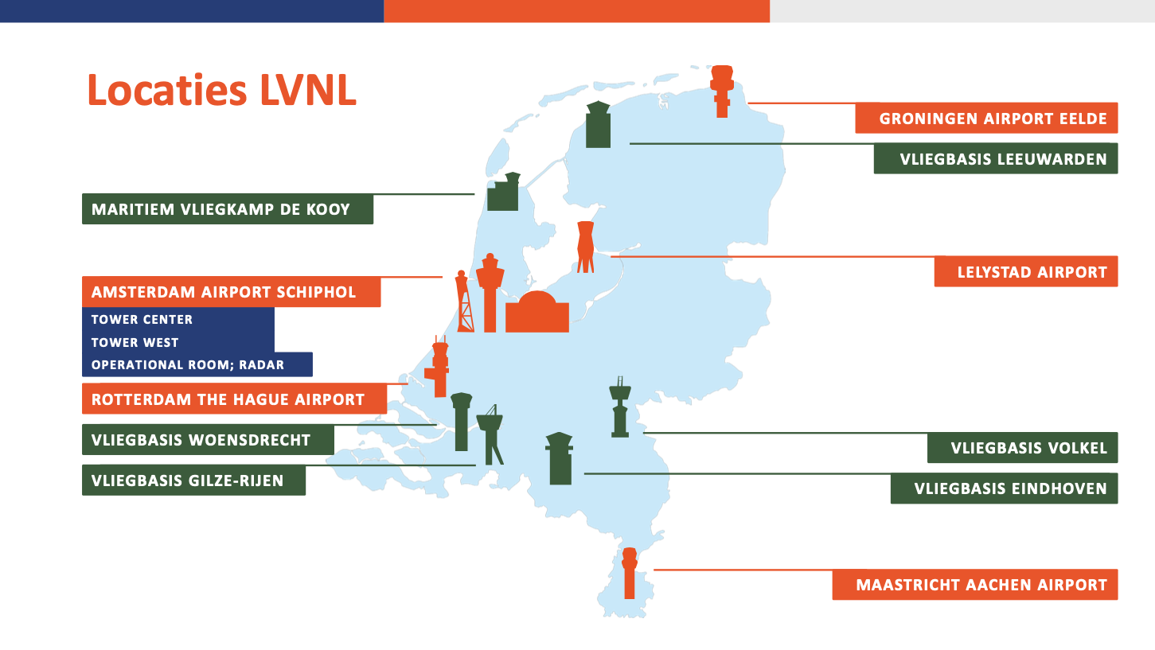
15-10-2024
CNS Datacom Visie

Slide 8
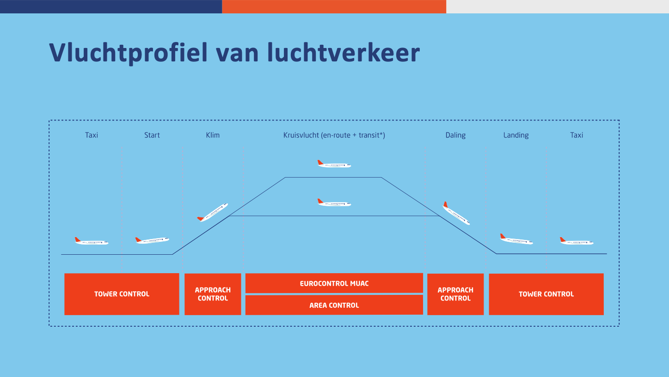
15-10-2024
CNS Datacom

Slide 9
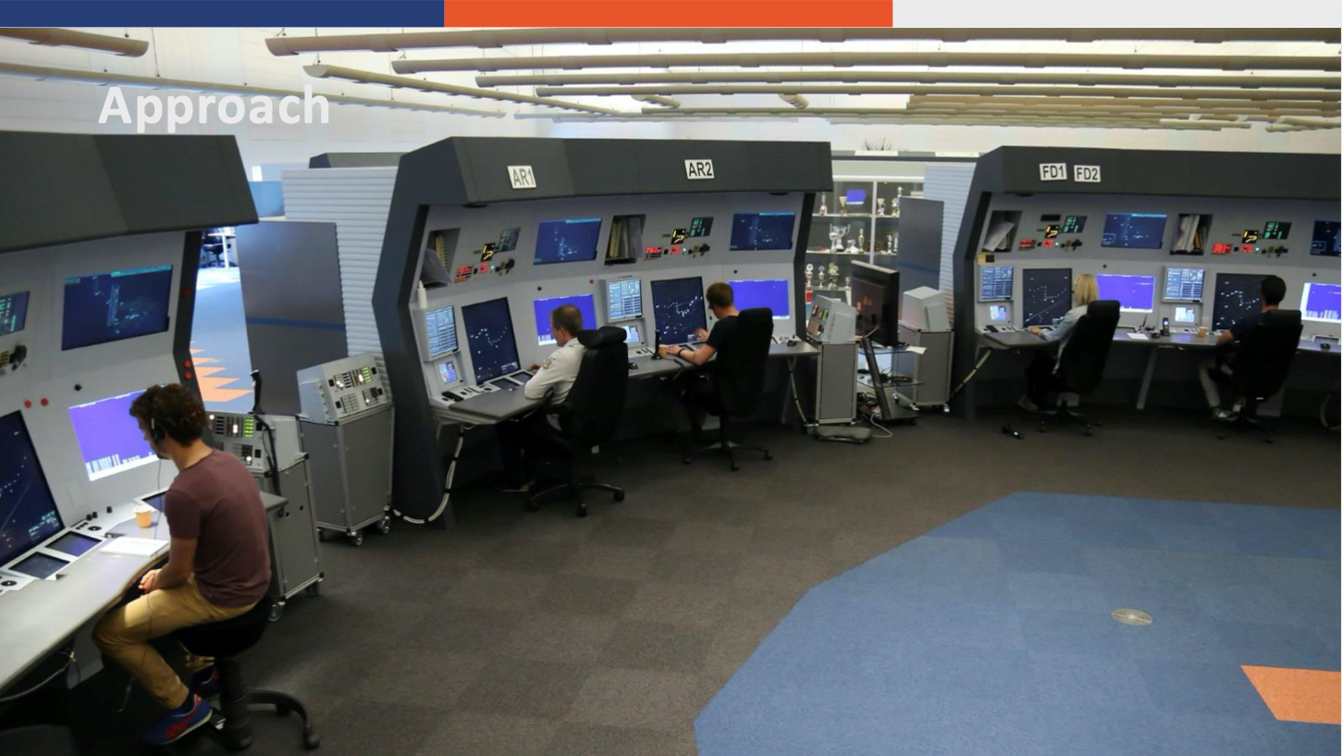
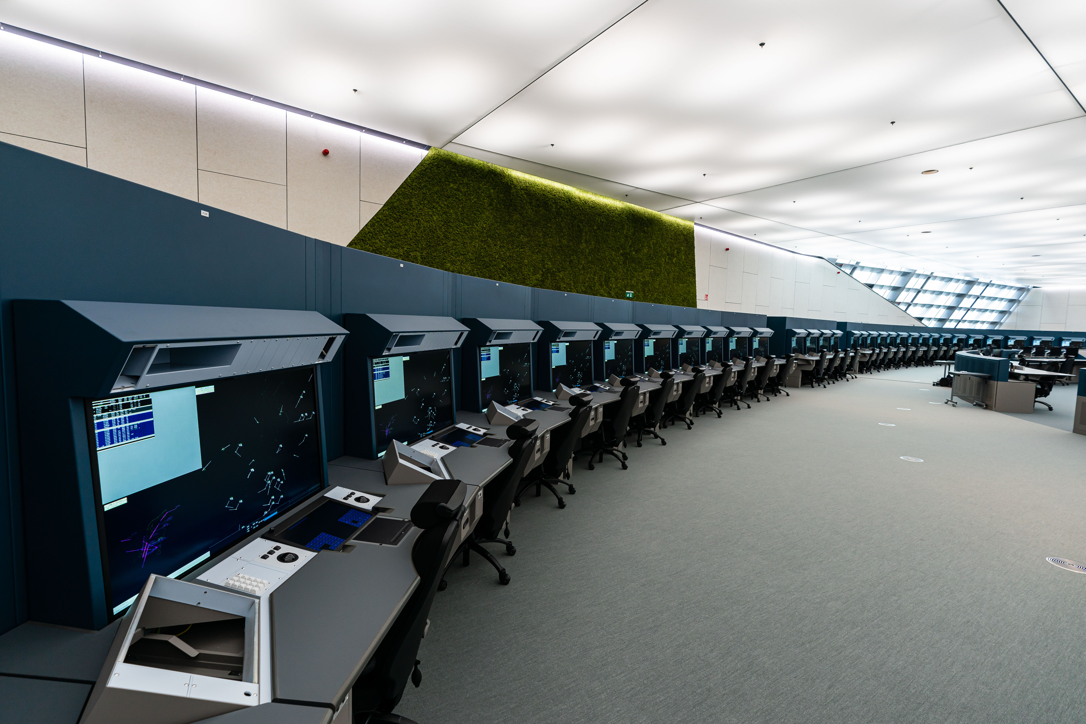
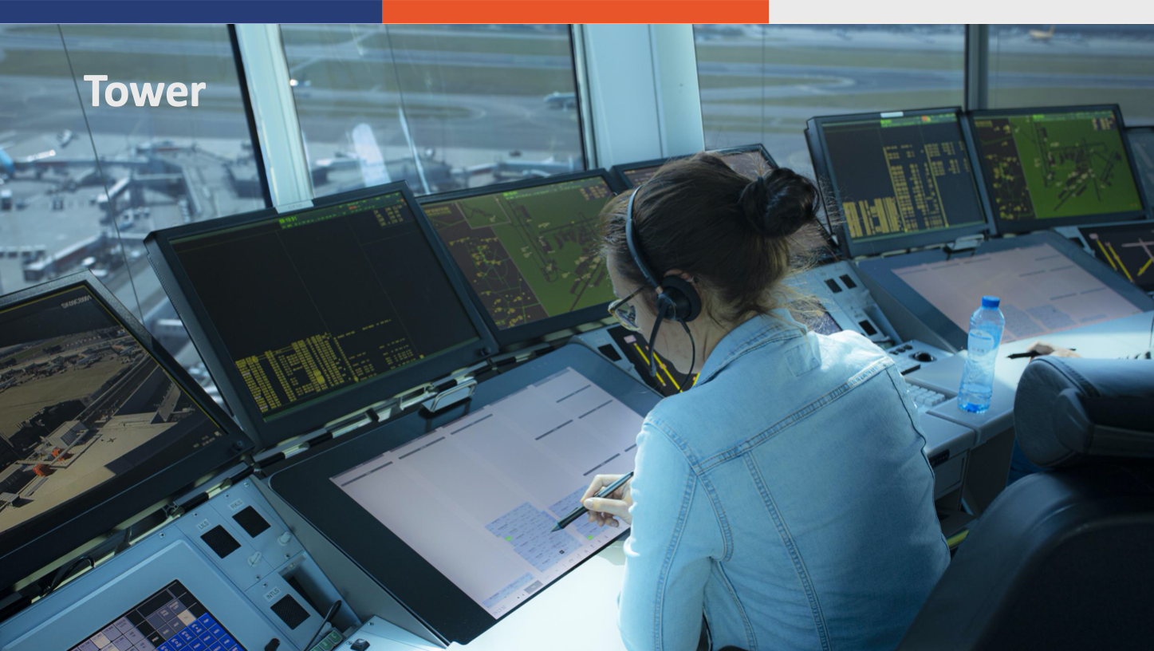
Location Schiphol
- Area Control
- Approach
- Tower
Schiphol Oost Headquarters
Schiphol Tower Center

Slide 10
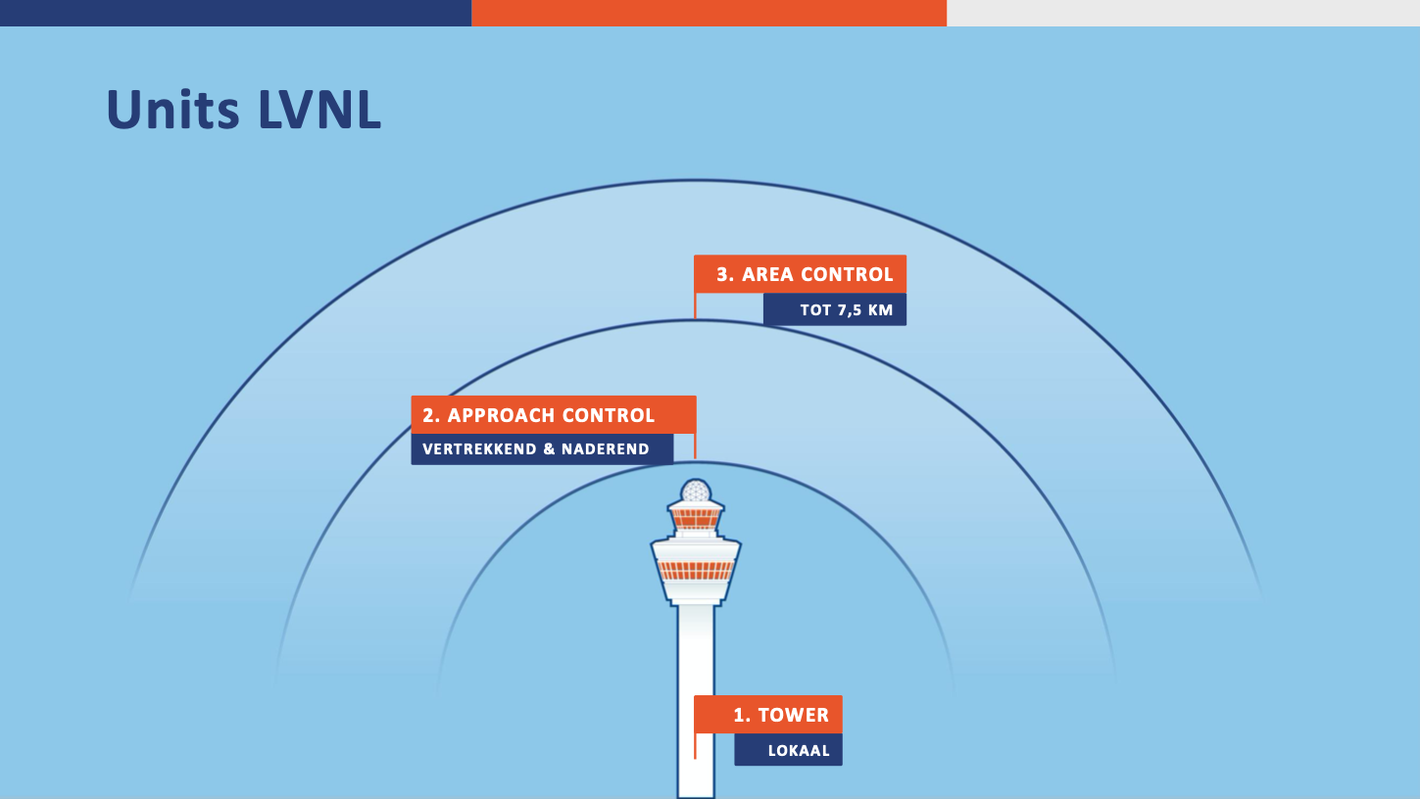
15-10-2024
CNS Datacom

Slide 11
Our Networks facilitating ATC

Slide 12
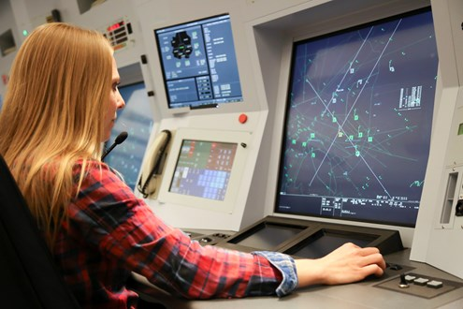
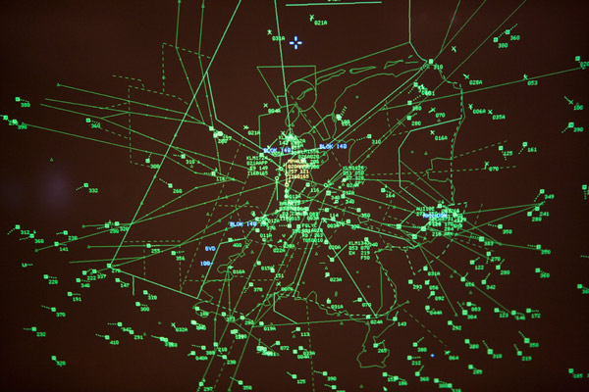
What is ATC ?
Separation of Aircraft in “controlled airspace”
How?
  Radar
  Radio comms

Slide 13
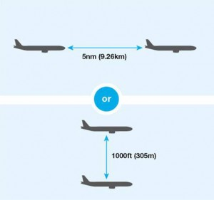

System Failure
No radar image:
  Location of aircraft not visible.
Voice comms:
  No possibility to separate aircraft.
5 nm
500 mph
500 mph
18 sec

Slide 14
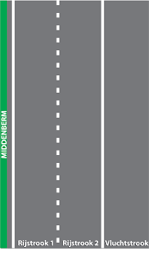
Three lane principle
Functionality for ATC is “a system”.
Critical systems: 3-lane principle:
  Radar screen (eyes).
  Air-ground voice comms (primary means of communication between cotroler and pilot).
Primary systems
Backup systems
Last resort systems

Slide 15
“Systems on multiple networks”
A mumber of critical systems are connected to a duplicate LAN network environment:
  Data is duped on both networks.
  Switching between networks is up to the application.
  Almost no interruption in service when switching networks.
Example:

Slide 16
Our Networks

Slide 17
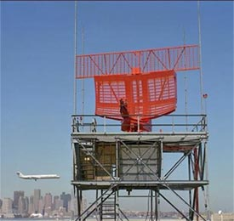
Applications on the LVNL networks (OPS)
Systems for
  Pilots
  ATC.
Radar screen:
  Air traffic situation picture (RADAR screen, VDF)
Voice comms:
  Ground-Ground voice communication
  Ground-Air voice communication
Aux systems:
  Flightplan data exchange
  Meteorological data exchange
  Recording data
  Monitoring and control
  Aircraft Navigation data (VOR/DME beacons, ILS at runways)

Slide 18
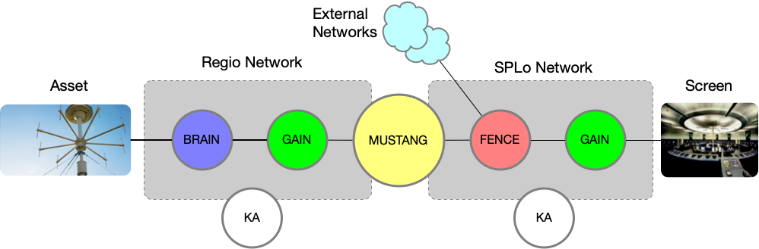
The Networks
KA network, NON OPS:
Office
Support network
Cisco
BRAIN Networks:
Around Airfields
Sensors (eg. KNMI)
Ring network
Cisco
MUSTANG Networks:
Nation Wide
Transport
Cisco
GAIN Networks:
MAIN ATC LAN
All systems @ SPLo / reg
MPLS
Cisco
FENCE Firewall Infra:
Networking Security
Multilayer
Not disclosed

Slide 19
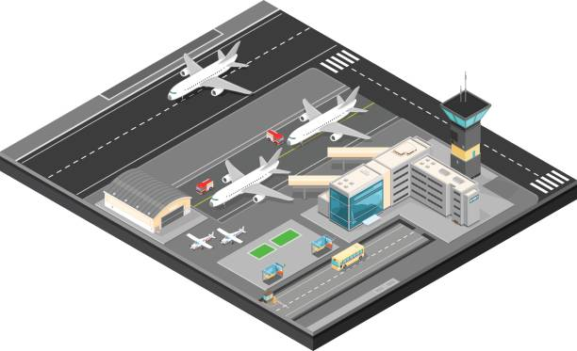

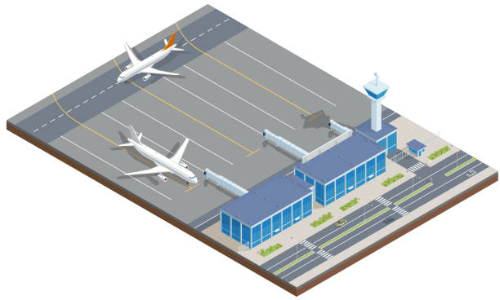
BRAIN
BRAIN
BRAIN
PENS
GAIN
FENCE
IP-VPN
BRAIN
MUSTANG-NW
KA
EHAM
GAIN
HQ
Polaris
KA
BRAIN(HS)
EHGG
GAIN
MUSTANG-NW
KA
MUSTANG-NW
BRAIN
BRAIN
GAIN
GAIN
BRAIN
GAIN
IP-VPN
KA
EHRD
KA
KA
EHBK
EHLE

Slide 20
LVNL networks
History
  Evolution vs Revolution
  We do not live in an IP-only environment (yet)
Life cycle
  Slow development (on end-systems)
  Long life (30+yrs)
Criticalness
  Uptime
  Safety
Complexity
  Interfaces
  Redundancy
  Interconnects
  Physical
  Technology
  Environments
    DTAE (NON OPS)
    P (OPS)

Slide 21
How to get this done ?

Slide 22



Continuous Transformations
Previous situation
  Product groups (NAV, SUR, AAA, TOWER)
    Servers
    Network
    Infra
Moving to
  A LVNL wide
    Server
    Network
    INFRA
Standardize !
And here we are….
  Somebody should do something …

Slide 23
Standardization while
Integrating 400 + “silo” (legacy) networks
Supporting loads of projects
  Building new systems
  Integrating military fields
Doing our own LCM
Act on changing environments
  3rd party Infra
  Regulations and other external factors.
Optimization of the operation
  Enhancing Safety
  New Systems / innovation

Slide 24
But: we are running a 24x7 safety company
Regulations
  When, what
Procedures
  How, why, backup
Continuously running operation
  No time to “close down airspace”
We need to fix and enhance / replace the plane in mid air!
  Otherwise, we cannot land anymore
  Challenges of doing Innovation in a risk aversive organization
    Communication
    Planning
    Understanding each others needs and fears
    Calculated risk vs risk aversive

Slide 25
(Back to) the Future

Slide 26
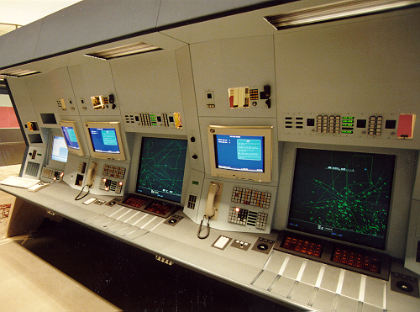
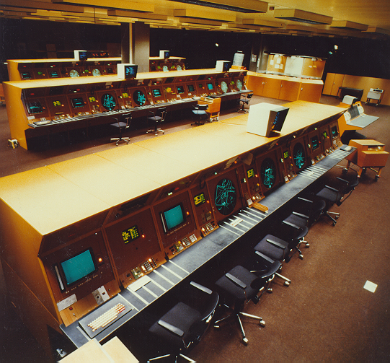
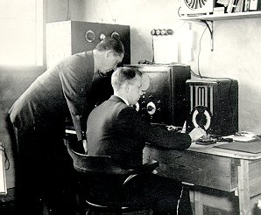
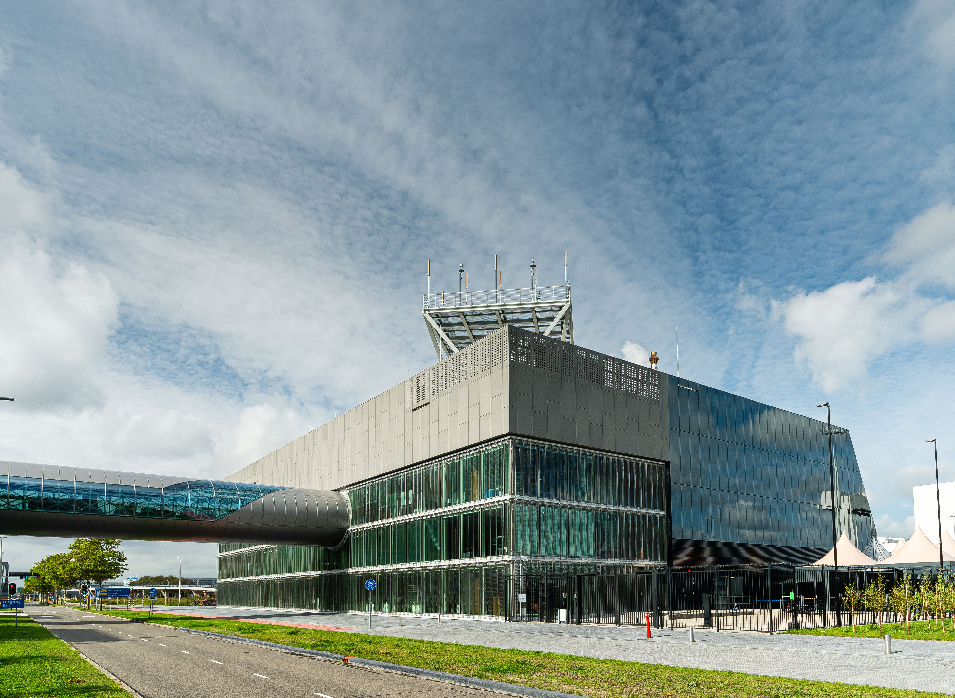
Evolution of the Controller Working Position
(data driven, all digital, AI)
“Luchtverkeersbeveiliging” (1940)
SARP II (1978)
AAA (1992)
2026+: iCAS
Cooperation with DFS
Product of INDRA, Spain
Polaris building @ Schiphol Oost
On the NL-IT top 5 list

Slide 27
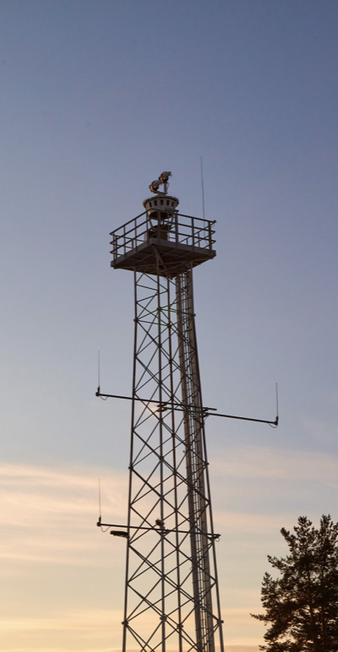
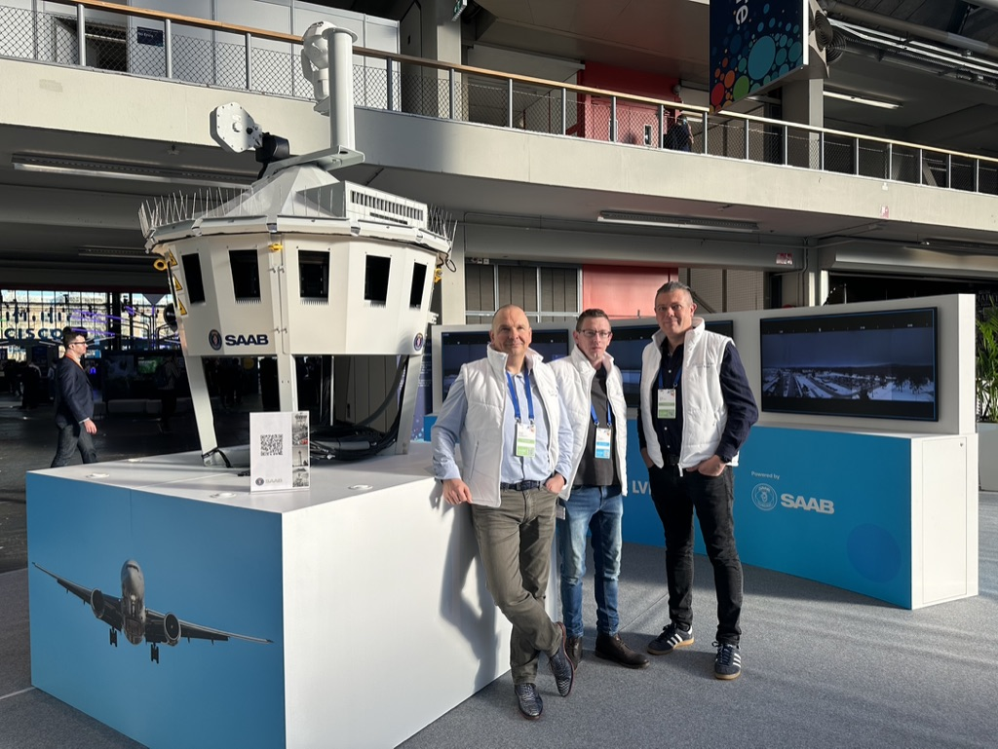
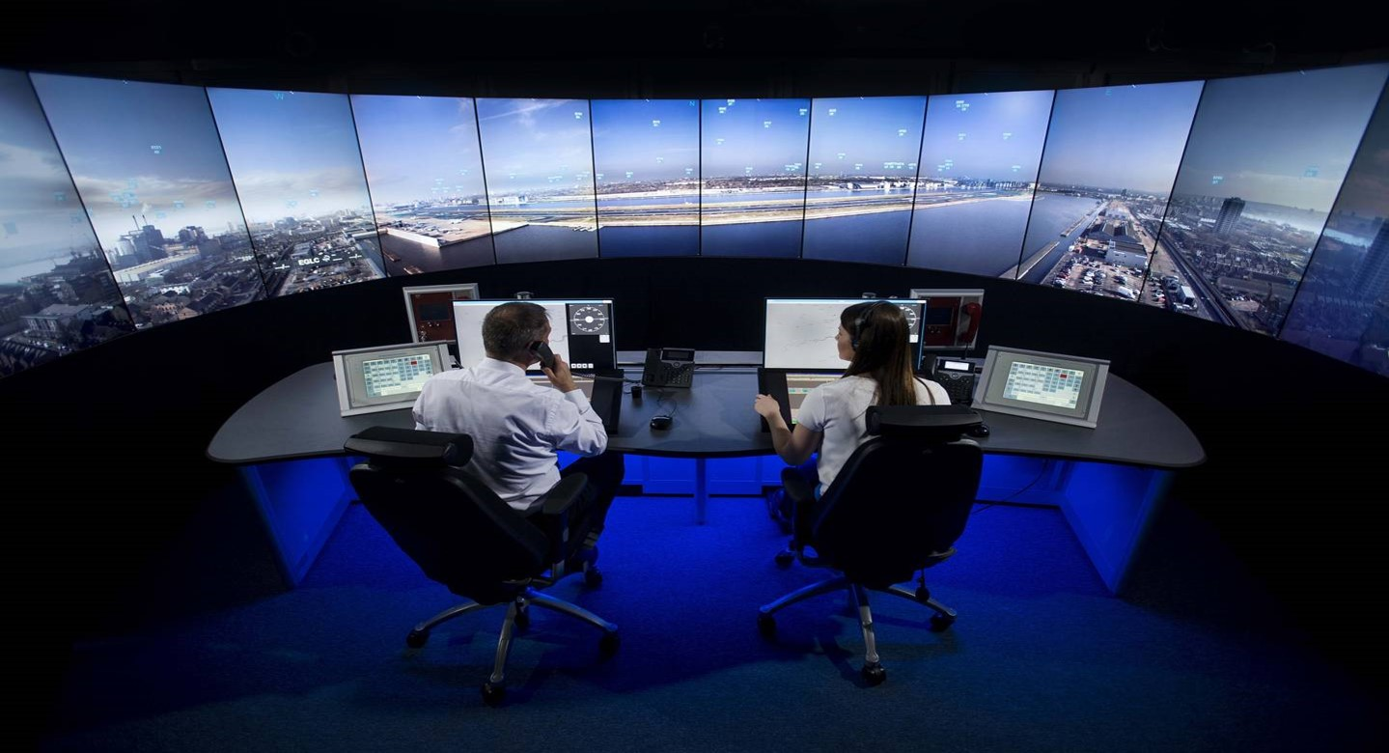
Centralised Base / remote tower
Remote Air traffic control from Schiphol (TWR-W, Eelde, Beek)
SAAB development
In use at London City and Norway

Slide 28
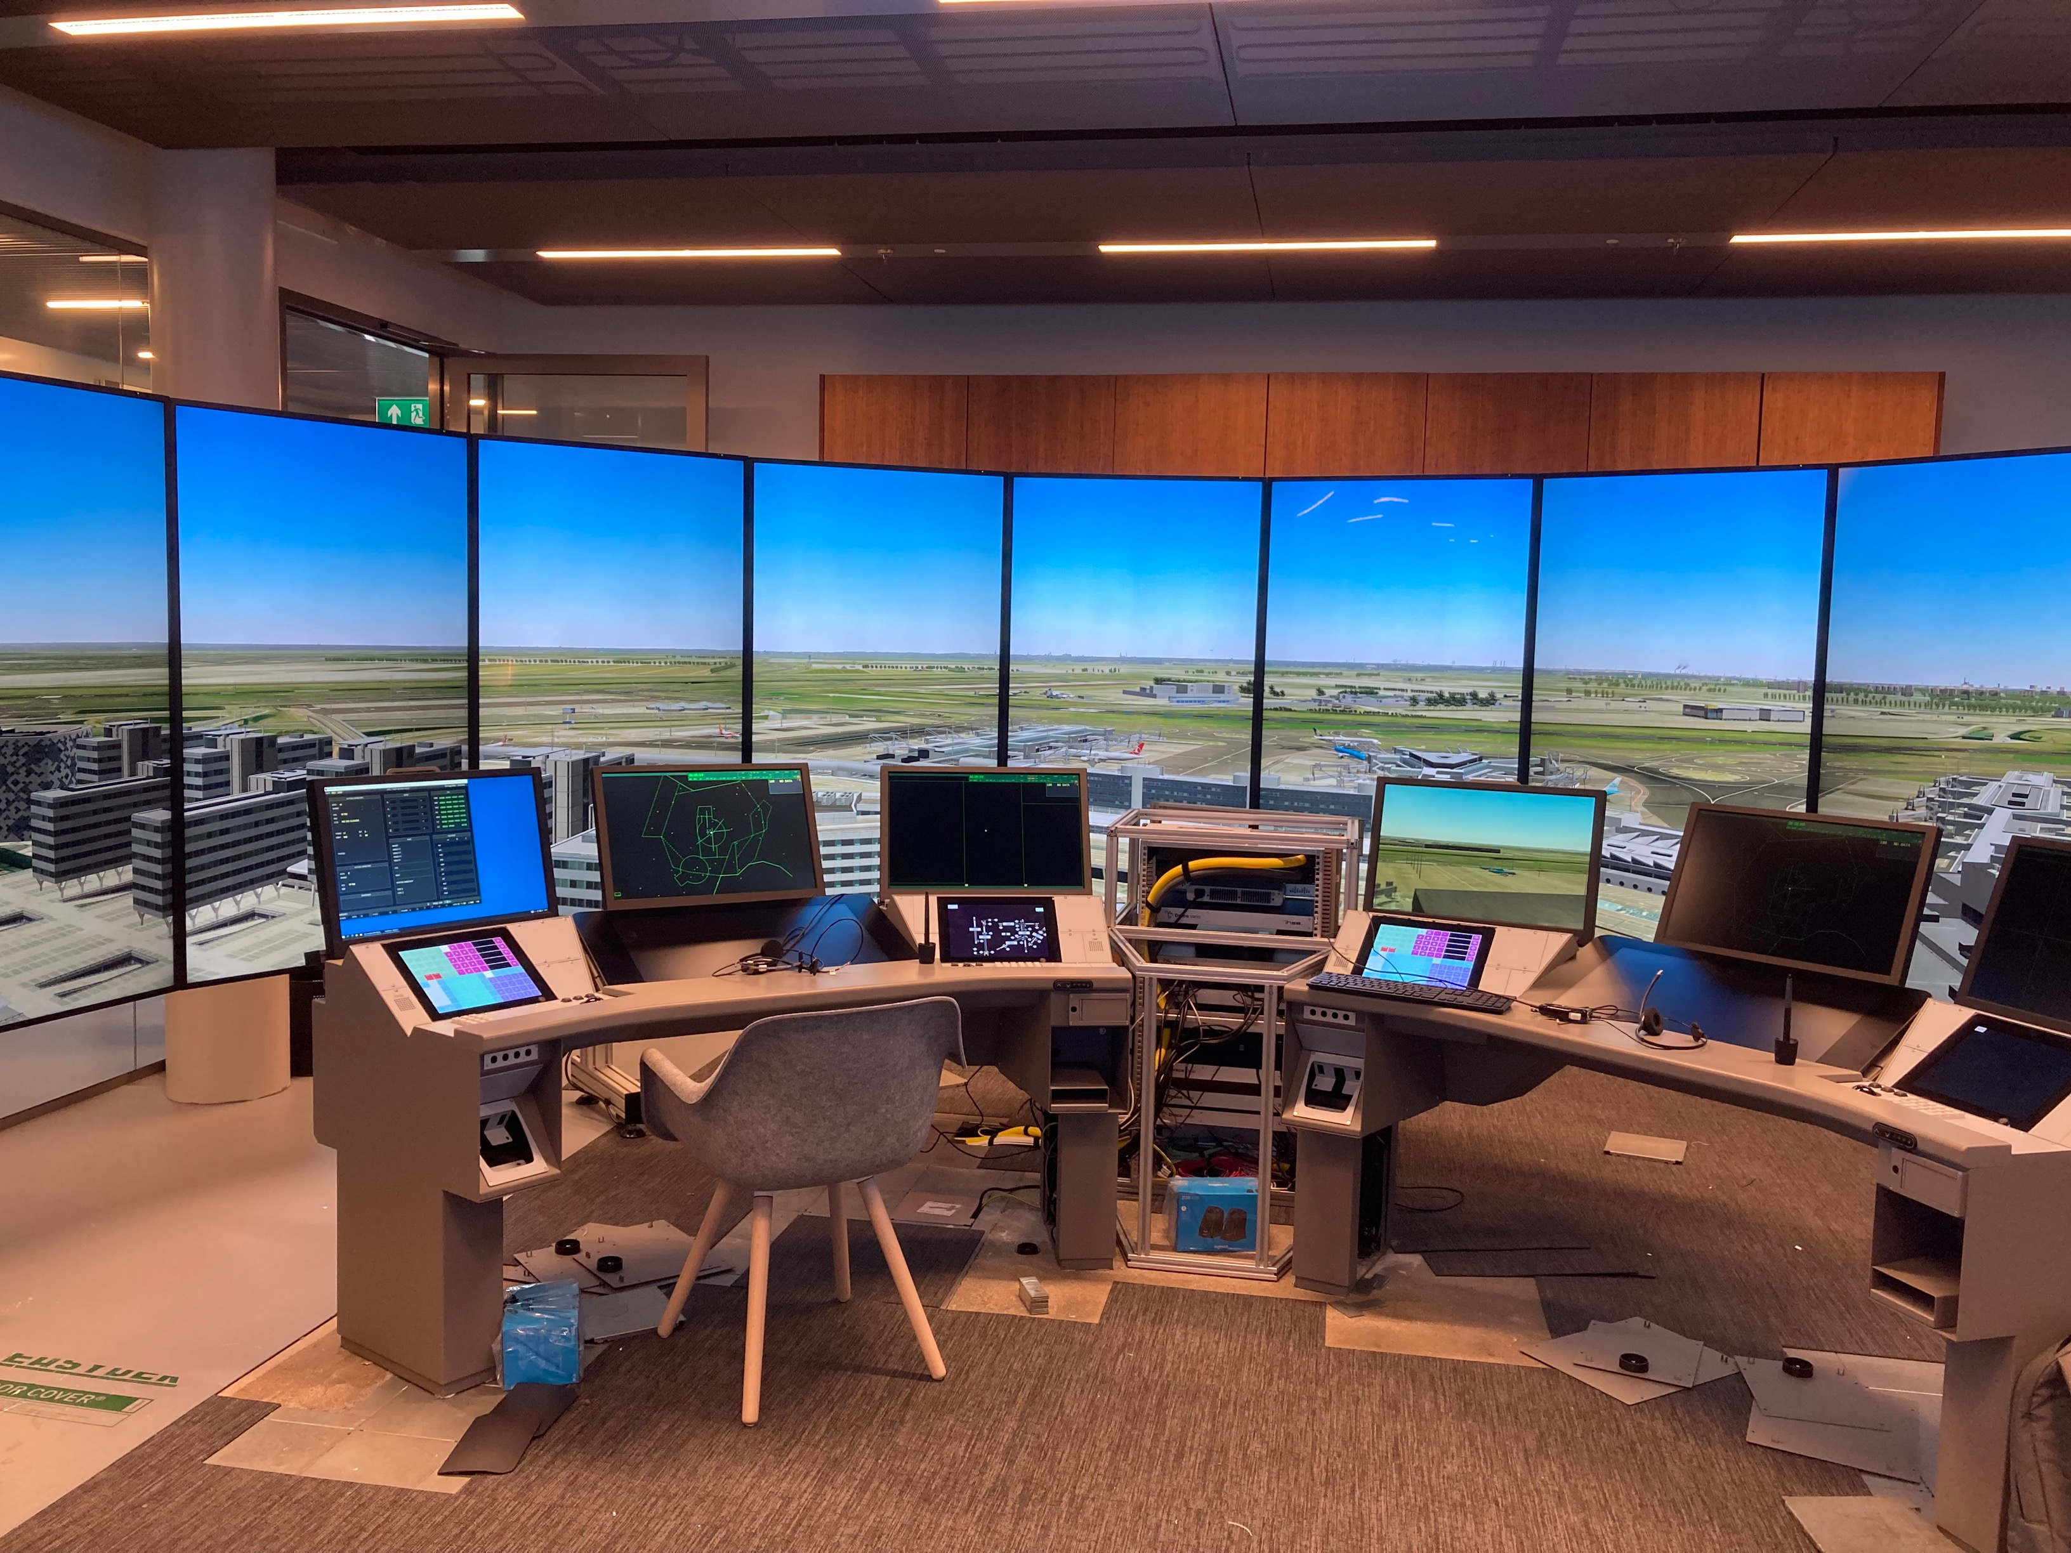
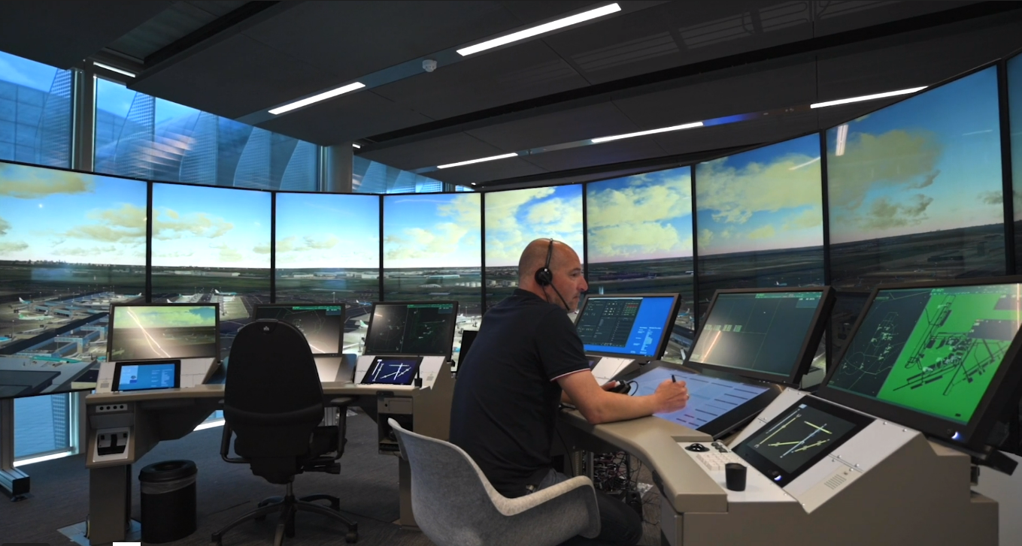
(Tower) Sims
Educational
Business critical

Slide 29
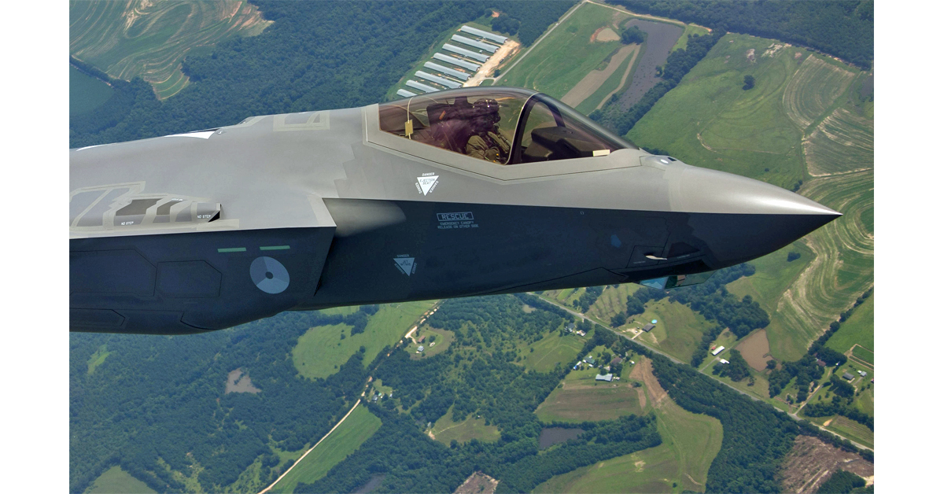
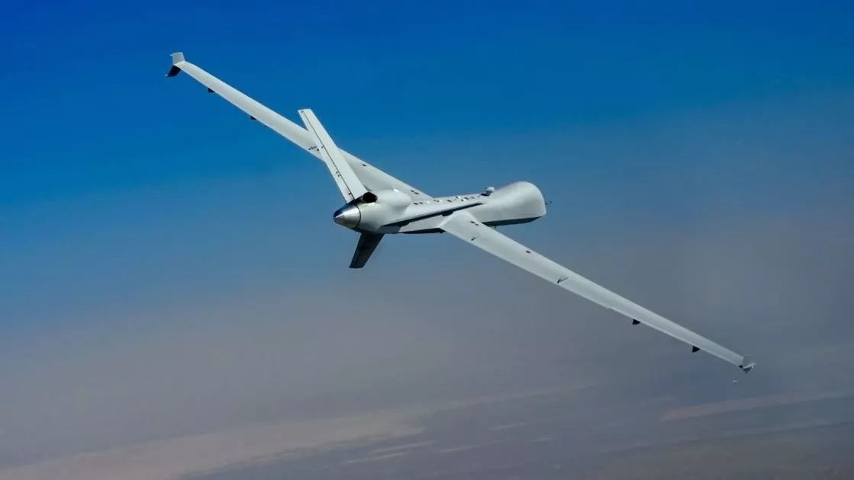
1ATM
Integration of military air traffic control org and systems
@military airbases LVNL ATC .
Integration
  Technical
  Organization

Slide 30




Questions ??
E-mail: rudi.vandrunen@lvnl.nl
www.lvnl.nl
@luchtverkeersleiding

Slide 31
How can you help ?
Do you like to:
  Architecture
  Design
  Build
  Maintain
One of the most complex and critical network environments in NL ?
There are lots of possibilities for cooperation.

