Slide 1
The year of RPKI on the Control-Plane
312ff2858900a9d12dc20ecc5f96b830

Slide 2
The year of RPKI on the Control-Plane
Codename: good intern project 2019-2020
312ff2858900a9d12dc20ecc5f96b830

Slide 4


Slide 5
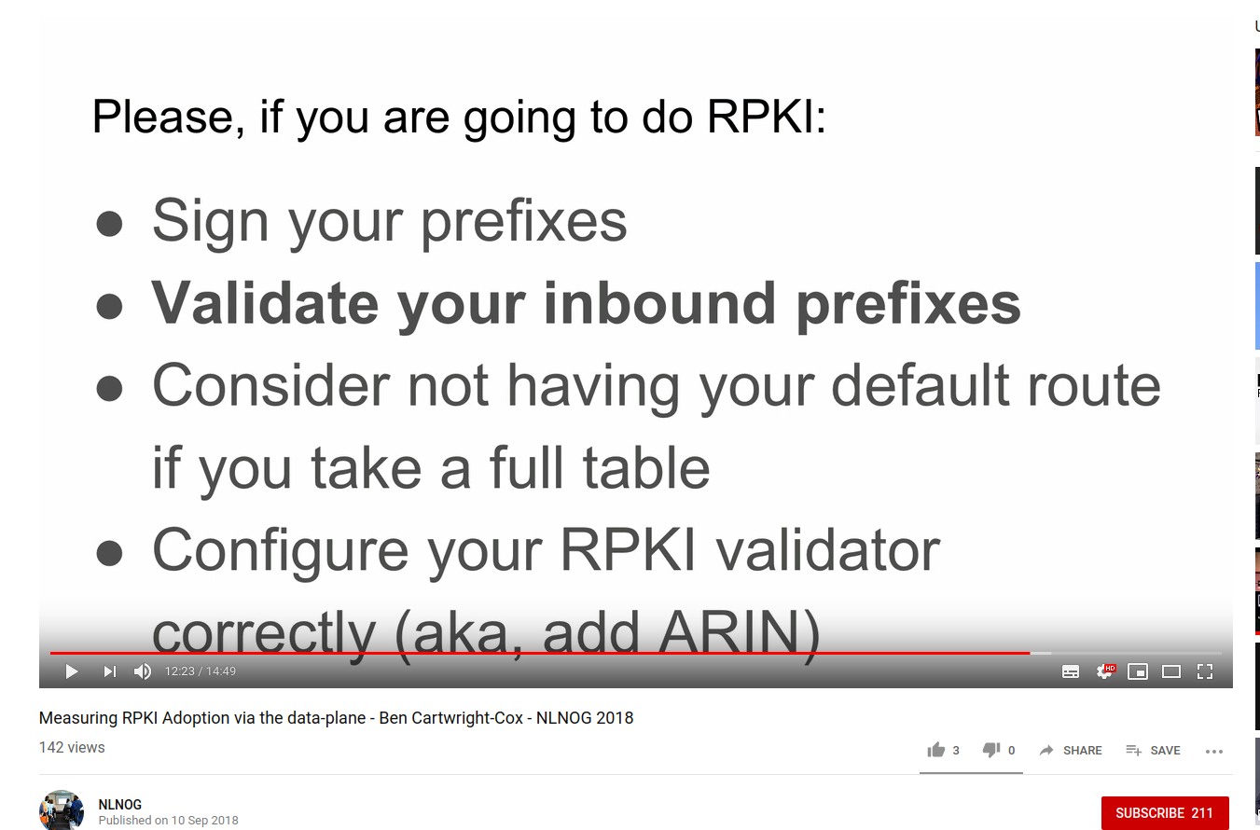

Slide 8
We have learned things in the last year

Slide 9




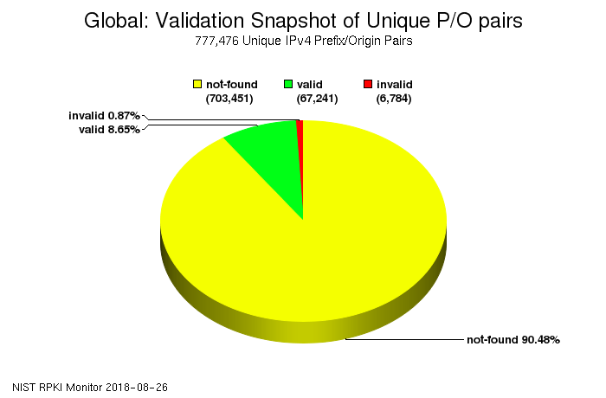







From NLNOG 2018
This is still a lot of traffic
0.0.0.0/0
Fixing this is hard to justify

Slide 10

It does not matter
*

Slide 11
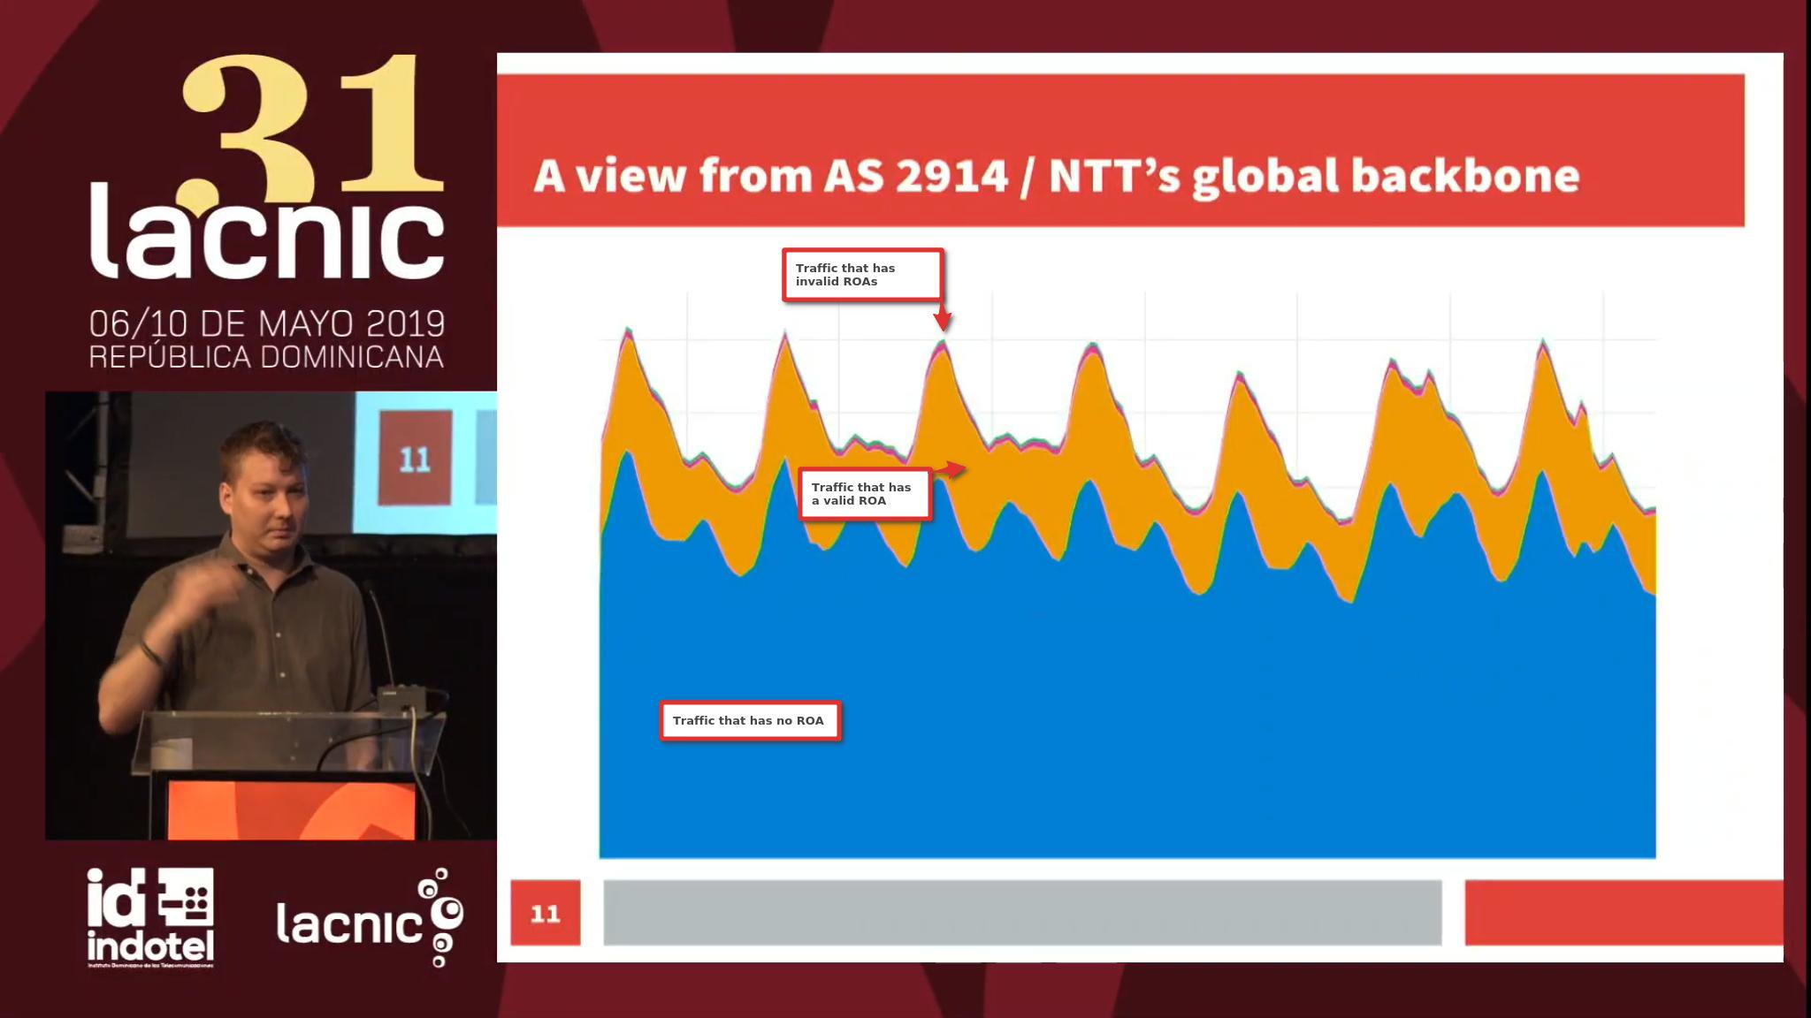

Slide 12
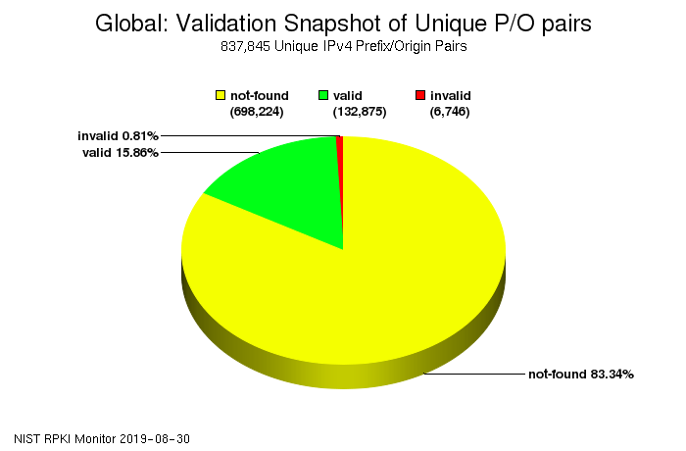

From Today-ish

Slide 13
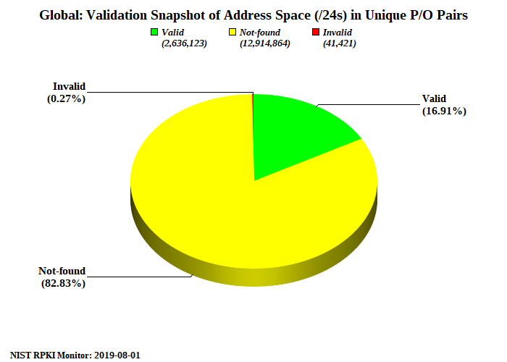


Slide 15
No Path Validation
and why RPKI does not have to be perfect

Slide 16


192.0.2.0/24
192.0.2.0/24
192.0.2.0/24

Slide 17

192.0.2.0/24
192.0.2.0/24
192.0.2.0/24

Slide 18
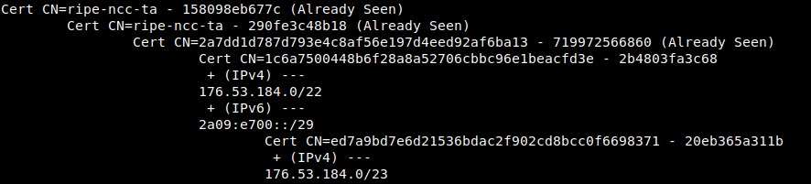
192.0.2.0/24
192.0.2.0/24
192.0.2.0/24

Slide 19
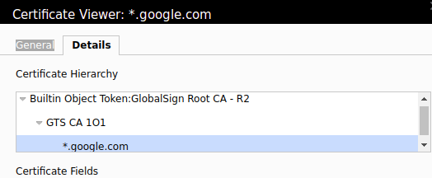
192.0.2.0/24
192.0.2.0/24
192.0.2.0/24

Slide 20



192.0.2.0/24
192.0.2.0/24
192.0.2.0/24

Slide 21

192.0.2.0/24
192.0.2.0/24
192.0.2.0/24

Slide 22
192.0.2.0/24
192.0.2.0/24
192.0.2.0/24

Slide 25
RPKI > IRR Databases

Slide 26
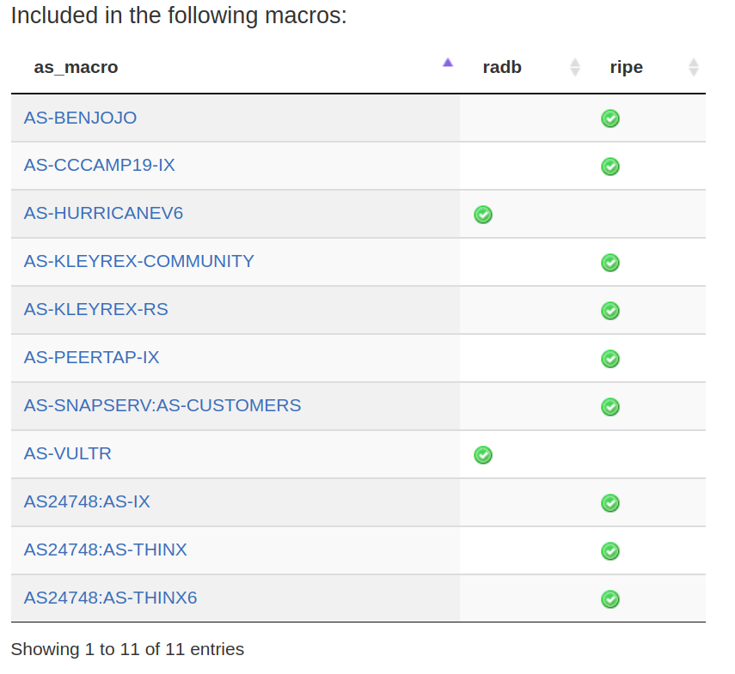
http://irrexplorer.nlnog.net/search/206924

Slide 27
RPKI >>> IRR Databases

Slide 28
So.

Slide 29
It's 2019, how is adoption?

Slide 31
Assumptions
Lots of people have default routes
Lots of people are signing but not validating

Slide 32
Testing methodology

Slide 33
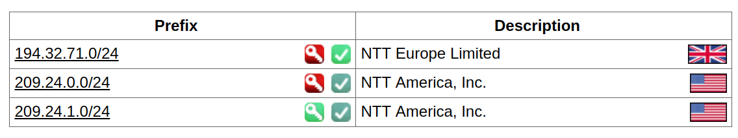
Testing methodology

Slide 34

Testing methodology

Slide 35




Slide 36

All 0.0.0.0/0 responses collected

Slide 37

ARIN ROA invalid
RIPE ROA invalid
ARIN ROA valid

Slide 38
ben@rpkimapper:~/Aug22-Scan$ ls -alh
total 13G
drwxr-xr-x 2 ben ben 4.0K Aug 31 12:17 .
drwxr-xr-x 10 ben ben 4.0K Aug 22 10:44 ..
-rwxr-xr-x 1 root root 4.0G Aug 23 18:33 ARINinvalidROI.ipv4.data
-rw-r--r-- 1 ben ben 1.4M Aug 31 12:17 asn.csv
-rw-r--r-- 1 ben ben 17M Aug 31 12:17 prefix.csv
-rwxr-xr-x 1 root root 4.0G Aug 23 18:33 RIPEinvalidROI.ipv4.data
-rw-r--r-- 1 ben ben 22M Aug 22 10:44 table.txt
-rw-r--r-- 1 ben ben 16M Aug 22 10:46 table.txt_
-rwxr-xr-x 1 root root 4.0G Aug 23 18:33 validROI.ipv4.data

Slide 39
ben@rpkimapper:~/Aug22-Scan$ ls -alh
total 13G
drwxr-xr-x 2 ben ben 4.0K Aug 31 12:17 .
drwxr-xr-x 10 ben ben 4.0K Aug 22 10:44 ..
-rwxr-xr-x 1 root root 4.0G Aug 23 18:33 ARINinvalidROI.ipv4.data
-rw-r--r-- 1 ben ben 1.4M Aug 31 12:17 asn.csv
-rw-r--r-- 1 ben ben 17M Aug 31 12:17 prefix.csv
-rwxr-xr-x 1 root root 4.0G Aug 23 18:33 RIPEinvalidROI.ipv4.data
-rw-r--r-- 1 ben ben 22M Aug 22 10:44 table.txt
-rw-r--r-- 1 ben ben 16M Aug 22 10:46 table.txt_
-rwxr-xr-x 1 root root 4.0G Aug 23 18:33 validROI.ipv4.data

Slide 40
ben@rpkimapper:~/Aug22-Scan$ ls -alh
total 13G
drwxr-xr-x 2 ben ben 4.0K Aug 31 12:17 .
drwxr-xr-x 10 ben ben 4.0K Aug 22 10:44 ..
-rwxr-xr-x 1 root root 4.0G Aug 23 18:33 ARINinvalidROI.ipv4.data
-rw-r--r-- 1 ben ben 1.4M Aug 31 12:17 asn.csv
-rw-r--r-- 1 ben ben 17M Aug 31 12:17 prefix.csv
-rwxr-xr-x 1 root root 4.0G Aug 23 18:33 RIPEinvalidROI.ipv4.data
-rw-r--r-- 1 ben ben 22M Aug 22 10:44 table.txt
-rw-r--r-- 1 ben ben 16M Aug 22 10:46 table.txt_
-rwxr-xr-x 1 root root 4.0G Aug 23 18:33 validROI.ipv4.data

Slide 41
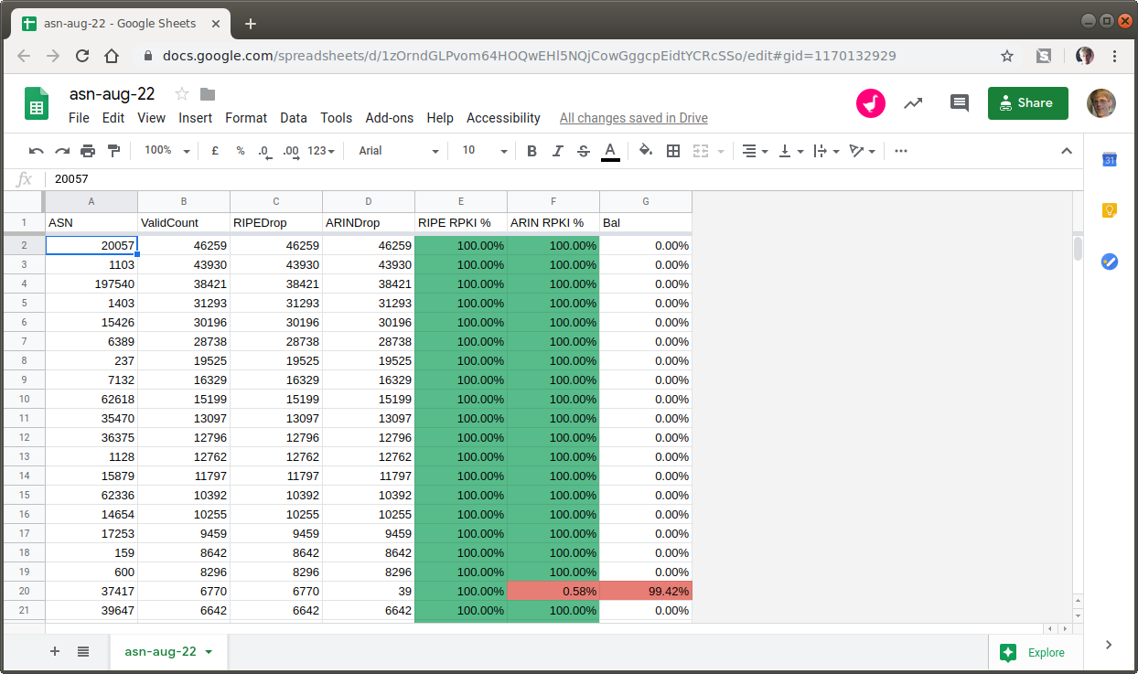

Slide 42


What means what?
ARIN
ARIN
RIPE

Slide 43
IF
ARIN
ARIN
RIPE

Slide 44

IF
ARIN
ARIN
RIPE
Then they are validating and dropping(!)

Slide 45
IF
ARIN
ARIN
RIPE
Then they are using a popular ROA validator setup with defaults

Slide 46
IF
ARIN
ARIN
RIPE
Then they are not validating anything

Slide 47
Wait, what?!
Not all ROA's are equal?

Slide 48
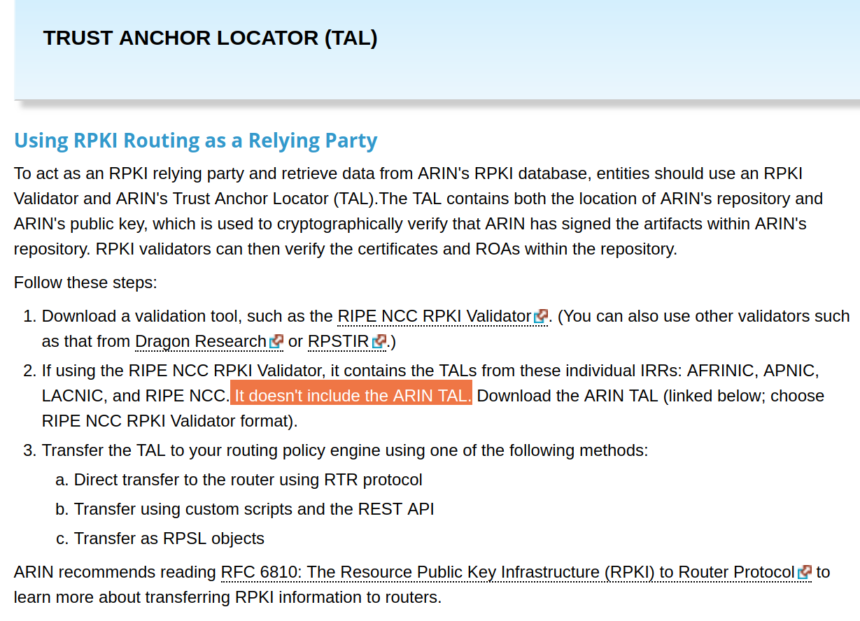

Slide 49
Sad.

Slide 50
2018
ARIN
ARIN
RIPE
130 Mil
128.3 Mil
128.2 Mil
2019
ARIN
ARIN
RIPE
282 Mil
278.7 Mil
278.2 Mil

Slide 51
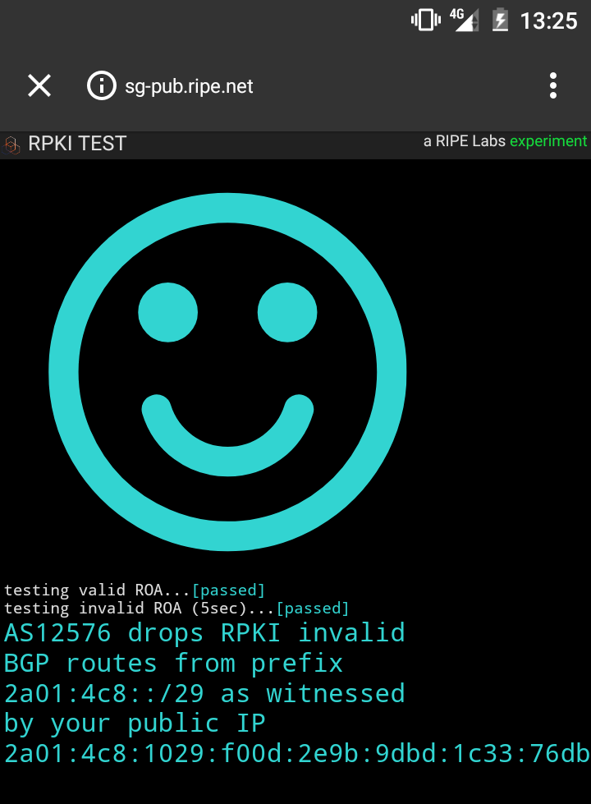

Slide 52
616 RPKI Filtering ASNs
Up from 50 or so last year

Slide 53
Amounts to 6 /8's protected by RPKI
Last year it was 2 /11's

Slide 54





T1 and T2 Providers doing RPKI filtering

Slide 55
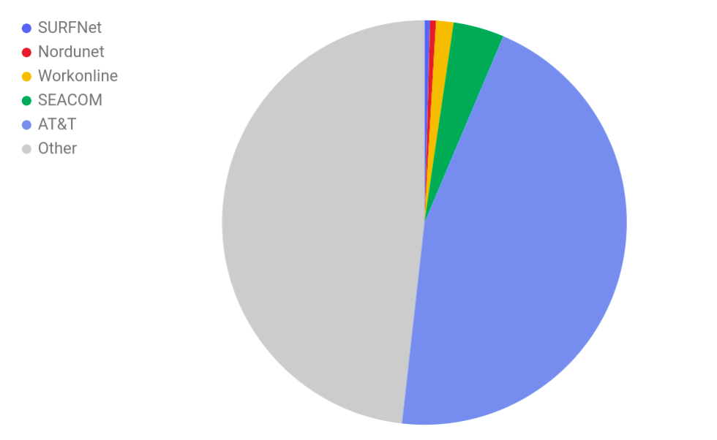

Slide 56

Graphs for
decision makers

Slide 57
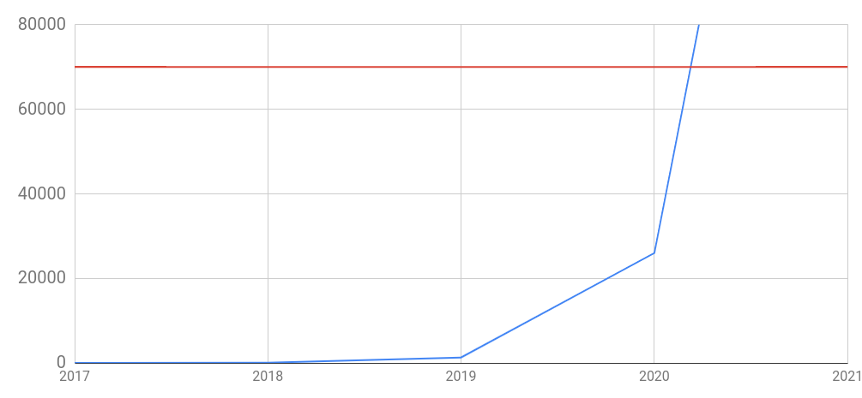
Uniq ASNs
Assuming same
growth rate

Slide 58





24730 | NL | ripencc | ASN-NETHOLDING, NL
60820 | NL | ripencc | WIFI4ALL-AS, NL
202916 | NL | ripencc | IPS, NL
28747 | BE | ripencc | EASYHOST-COLO-AS, BE
34215 | NL | ripencc | ATINET, NL
42812 | NL | ripencc | DT-IT, NL
48729 | NL | ripencc | O4S-AS, NL
199456 | GB | ripencc | VLDTECH-ASN, GB
60950 | NL | ripencc | CLOUDNL-AS, NL
202016 | NL | ripencc | DOMINOICT, NL
61429 | NL | ripencc | AS-CASTOR, NL
35027 | NL | ripencc | ASN-SEVENP, NL
21073 | NL | ripencc | ZORANET-AS Amsterdam, NL
41153 | NL | ripencc | GNTEL-AS, NL
49627 | NL | ripencc | SPEAKUP, NL
61147 | NL | ripencc | CALLHOSTED-AS Callhosted NL
42585 | NL | ripencc | NETWORKING4ALL, NL
15703 | NL | ripencc | TRUESERVER-AS TrueServer BV, NL
15879 | NL | ripencc | KPN-INTERNEDSERVICES, NL
35260 | NL | ripencc | IU-NET, NL
62353 | NL | ripencc | ASN-DATAPLACE, NL
202947 | NL | ripencc | Multi ICT B.V., Almere, NL
34141 | NL | ripencc | IN2IP-AS, NL
41960 | NL | ripencc | NEXTPERTISE Nextpertise, NL
20495 | NL | ripencc | WEDARE wd6.NET B.V, NL
52144 | NL | ripencc | NOTUBIZ, NL
42755 | NL | ripencc | DATAFIBER, NL
57598 | MD | ripencc | SHA-AS, MD
15426 | NL | ripencc | XENOSITE Amsterdam, NL
34968 | NL | ripencc | IUNXI, NL
35470 | NL | ripencc | XL-AS, NL
34762 | BE | ripencc | COMBELL-AS, BE
28878 | NL | ripencc | SIGNET-AS, NL
39647 | NL | ripencc | REDHOSTING-AS, NL
8455 | NL | ripencc | ATOM86-AS ATOM86, NL
21155 | NL | ripencc | ASN-PROSERVE Amsterdam, NL
197902 | NL | ripencc | HOSTNET, NL
24679 | DE | ripencc | SSERV-AS, DE
20559 | NL | ripencc | FUNDAMENTS-AS, NL
8608 | NL | ripencc | QINIP Esprit Telecom B.V., NL
200831 | NL | ripencc | MIHOSNET, NL
30870 | NL | ripencc | TRANS-IX-AS Trans-iX, NL
29028 | NL | ripencc | COMPUKOS-AS, NL
24586 | NL | ripencc | NL-INTERMAX B.V., NL
34756 | NL | ripencc | ASN-GVRH, NL
8312 | NL | ripencc | ZYLON-AS, NL
202955 | NL | ripencc | IAHOSTER, NL
201975 | NL | ripencc | UNISCAPEB IT-Services & Hosting, NL
41480 | NL | ripencc | SYSTEMEC-AS, NL
201290 | NL | ripencc | BLACKGATE, NL
39637 | NL | ripencc | NETLOGICS-AS, NL
8587 | NL | ripencc | INFRACOM-AS, NL
50554 | NL | ripencc | NCBV-BACKBONE, NL
61349 | NL | ripencc | MAXITEL, NL
58075 | NL | ripencc | X2COM, NL
59980 | NL | ripencc | MIJNDOMEIN, NL
From NLNOG 2018
91%
3%

Slide 59
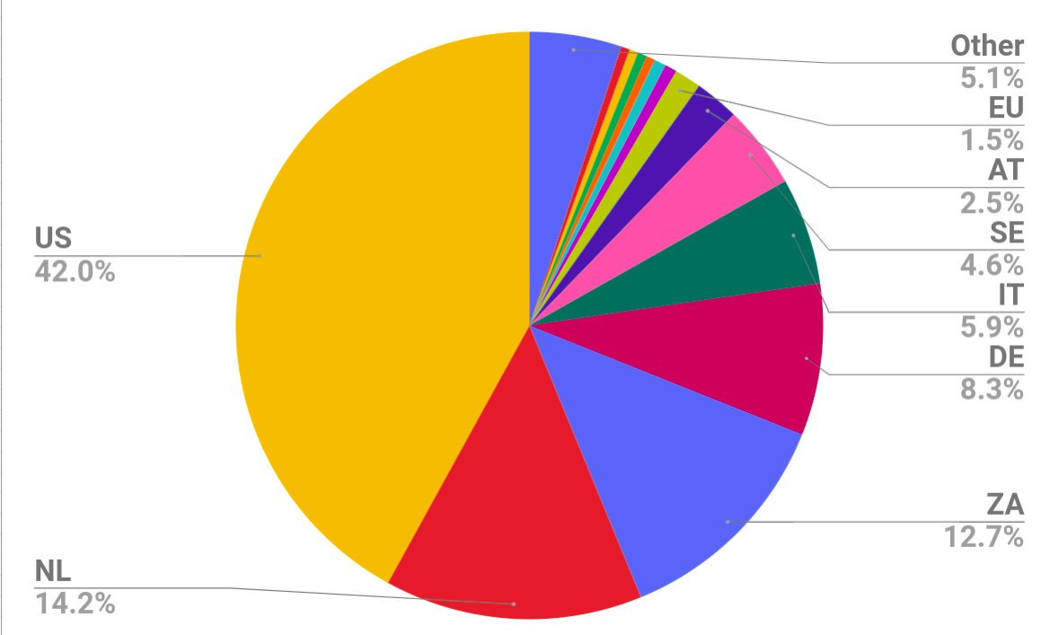
1 BG
1 BR
1 BW
1 CH
1 CW
1 HK
1 IE
1 KM
1 KR
1 PL
1 RU
1 RW
1 TH
2 CA
2 CZ
2 DK
2 GB
2 IS
2 MU
2 MZ
2 PR
2 TZ
3
3 BE
3 FI
3 GR
3 UG
4 MY
4 NO
9 EU
15 AT
28 SE
36 IT
51 DE
78 ZA
87 NL
257 US

Slide 60
While your upstream might do it, you still need to do it for peering / PNI links

Slide 61
Shout outs
@Benjojo12 / ben@benjojo.co.uk / $whois as206924
Huge thanks to Job for the 10GBE server and the helping with prefixes
NTT Communications
For the ARIN and RIPE prefix
Questions? ( if I have time )

Slide 62

Links
@Benjojo12 / ben@benjojo.co.uk / $whois as206924
https://docs.google.com/spreadsheets/d/1zOrndGLPvom64HOQwEHl5NQjCowGggcpEidtYCRcSSo/edit
Questions? ( if I have time )

