Slide 1

Measuring RPKI Adoption
@Benjojo12 / ben@benjojo.co.uk / $whois as206924
using the data-plane
Ben Cartwright-Cox

Slide 2
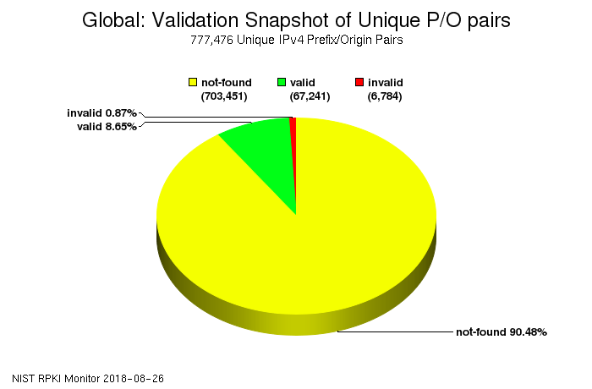
RPKI adoption is growing

Slide 3
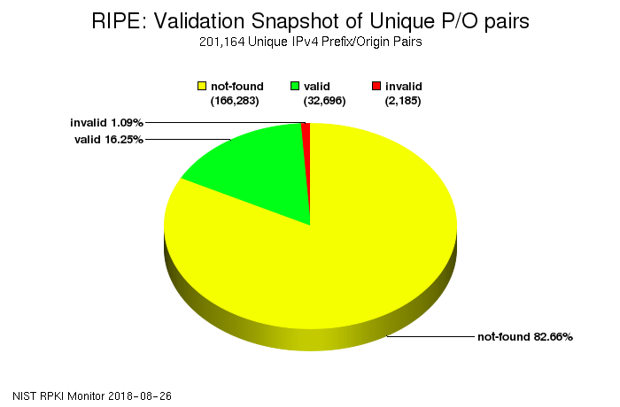
Even better in RIPE

Slide 4







Slide 5


Slide 6


Slide 7



Slide 8
This is not good

Slide 10



Slide 11
So far so good

Slide 12


Slide 14
This shouldn't route

Slide 16

0.0.0.0/0

Slide 17
0.0.0.0/0
Fixing this is hard to justify

Slide 18

0.0.0.0/0
Fixing this is hard to justify

Slide 19
This is still a lot of traffic
0.0.0.0/0
Fixing this is hard to justify

Slide 20
Assumptions
Lots of people have default routes
Lots of people are signing but not validating

Slide 21

Testing rig

Slide 22
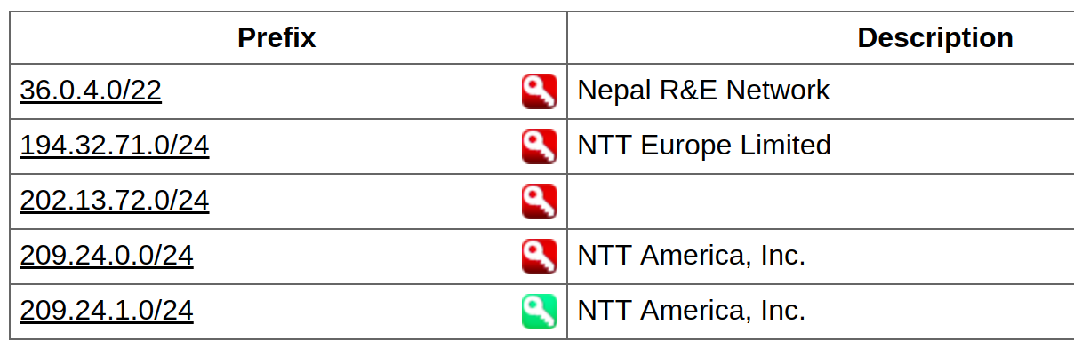
Testing rig
+

Slide 23




Slide 24

All 0.0.0.0/0 responses collected

Slide 25

ARIN ROA invalid
RIPE ROA invalid
ARIN ROA valid

Slide 26


What means what?
ARIN
ARIN
RIPE

Slide 27
IF
ARIN
ARIN
RIPE

Slide 28

IF
ARIN
ARIN
RIPE
Then they are validating and dropping(!)

Slide 29
IF
ARIN
ARIN
RIPE
Then they are using a popular ROA validator setup with defaults

Slide 30
IF
ARIN
ARIN
RIPE
Then they are not validating anything

Slide 31
Wait, what?!
Not all ROA's are equal?

Slide 32
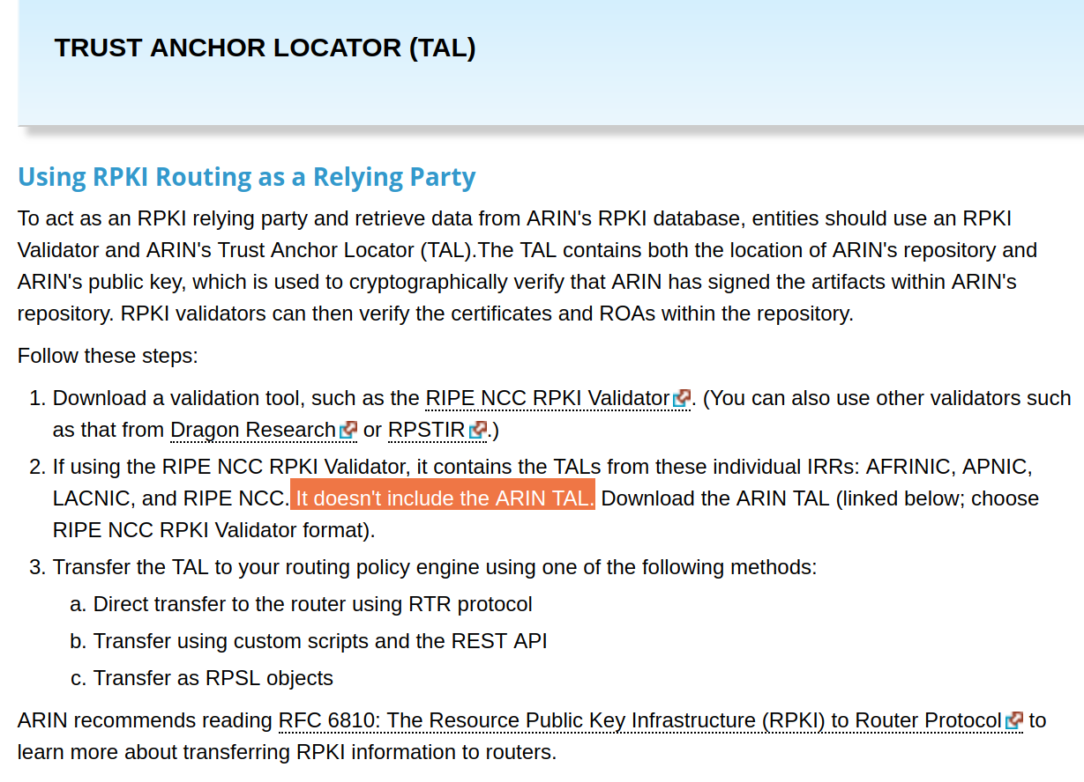

Slide 33
Sad.

Slide 34
Total counts
ARIN
ARIN
RIPE

Slide 35
ARIN
ARIN
RIPE
130 Mil

Slide 36
ARIN
ARIN
RIPE
130 Mil
128.2 Mil

Slide 37
ARIN
ARIN
RIPE
130 Mil
128.3 Mil
128.2 Mil

Slide 38
ARIN
ARIN
RIPE
130 Mil
128.3 Mil
128.2 Mil
APNIC
JPNIC
AFRINIC
127.9 Mil
128.1 Mil
128.1 Mil

Slide 39
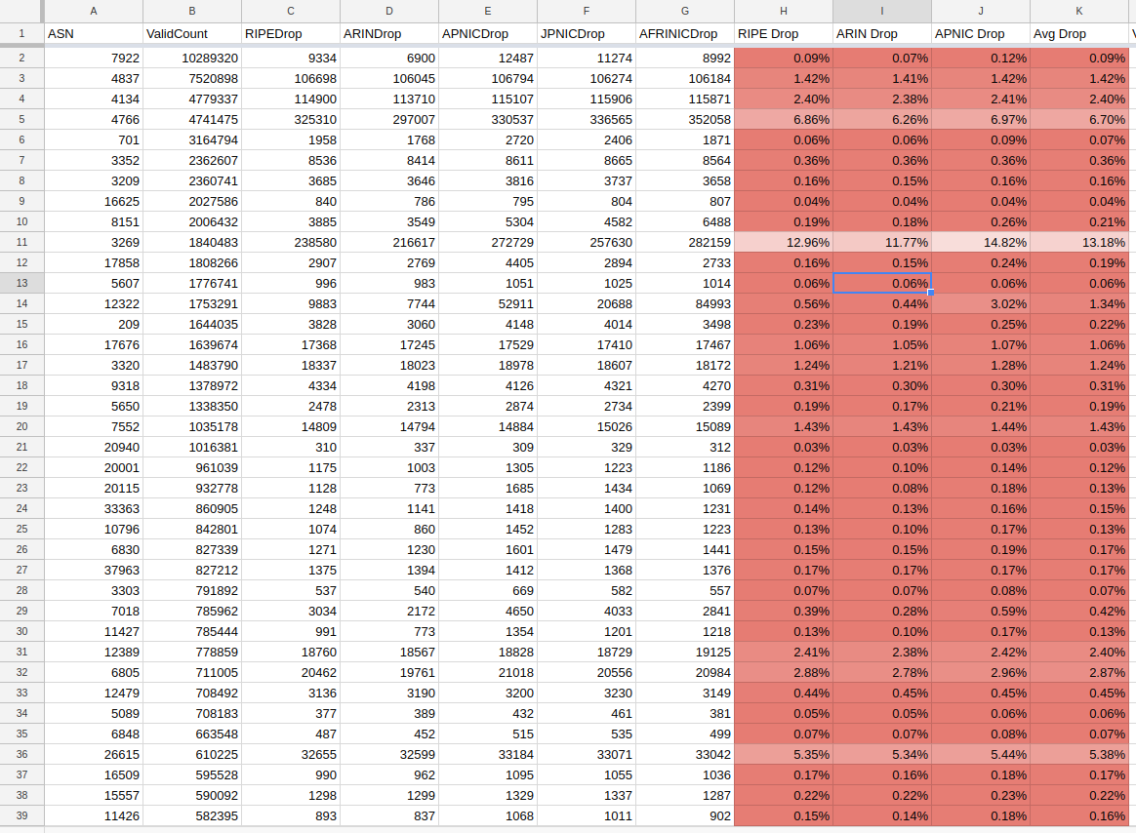

Slide 40
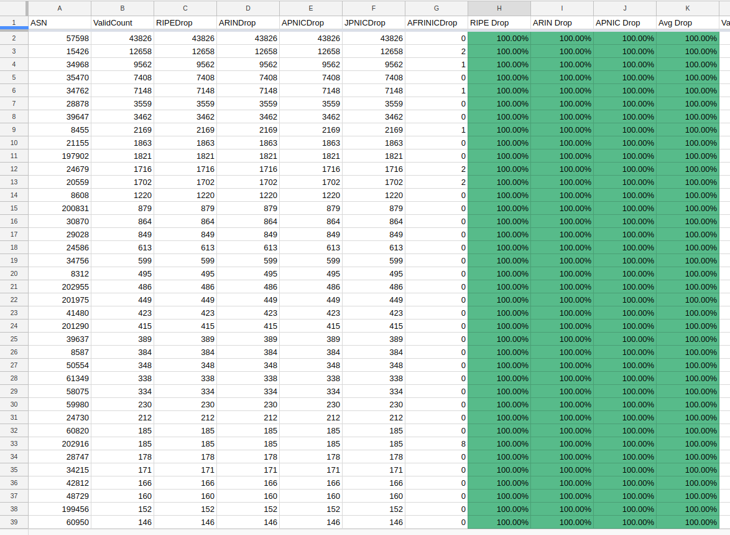
AS57598
AS15426
AS34968
AS35470
AS34762
AS28878
AS39647
AS8455
AS21155
AS197902
AS24679
AS20559
AS8608
AS200831
AS30870
AS29028
AS24586
AS34756
AS8312
AS202955
AS201975
AS41480
AS201290
AS39637
AS8587
AS50554
AS61349
AS58075
AS59980
AS24730
AS60820
AS202916
AS28747
AS34215
AS42812
AS48729
AS199456
AS60950
AS202016
AS61429
AS35027
AS21073
AS41153
AS49627
AS61147
AS42585
AS15703
AS15879
AS35260
AS62353
AS202947
AS34141
AS41960
AS20495
AS52144
AS42755

Slide 41
24730 | NL | ripencc | ASN-NETHOLDING, NL
60820 | NL | ripencc | WIFI4ALL-AS, NL
202916 | NL | ripencc | IPS, NL
28747 | BE | ripencc | EASYHOST-COLO-AS, BE
34215 | NL | ripencc | ATINET, NL
42812 | NL | ripencc | DT-IT, NL
48729 | NL | ripencc | O4S-AS, NL
199456 | GB | ripencc | VLDTECH-ASN, GB
60950 | NL | ripencc | CLOUDNL-AS, NL
202016 | NL | ripencc | DOMINOICT, NL
61429 | NL | ripencc | AS-CASTOR, NL
35027 | NL | ripencc | ASN-SEVENP, NL
21073 | NL | ripencc | ZORANET-AS Amsterdam, NL
41153 | NL | ripencc | GNTEL-AS, NL
49627 | NL | ripencc | SPEAKUP, NL
61147 | NL | ripencc | CALLHOSTED-AS Callhosted NL
42585 | NL | ripencc | NETWORKING4ALL, NL
15703 | NL | ripencc | TRUESERVER-AS TrueServer BV, NL
15879 | NL | ripencc | KPN-INTERNEDSERVICES, NL
35260 | NL | ripencc | IU-NET, NL
62353 | NL | ripencc | ASN-DATAPLACE, NL
202947 | NL | ripencc | Multi ICT B.V., Almere, NL
34141 | NL | ripencc | IN2IP-AS, NL
41960 | NL | ripencc | NEXTPERTISE Nextpertise, NL
20495 | NL | ripencc | WEDARE wd6.NET B.V, NL
52144 | NL | ripencc | NOTUBIZ, NL
42755 | NL | ripencc | DATAFIBER, NL
57598 | MD | ripencc | SHA-AS, MD
15426 | NL | ripencc | XENOSITE Amsterdam, NL
34968 | NL | ripencc | IUNXI, NL
35470 | NL | ripencc | XL-AS, NL
34762 | BE | ripencc | COMBELL-AS, BE
28878 | NL | ripencc | SIGNET-AS, NL
39647 | NL | ripencc | REDHOSTING-AS, NL
8455 | NL | ripencc | ATOM86-AS ATOM86, NL
21155 | NL | ripencc | ASN-PROSERVE Amsterdam, NL
197902 | NL | ripencc | HOSTNET, NL
24679 | DE | ripencc | SSERV-AS, DE
20559 | NL | ripencc | FUNDAMENTS-AS, NL
8608 | NL | ripencc | QINIP Esprit Telecom B.V., NL
200831 | NL | ripencc | MIHOSNET, NL
30870 | NL | ripencc | TRANS-IX-AS Trans-iX, NL
29028 | NL | ripencc | COMPUKOS-AS, NL
24586 | NL | ripencc | NL-INTERMAX B.V., NL
34756 | NL | ripencc | ASN-GVRH, NL
8312 | NL | ripencc | ZYLON-AS, NL
202955 | NL | ripencc | IAHOSTER, NL
201975 | NL | ripencc | UNISCAPEB IT-Services & Hosting, NL
41480 | NL | ripencc | SYSTEMEC-AS, NL
201290 | NL | ripencc | BLACKGATE, NL
39637 | NL | ripencc | NETLOGICS-AS, NL
8587 | NL | ripencc | INFRACOM-AS, NL
50554 | NL | ripencc | NCBV-BACKBONE, NL
61349 | NL | ripencc | MAXITEL, NL
58075 | NL | ripencc | X2COM, NL
59980 | NL | ripencc | MIJNDOMEIN, NL

Slide 42





24730 | NL | ripencc | ASN-NETHOLDING, NL
60820 | NL | ripencc | WIFI4ALL-AS, NL
202916 | NL | ripencc | IPS, NL
28747 | BE | ripencc | EASYHOST-COLO-AS, BE
34215 | NL | ripencc | ATINET, NL
42812 | NL | ripencc | DT-IT, NL
48729 | NL | ripencc | O4S-AS, NL
199456 | GB | ripencc | VLDTECH-ASN, GB
60950 | NL | ripencc | CLOUDNL-AS, NL
202016 | NL | ripencc | DOMINOICT, NL
61429 | NL | ripencc | AS-CASTOR, NL
35027 | NL | ripencc | ASN-SEVENP, NL
21073 | NL | ripencc | ZORANET-AS Amsterdam, NL
41153 | NL | ripencc | GNTEL-AS, NL
49627 | NL | ripencc | SPEAKUP, NL
61147 | NL | ripencc | CALLHOSTED-AS Callhosted NL
42585 | NL | ripencc | NETWORKING4ALL, NL
15703 | NL | ripencc | TRUESERVER-AS TrueServer BV, NL
15879 | NL | ripencc | KPN-INTERNEDSERVICES, NL
35260 | NL | ripencc | IU-NET, NL
62353 | NL | ripencc | ASN-DATAPLACE, NL
202947 | NL | ripencc | Multi ICT B.V., Almere, NL
34141 | NL | ripencc | IN2IP-AS, NL
41960 | NL | ripencc | NEXTPERTISE Nextpertise, NL
20495 | NL | ripencc | WEDARE wd6.NET B.V, NL
52144 | NL | ripencc | NOTUBIZ, NL
42755 | NL | ripencc | DATAFIBER, NL
57598 | MD | ripencc | SHA-AS, MD
15426 | NL | ripencc | XENOSITE Amsterdam, NL
34968 | NL | ripencc | IUNXI, NL
35470 | NL | ripencc | XL-AS, NL
34762 | BE | ripencc | COMBELL-AS, BE
28878 | NL | ripencc | SIGNET-AS, NL
39647 | NL | ripencc | REDHOSTING-AS, NL
8455 | NL | ripencc | ATOM86-AS ATOM86, NL
21155 | NL | ripencc | ASN-PROSERVE Amsterdam, NL
197902 | NL | ripencc | HOSTNET, NL
24679 | DE | ripencc | SSERV-AS, DE
20559 | NL | ripencc | FUNDAMENTS-AS, NL
8608 | NL | ripencc | QINIP Esprit Telecom B.V., NL
200831 | NL | ripencc | MIHOSNET, NL
30870 | NL | ripencc | TRANS-IX-AS Trans-iX, NL
29028 | NL | ripencc | COMPUKOS-AS, NL
24586 | NL | ripencc | NL-INTERMAX B.V., NL
34756 | NL | ripencc | ASN-GVRH, NL
8312 | NL | ripencc | ZYLON-AS, NL
202955 | NL | ripencc | IAHOSTER, NL
201975 | NL | ripencc | UNISCAPEB IT-Services & Hosting, NL
41480 | NL | ripencc | SYSTEMEC-AS, NL
201290 | NL | ripencc | BLACKGATE, NL
39637 | NL | ripencc | NETLOGICS-AS, NL
8587 | NL | ripencc | INFRACOM-AS, NL
50554 | NL | ripencc | NCBV-BACKBONE, NL
61349 | NL | ripencc | MAXITEL, NL
58075 | NL | ripencc | X2COM, NL
59980 | NL | ripencc | MIJNDOMEIN, NL
91%
3%

Slide 43

24730 | NL | ripencc | ASN-NETHOLDING, NL
60820 | NL | ripencc | WIFI4ALL-AS, NL
202916 | NL | ripencc | IPS, NL
28747 | BE | ripencc | EASYHOST-COLO-AS, BE
34215 | NL | ripencc | ATINET, NL
42812 | NL | ripencc | DT-IT, NL
48729 | NL | ripencc | O4S-AS, NL
199456 | GB | ripencc | VLDTECH-ASN, GB
60950 | NL | ripencc | CLOUDNL-AS, NL
202016 | NL | ripencc | DOMINOICT, NL
61429 | NL | ripencc | AS-CASTOR, NL
35027 | NL | ripencc | ASN-SEVENP, NL
21073 | NL | ripencc | ZORANET-AS Amsterdam, NL
41153 | NL | ripencc | GNTEL-AS, NL
49627 | NL | ripencc | SPEAKUP, NL
61147 | NL | ripencc | CALLHOSTED-AS Callhosted NL
42585 | NL | ripencc | NETWORKING4ALL, NL
15703 | NL | ripencc | TRUESERVER-AS TrueServer BV, NL
15879 | NL | ripencc | KPN-INTERNEDSERVICES, NL
35260 | NL | ripencc | IU-NET, NL
62353 | NL | ripencc | ASN-DATAPLACE, NL
202947 | NL | ripencc | Multi ICT B.V., Almere, NL
34141 | NL | ripencc | IN2IP-AS, NL
41960 | NL | ripencc | NEXTPERTISE Nextpertise, NL
20495 | NL | ripencc | WEDARE wd6.NET B.V, NL
52144 | NL | ripencc | NOTUBIZ, NL
42755 | NL | ripencc | DATAFIBER, NL
57598 | MD | ripencc | SHA-AS, MD
15426 | NL | ripencc | XENOSITE Amsterdam, NL
34968 | NL | ripencc | IUNXI, NL
35470 | NL | ripencc | XL-AS, NL
34762 | BE | ripencc | COMBELL-AS, BE
28878 | NL | ripencc | SIGNET-AS, NL
39647 | NL | ripencc | REDHOSTING-AS, NL
8455 | NL | ripencc | ATOM86-AS ATOM86, NL
21155 | NL | ripencc | ASN-PROSERVE Amsterdam, NL
197902 | NL | ripencc | HOSTNET, NL
24679 | DE | ripencc | SSERV-AS, DE
20559 | NL | ripencc | FUNDAMENTS-AS, NL
8608 | NL | ripencc | QINIP Esprit Telecom B.V., NL
200831 | NL | ripencc | MIHOSNET, NL
30870 | NL | ripencc | TRANS-IX-AS Trans-iX, NL
29028 | NL | ripencc | COMPUKOS-AS, NL
24586 | NL | ripencc | NL-INTERMAX B.V., NL
34756 | NL | ripencc | ASN-GVRH, NL
8312 | NL | ripencc | ZYLON-AS, NL
202955 | NL | ripencc | IAHOSTER, NL
201975 | NL | ripencc | UNISCAPEB IT-Services & Hosting, NL
41480 | NL | ripencc | SYSTEMEC-AS, NL
201290 | NL | ripencc | BLACKGATE, NL
39637 | NL | ripencc | NETLOGICS-AS, NL
8587 | NL | ripencc | INFRACOM-AS, NL
50554 | NL | ripencc | NCBV-BACKBONE, NL
61349 | NL | ripencc | MAXITEL, NL
58075 | NL | ripencc | X2COM, NL
59980 | NL | ripencc | MIJNDOMEIN, NL
This amounts to a /15 protected
91%
3%

Slide 44
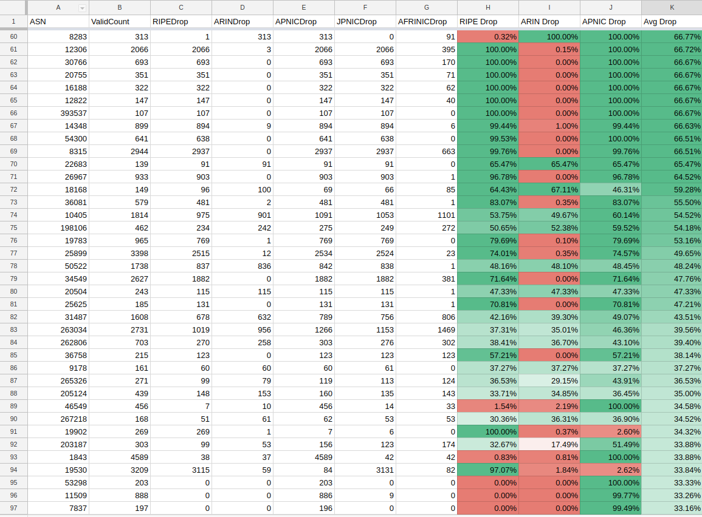

Slide 45
But wait
What about those who take default routes?

Slide 46
--- 139.138.224.4 ping statistics ---
100 packets transmitted, 100 received, 0% packet loss, time 19887ms
rtt min/avg/max/mdev = 243.039/243.758/251.173/1.088 ms, pipe 2
Valid
--- 139.138.224.4 ping statistics ---
100 packets transmitted, 100 received, 0% packet loss, time 19877ms
rtt min/avg/max/mdev = 245.384/246.097/248.497/0.608 ms, pipe 2
Invalid

Slide 47
--- 139.138.224.4 ping statistics ---
100 packets transmitted, 100 received, 0% packet loss, time 19887ms
rtt min/avg/max/mdev = 243.039/243.758/251.173/1.088 ms, pipe 2
Valid
Reliably a 3ms~ difference
--- 139.138.224.4 ping statistics ---
100 packets transmitted, 100 received, 0% packet loss, time 19877ms
rtt min/avg/max/mdev = 245.384/246.097/248.497/0.608 ms, pipe 2
Invalid

Slide 48


Slide 49
But wait
x 2
Maybe services do a better job?

Slide 50


Slide 51
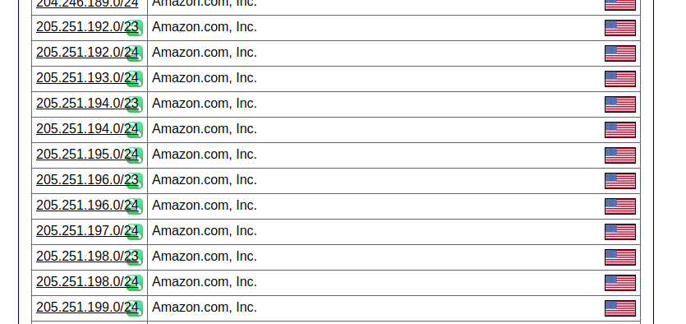

Slide 52
Are you validating?
ben@eshwil:~$ dig ripe.playfeniks.com
ben@eshwil:~$ dig arin.playfeniks.com
ben@eshwil:~$ dig apnic.playfeniks.com
ben@eshwil:~$ dig jpnic.playfeniks.com
* These are likely not going to work that much longer after the talk
Try it??

Slide 53

[15:02:03] ben@metropolis:~$ dig @1.1.1.1 ripe.playfeniks.com
; <<>> DiG 9.10.3-P4-Ubuntu <<>> @1.1.1.1 ripe.playfeniks.com
; (1 server found)
;; global options: +cmd
;; Got answer:
;; ->>HEADER<<- opcode: QUERY, status: NOERROR, id: 25737
;; flags: qr rd ra; QUERY: 1, ANSWER: 1, AUTHORITY: 0, ADDITIONAL: 1
;; OPT PSEUDOSECTION:
; EDNS: version: 0, flags:; udp: 1452
;; QUESTION SECTION:
;ripe.playfeniks.com. IN A
;; ANSWER SECTION:
ripe.playfeniks.com. 10193 IN A 1.3.3.7
;; Query time: 1 msec
;; SERVER: 1.1.1.1#53(1.1.1.1)
;; WHEN: Thu Sep 06 15:02:11 BST 2018
;; MSG SIZE rcvd: 64

Slide 54

[15:02:11] ben@metropolis:~$ dig @8.8.8.8 ripe.playfeniks.com
; <<>> DiG 9.10.3-P4-Ubuntu <<>> @8.8.8.8 ripe.playfeniks.com
; (1 server found)
;; global options: +cmd
;; Got answer:
;; ->>HEADER<<- opcode: QUERY, status: NOERROR, id: 30212
;; flags: qr rd ra; QUERY: 1, ANSWER: 1, AUTHORITY: 0, ADDITIONAL: 1
;; OPT PSEUDOSECTION:
; EDNS: version: 0, flags:; udp: 512
;; QUESTION SECTION:
;ripe.playfeniks.com. IN A
;; ANSWER SECTION:
ripe.playfeniks.com. 20990 IN A 1.3.3.7
;; Query time: 9 msec
;; SERVER: 8.8.8.8#53(8.8.8.8)
;; WHEN: Thu Sep 06 15:02:18 BST 2018
;; MSG SIZE rcvd: 64

Slide 55

[15:02:18] ben@metropolis:~$ dig @9.9.9.9 ripe.playfeniks.com
; <<>> DiG 9.10.3-P4-Ubuntu <<>> @9.9.9.9 ripe.playfeniks.com
; (1 server found)
;; global options: +cmd
;; Got answer:
;; ->>HEADER<<- opcode: QUERY, status: NOERROR, id: 44713
;; flags: qr rd ra; QUERY: 1, ANSWER: 1, AUTHORITY: 0, ADDITIONAL: 1
;; OPT PSEUDOSECTION:
; EDNS: version: 0, flags:; udp: 4096
;; QUESTION SECTION:
;ripe.playfeniks.com. IN A
;; ANSWER SECTION:
ripe.playfeniks.com. 43200 IN A 1.3.3.7
;; Query time: 129 msec
;; SERVER: 9.9.9.9#53(9.9.9.9)
;; WHEN: Thu Sep 06 15:02:23 BST 2018
;; MSG SIZE rcvd: 64

Slide 56

[15:02:23] ben@metropolis:~$ dig @80.80.80.80 ripe.playfeniks.com
; <<>> DiG 9.10.3-P4-Ubuntu <<>> @80.80.80.80 ripe.playfeniks.com
; (1 server found)
;; global options: +cmd
;; Got answer:
;; ->>HEADER<<- opcode: QUERY, status: NOERROR, id: 29235
;; flags: qr rd ra; QUERY: 1, ANSWER: 1, AUTHORITY: 2, ADDITIONAL: 1
;; OPT PSEUDOSECTION:
; EDNS: version: 0, flags:; udp: 4096
;; QUESTION SECTION:
;ripe.playfeniks.com. IN A
;; ANSWER SECTION:
ripe.playfeniks.com. 604800 IN A 1.3.3.7
;; Query time: 251 msec
;; SERVER: 80.80.80.80#53(80.80.80.80)
;; WHEN: Thu Sep 06 15:02:34 BST 2018
;; MSG SIZE rcvd: 124

Slide 57
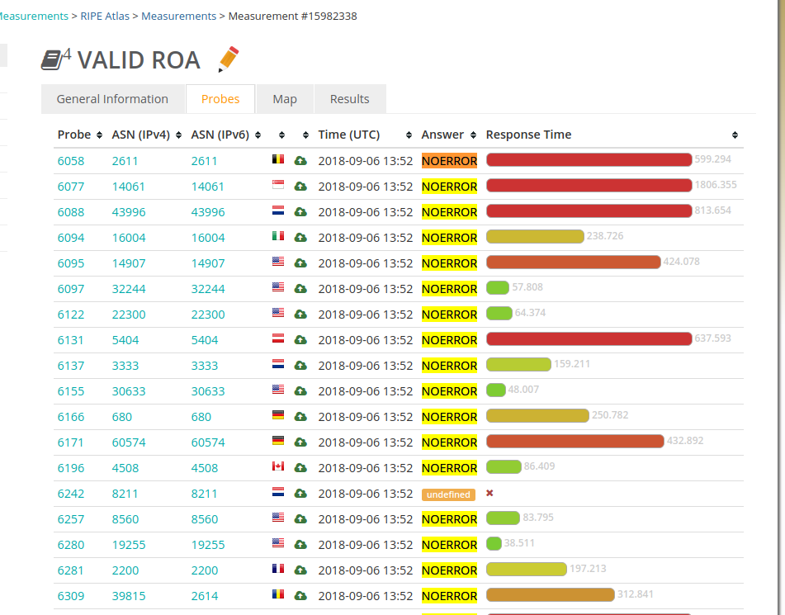
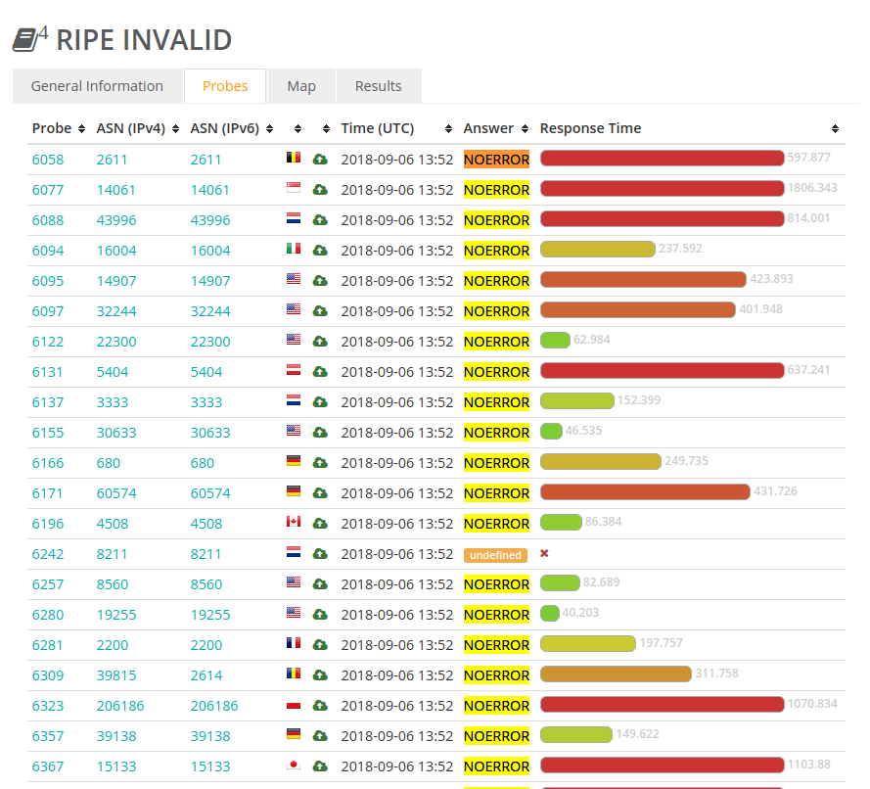
excluding one probe, out of the 1k sample all worked

Slide 58
Lessons

Slide 59
Please, if you are going to do RPKI:
Sign your prefixes
Validate your inbound prefixes
Consider not having your default route if you take a full table
Configure your RPKI validator correctly (aka, add ARIN)

Slide 60
Shout outs
Huge thanks to Job for the 10GBE server and the helping with prefixes
  Even though later on a qemu limitation ment I could barely do 150mbps :(
Nepal Research and Education Network (NREN)
  For the APNIC prefix to test with
Japan Network Information Center / PPP-EXP
  For the JPNIC prefix
NTT Communications
  For the ARIN and RIPE prefix
LARUS Cloud Service Ltd
  For the AFRINIC prefix

Slide 61
Shout outs
@Benjojo12 / ben@benjojo.co.uk / $whois as206924
Huge thanks to Job for the 10GBE server and the helping with prefixes
  Even though later on a qemu limitation ment I could barely do 150mbps :(
Nepal Research and Education Network (NREN)
  For the APNIC prefix to test with
Japan Network Information Center / PPP-EXP
  For the JPNIC prefix
NTT Communications
  For the ARIN and RIPE prefix
LARUS Cloud Service Ltd
  For the AFRINIC prefix
Questions? ( if I have time )

Slide 62


Links
@Benjojo12 / ben@benjojo.co.uk / $whois as206924
https://docs.google.com/spreadsheets/d/14gwdinxXAq-G3XBqJOxQfsrMpmfDAgaRK0z05TBq6UY/edit
Questions? ( if I have time )
<- Spreadsheet Raw Data ->
https://drive.google.com/drive/folders/1j9XoapFo4vO4DFZ2o2htopZgcJ0uL3_b?usp=sharing

