Slide 1

BGP Monitoring Protocol
NLNOG Day 2018
Henk Smit (Nokia) & Paolo Lucente (NTT Communications)
7 September 2018

Slide 2
Agenda
Original problem
Solution: a new protocol: BMP, RFC 7854
We want moar
Two proposed drafts from 2017
A proposal for route-monitoring messages with an extensible message-format

Slide 3
Original problem
Providers want to know what their network is doing
In this particular case: what BGP is doing
Most interesting: received routes and peer state
Snmp is useless for these large amounts of data
Netconf could be used, but still it’s a lot of routes
  Netconf wasn’t widely used 10 years ago
We want a “push” solution, not a “pull” solution
  We need a “telemetry” solution

Slide 4
Original solution
Use show commands in the CLI
  Automate through screen-scraping
  Still a “pull” solution
Or do BGP-peering to a spot where you want to monitor your router(s)
  Like a looking-glass server
Has downsides:
  Looking-glass server might send you routes by mistake
  Prone to configuration errors
  BGP will only send the best-path
    (can be overcome with add-paths, but that adds complexity)

Slide 5
Solution: a new protocol
BMP stands for BGP Monitoring Protocol
RFC7854 (Fernando, Scudder, Stuart)
Idea is from 2007 or so
RFC was published June 2016
Product of the Global Routing Operations Workgroup (grow)
Simple, efficient
“Push” solution, not a “pull” solution.
  No periodic polling.
Main goal is to just report the routes a router has received from its peers

Slide 6
What is BMP ?
BGP Monitoring Protocol, to monitor BGP (duh)
Point-to-point protocol
Between a router and a BMP-station
  A “Station” is sometimes called a “Collector”
Collector is software that runs on a Linux box
A collector collects events, statistics and routes from BGP
  Data can be stored in a real data-base
  Analysis can be done later, at any time
  Analysis doesn’t consume router resources

Slide 7
The BMP session
Runs over TCP
  No well-known port-number. Pick one
  Can use TCP-keepalives if you want
Uni-directional
  Router sends messages to the station
  Station never ever sends messages to a router
Simple
  No hand-shakes, no errors, no state-machine

Slide 8
BMP message types
Initiation
Termination
Peer-up
Peer-down
Periodic Statistics Reports
Route-monitoring
Route-mirroring

Slide 9
Format of a BMP message
6 bytes of BMP header
  1 byte protocol version (always 3)
  4 bytes of message length
  1 byte of message type
42 bytes of BMP per-peer header
  Not for initiation and termination messages
  Peer-address (ipv4 or ipv6), peer-type, ASN, RD
  Router-id, timestamp, 8 bits of flags
Message content
  BGP Update Message in a Route-monitoring message
  Counters in a Periodic Statistics Report message
  OPEN messages in a Peer-up message, etc

Slide 10
Typical life of a BMP session
Router sets up a TCP connection to the station
Router sends an Initiation Message
Send Peer-Up messages for each Established peer
Send Route-monitoring messages for all received routes
Send End-Of-RIB messages for all peers, all address-families
Keep sending Route-monitoring messages when new routes arrive
  Or withdrawals
Report peers going down or up via peer-up/down messages
Maybe send periodic Statistics Reports with counters
Session ends with a termination message

Slide 11
Examples of BMP Collectors
pmacct
  Set of monitoring tools
OpenBMP
  Part of toolset called snas.io
OpenDayLight
Ryu BMP
Simple python-scripts (search github)
Proprietary collectors implemented by hyper-scalers
Proprietary collectors implemented by router vendors
  Maybe to feed SDN-controllers

Slide 12
Example configuration for SR-OS
Configure a bmp-station in the global config
  configure bmp
  station lys create
  family ipv4 ipv6 vpn-ipv4 label-ipv6
  stats-report-interval 900
  connection
  station-address 192.31.231.16 port 1790
  no shutdown
  no shutdown

Slide 13
Example configuration for SR-OS (cont’d)
Configure which peers you want to monitor
  configure router bgp
  group internal-peers
  monitor
  station lys braavos myr
  route-monitoring pre-policy post-policy
  no shutdown

Slide 14
We want moar !!
RFC7854 was published in June 2016
Operators want more
BMP, like any protocol, can always be improved
Wish to monitor outgoing routes (Adj-RIB-Out)
Wish to see best BGP routes (Loc-RIB)
Want to know why routes were rejected
Want to know why routes didn’t win best-path selection

Slide 15
Two new BMP drafts
Draft-ietf-grow-bmp-adj-rib-out-01
  Allow reporting of outgoing routes, from Adj-RIB-Out
  Similar to reporting incoming routes
  Set a bit in the per-peer-header flags-field to distinguish from Adj-RIB-In
  Two new Periodic Stats Reports counters
Draft-ietf-grow-bmp-local-rib-00
  Allow reporting of routes in the BGP Loc-RIB
  Set peer-type to new value: Loc-RIB Instance Peer
  Set peer-address to all-zeros

Slide 16
Can we do better ?
Elegance is not a dispensable luxury but a quality that decides between success and failure
Edsger W. Dijkstra, 1999
  Computing Science: Achievements and Challenges
  https://www.cs.utexas.edu/users/EWD/transcriptions/EWD12xx/EWD1284.html

Slide 17
Limitations of the 2 current proposals
We only have 8 bits in the peer-flags in the per-peer header
4 Bits used now, only 4 bits free for future extensions
  We still have 249 unused message-types out of potential 256 message-types
We now know which routes are in the Loc-RIB, but we lost peer information
We want a solution where we can report all extra state we can think of
Some state requires a single bit
  We have only 4 bits left in the per-peer flags field
Some state requires more information
  Route-monitoring messages are fixed-format
  We can’t add anything

Slide 18
A new proposal: a new extensible route-monitoring message-format
Most BMP messages use TLV-based encoding
Only Route-monitoring messages have a fixed format
  6 bytes BMP header
  42 bytes per-peer header
  A full BGP Update Message, including marker, header, attributes and NLRI
Proposal: use TLV-encoding for the body of a BMP route-monitoring message !
Requires a new BMP message-type
  While we’re at it, define 3 new message-types:
  One for Adj-RIB-In, one for Adj-RIB-Out and one for Loc-RIB

Slide 19
Where to find more information
Draft was published in July 2018
https://datatracker.ietf.org/doc/draft-hsmit-bmp-extensible-routemon-msgs-00
New version of the draft will be published soon
  September or October 2018
  Backed by Juniper, NTT and hopefully many others

Slide 20
Example of a new BMP route-monitoring message
Bmp generic header (6 bytes)
Bmp per-peer header (42 bytes)
Tlv-header (4 bytes)
Flags-field content (2 bytes, can be longer)
Tlv-header (4 bytes)
BGP update message (marker, header, attributes, NLRI)
Potentially more TLVs

Slide 21
Flags-field TLV
Attributes are pre-policy, post-policy, or both
Route was accepted or rejected by policy
Route is valid/invalid (e.g. next-hop is unreachable)
Route is or is not best BGP route after best-path selection
Route is installed in the general routing table
Route is best route in the general routing table
Route is installed in the FIB
As-path is in 4-byte ASN notation
NLRI has path-id (add-paths)

Slide 22
Future TLVs
Tie-break reason why a route did not win best-path selection
Policy-name or route-map name why a route was rejected
  Maybe with line-number or entry-number of the exact line in a filter caused rejection
Got ideas ? What state of a route would you like to see ?

Slide 23
Implementation
Extensible encoding exists in Nokia’s SR-OS today
But not available to customers (yet)
  Config command removed from the CLI (and Yang/SNMP)
Earliest available in 17.0R1 (spring 2019)
  Ask your friendly Nokia product-manager
Proposed changes are not very complex
  So hopefully both BMP-collector implementors and router-vendors can adapt easily
No need for a configuration-option on the BMP-collector
Routers need an option to send old-style fixed-format messages (type 0), or
send the new tlv-encoded route-monitoring messages (type 7, 8 and 9)

Slide 24
Thank you for your attention
We hope BMP will be useful for you !
Contact info:
  paolo@ntt.net
  henk_hw.smit@nokia.com , or:
  hhw.smit@xs4all.nl

Slide 26
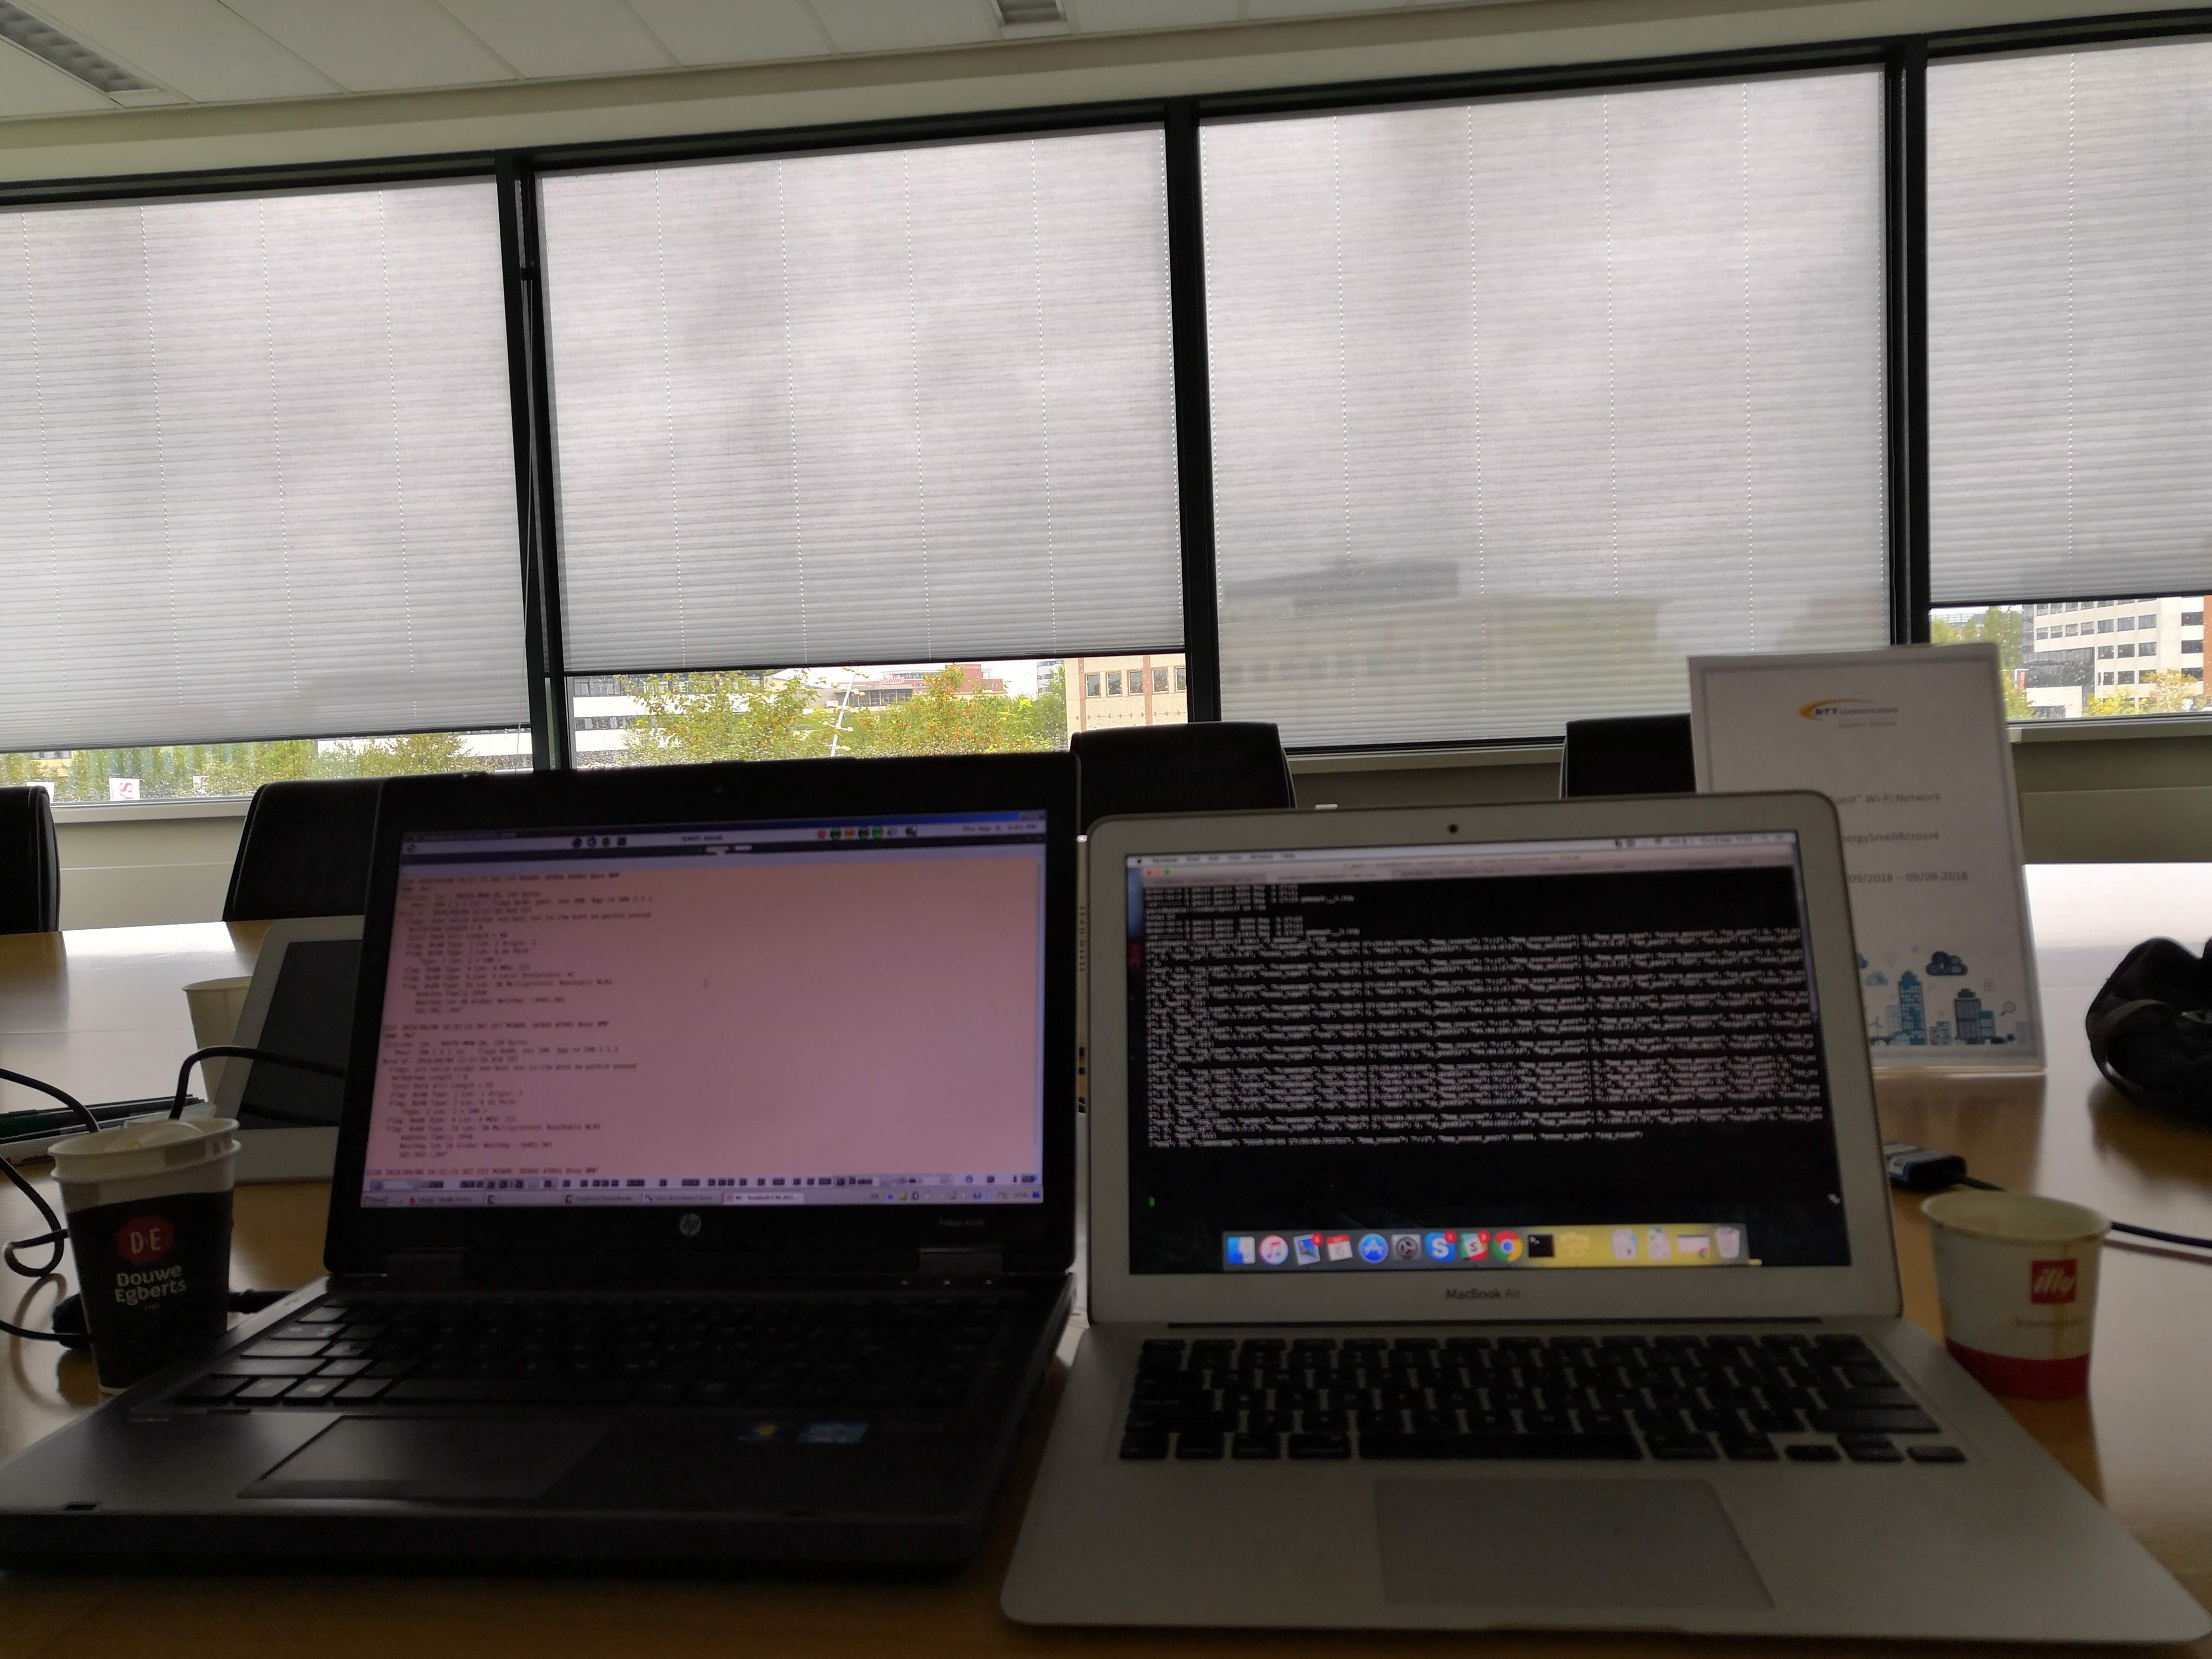
Interoperability

Slide 27
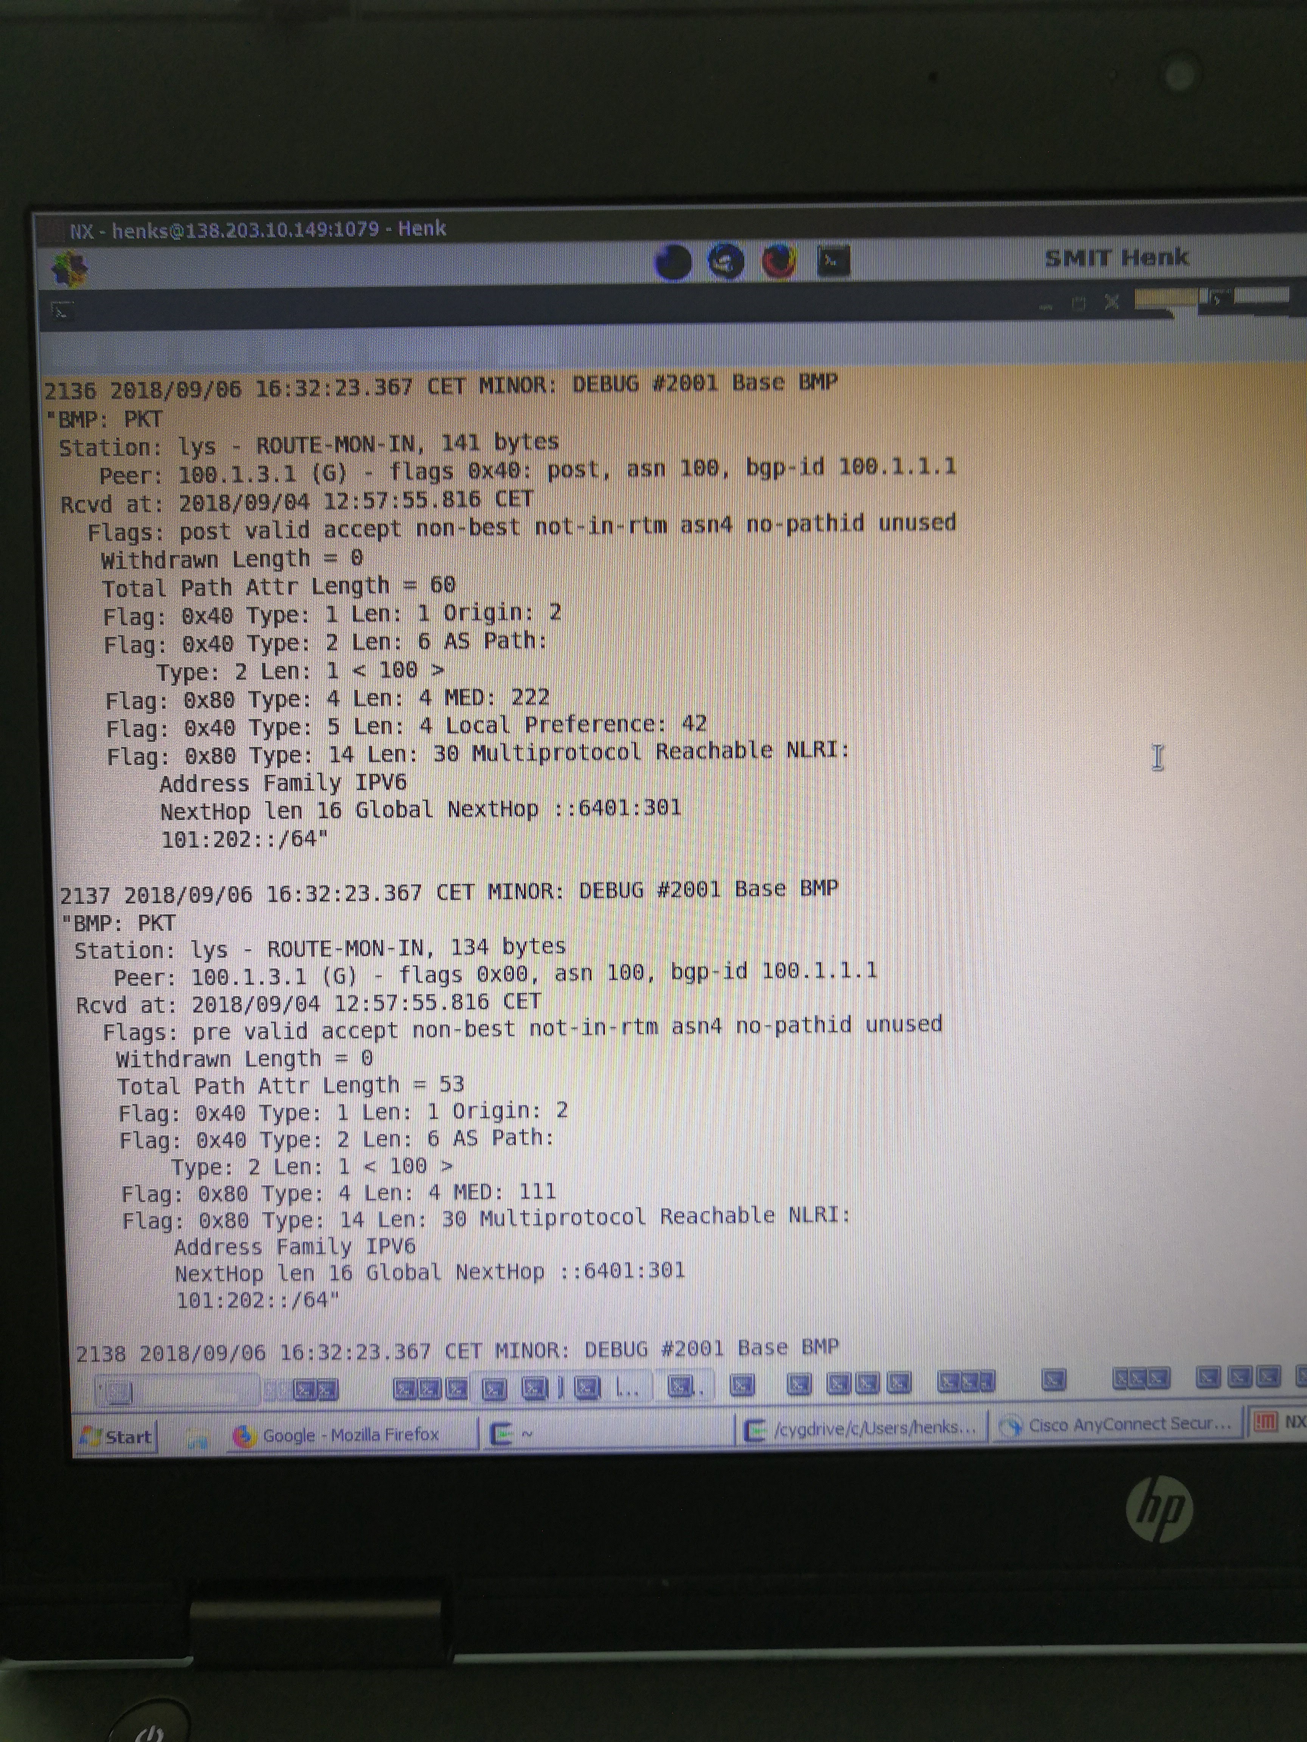
Empty

Slide 28
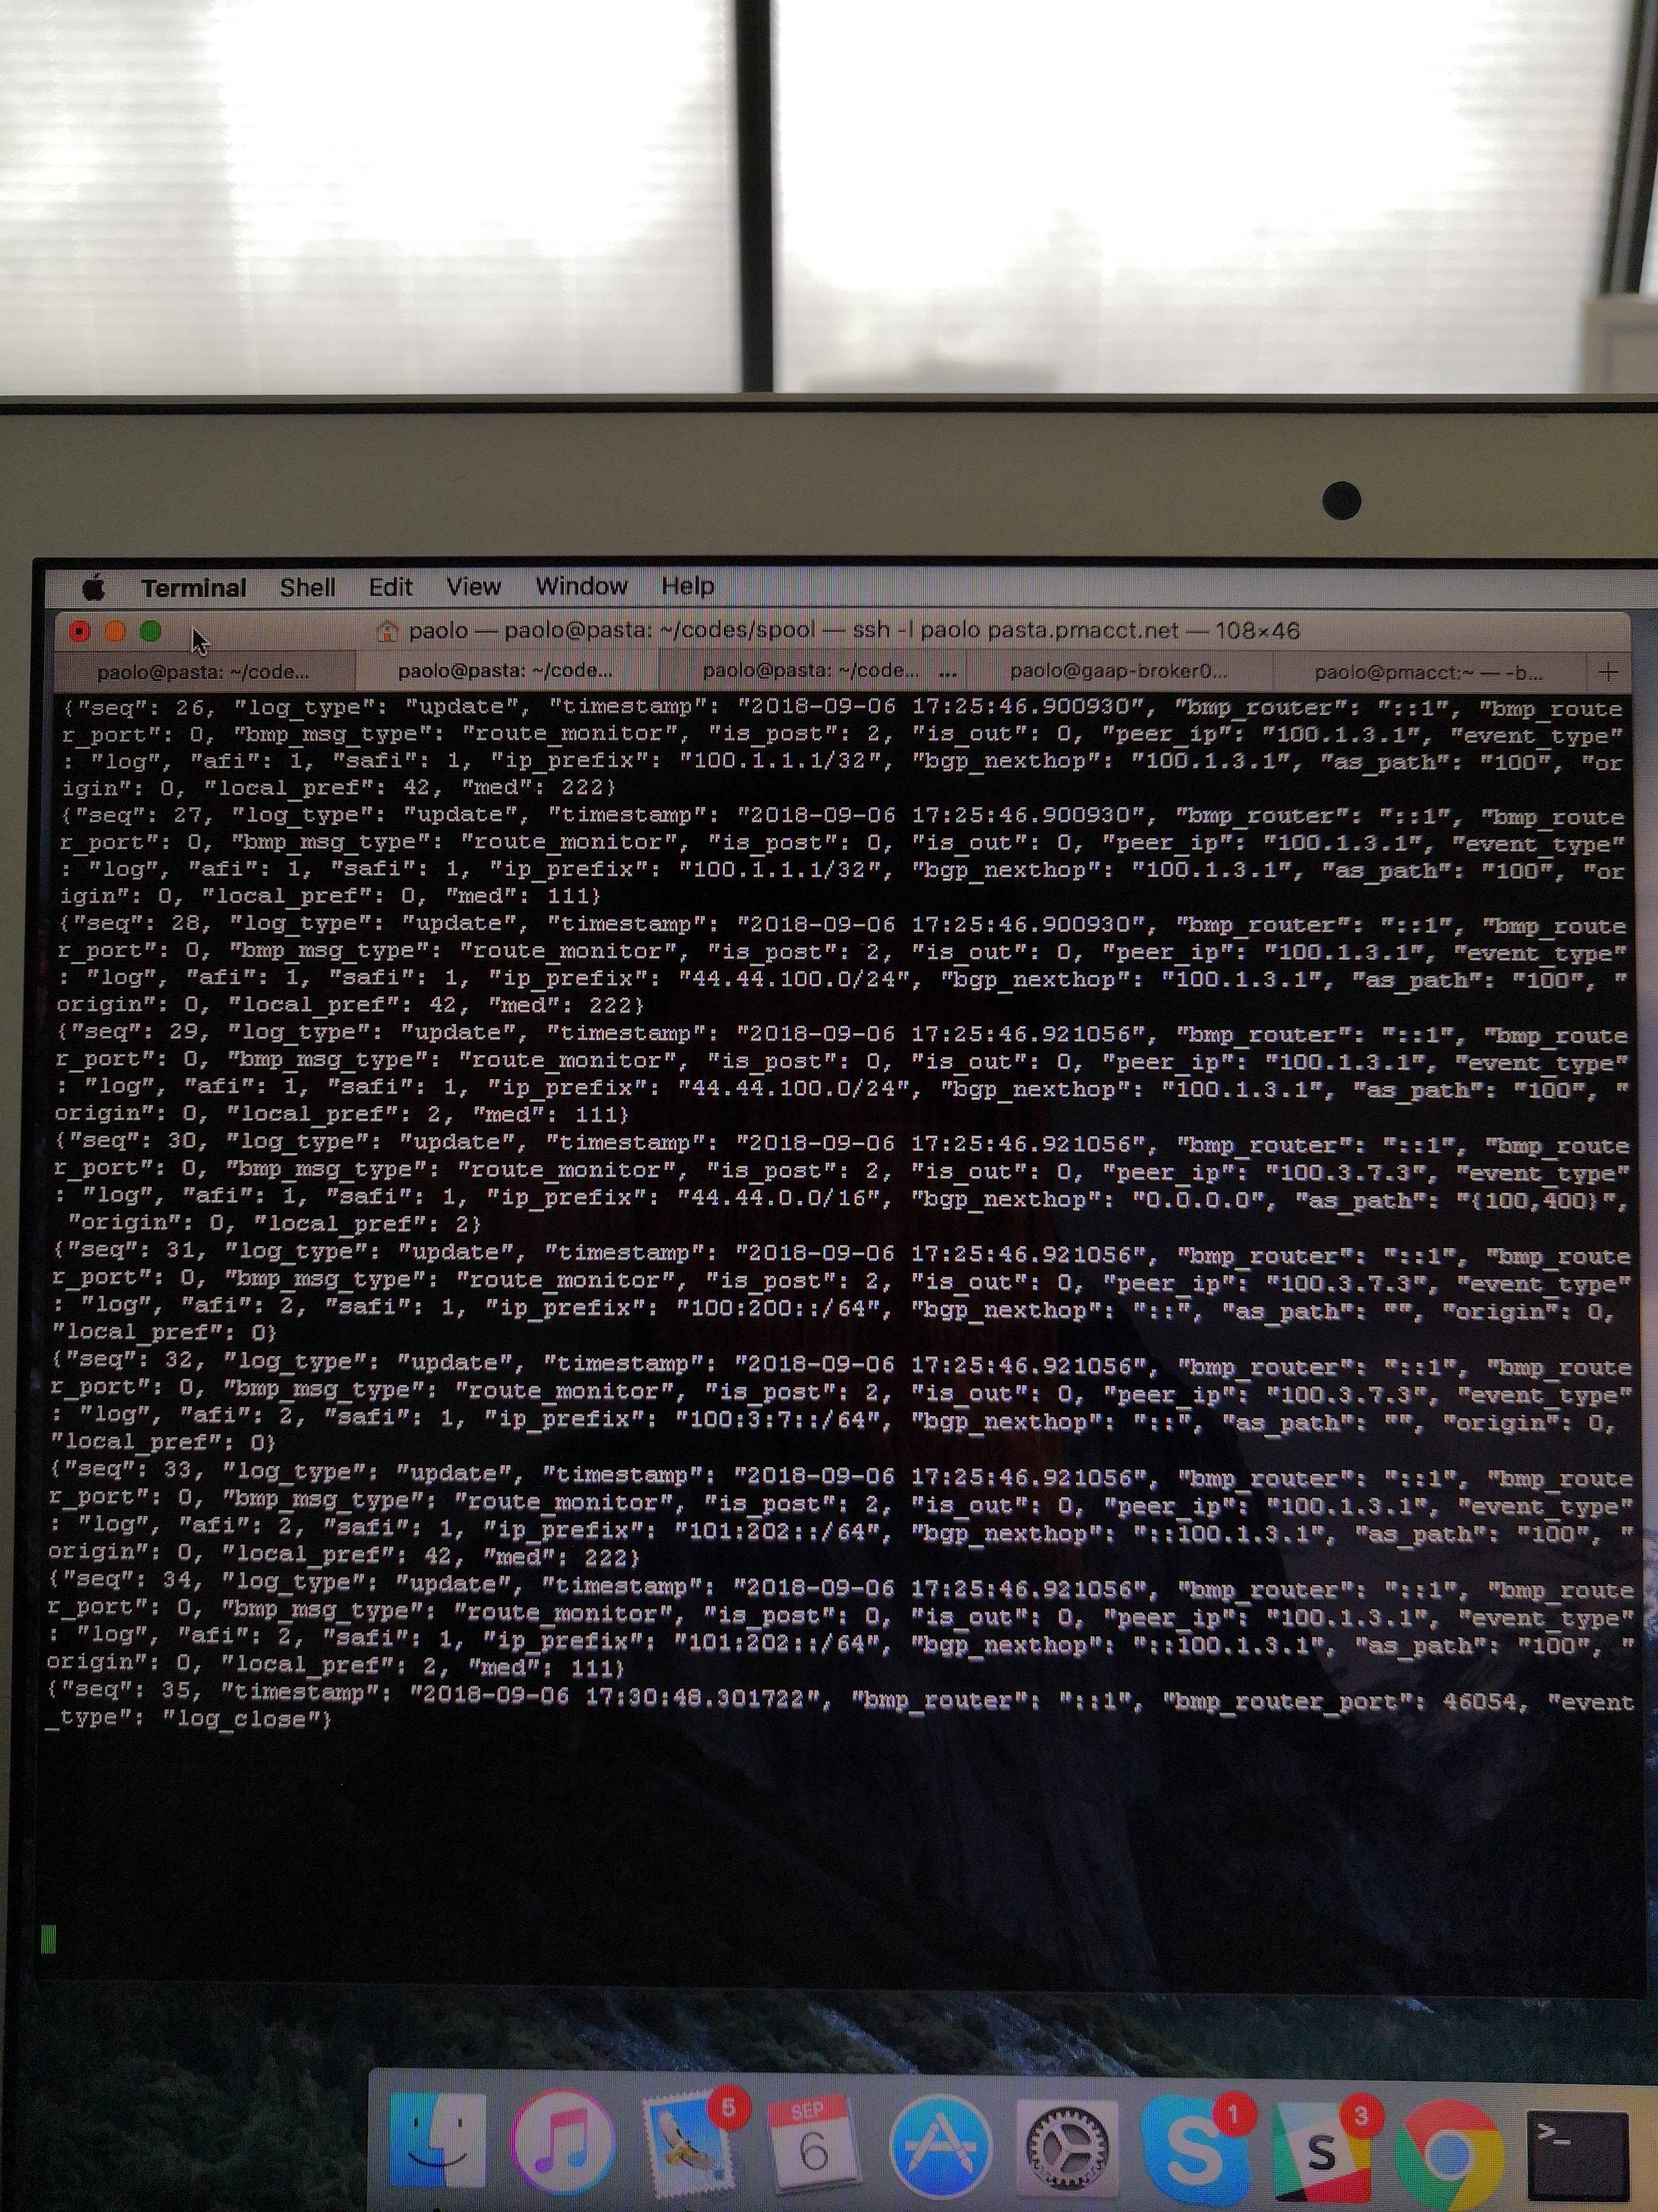
Empty

Slide 29

Paolo’s lunch

