Slide 1

SSID: Ocom – Public
Pass: wirelessinternet
http://nlnog.net/livestream

Slide 2

Een Stichting NLNOG event!

Slide 3
Bedankt!
Maxitel Telecom
Crossivity
LeaseWeb
BIT
Quanza Engineering
V.R.I.S
eBay Classifieds Group
RIPE NCC
NTT Communications
AMS-IX
NLNet Foundation
6connect
PCextreme
Fusix Networks
Triple-IT
Prefix Broker

Slide 4
Toiletten
De trap af, naar rechts, en dan aan de linker kant “HEREN” en “DAMES” op de deur
Leaseweb’s Gastvrijheid
Is beperkt tot de begane grond, de rookruimte buiten en deze eerste verdieping! Draag overal je badge.

Slide 5
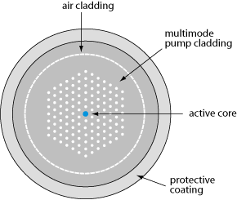
Did “pay what you want” work out?
Pretty good!
82 UTP, 11 MMF, 7 SMF, 2 photonic-crystal
~ 1500 euro
“Photonic-crystal fiber (PCF) is a new class of optical fiber based on the properties of photonic crystals. Because of its ability to confine light in hollow cores or with confinement characteristics not possible in conventional optical fiber.”

Slide 6
Schedule
09:00 – 09:30 Registration & Welcome
09:30 – 10:00 The State of Mobile Satellite Internet Niels Raijer (Fusix Networks)
10:00 – 10:30 Abuse.io – OSS abuse management for netops Bart Vrancken (Abuse.io/BIT)
10:30 – 11:00 Privacy and Security in the DNS Peter van Dijk (PowerDNS)
11:00 – 11:30 Coffee break
11:30 – 12:00 No More Free Bugs: 0-days & New Markets C. Ottow (Pine Digital Security)
12:00 – 12:30 NIPAP – the best IP address management system Kristian Larsson (NIPAP/DT)
12:30 – 14:00 Lunch!
14:00 – 14:30 Out of the data center: tales from the …. Bert Hubert (Open-Xchange)
14:30 – 15:00 A Buyers Guide to Solid State Drives M. van Smoorenburg (XS4ALL)
15:00 – 15:15 Stiching NLNOG update T. de Looff (Stichting NLNOG)
15:15 – 16:00 Coffee break #2
16:00 – 16:10 Ultra Fast DDoS detection at Coloclue Job Snijders (Coloclue)
16:10 – 16:30 DDoS detection & mitigation Thomas de Looff (PCextreme)
16:30 – 17:15 The Infamous NLNOG Quiz Job Snijders., Peter van Dijk
17:15 – 17:30 Closing Nathalie Kunneke-Trenaman
17:30 – 22:00 Drinks, food & laughter Everyone

Slide 7
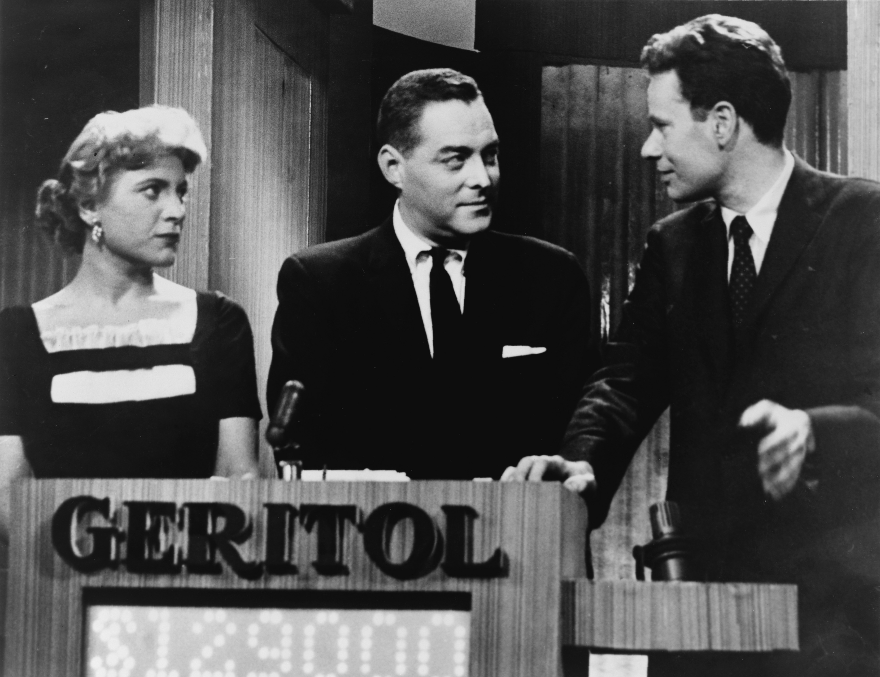
QUIZ?!?!

Slide 8
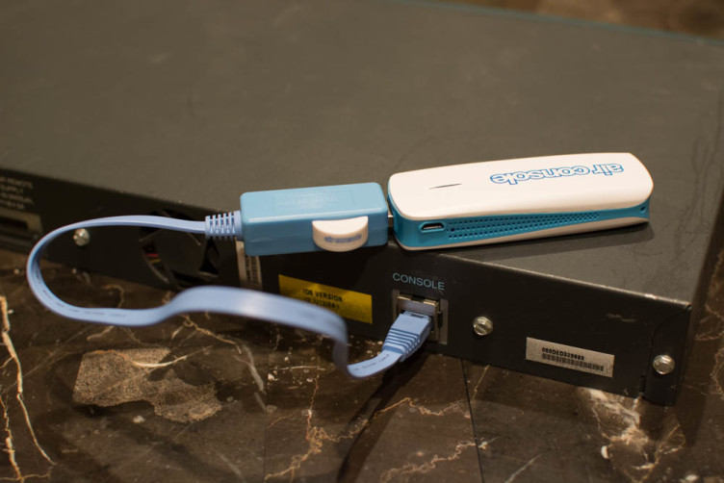
Second Prize! (thanks Fusix Networks!) AirConsole Pro

Slide 9
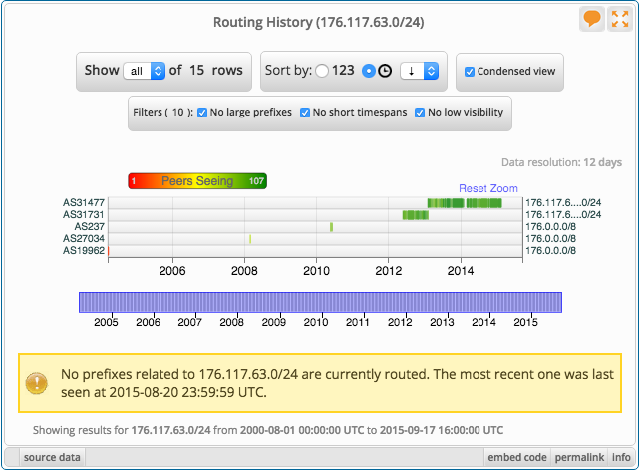
First Prize! (thanks Prefix Broker!) Globally unique IPv4 /24 PI block

Slide 10
SSID: Ocom – Public
Pass: wirelessinternet
http://nlnog.net/livestream

