Slide 1
Ultra fast DDoS Detection with FastNetMon at Coloclue (AS 8283)
Job Snijders
job@instituut.et

Slide 2
What who where how?
Coloclue non-profit 100% volunteer driven ISP
2 datacenters
4 routers
100 members
< 100mbit/sec total traffic
Received 2 DDoS attacks in the last year

Slide 3
Coloclue AS 8283
(TRUE) (ATOM86)
\ / \---+
[eun1]* * * * *[dcg2]
EUN _---/ * * \___ DCG
members `_ * * ,----` members
`\-[eun2] [dcg1]
/ | | |
(HIBERNIA) | \--+ |
(FIBERRING) | \
(AMS-IX) (NL-IX)
\ /
\__(BIT)_/

Slide 4
I got tired of it after second attack, decided to automate the problem away:
Ingredients: FastNetMon, BIRD & shellscripts
Detection within 3 seconds
Mitigation selective blackholing: 1 second
100% automated
???
Non-profit ;-)

Slide 5

Solving a DDoS problem in 4 seconds!!

Slide 6
Circle of life
DDoS
attack happening
Packets come in on eun-2 router
Fastnetmon triggers
BIRD injects routes to Hibernia
Wait 60 seconds
Withdraw selective blackhole routes

Slide 7
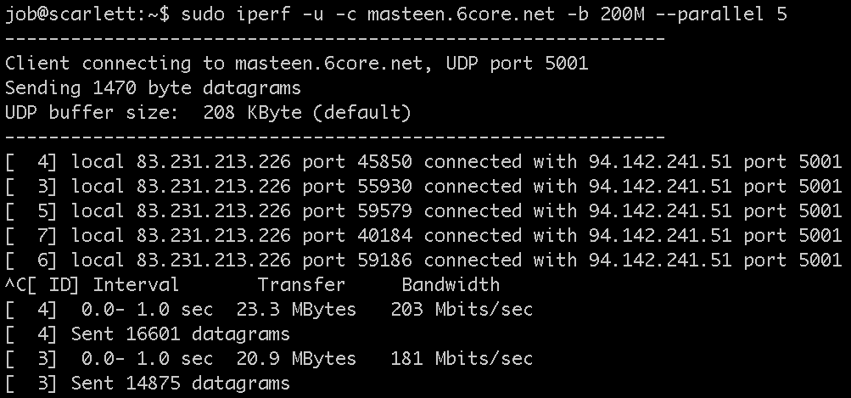
Launch a DDoS (iperf)

Slide 8
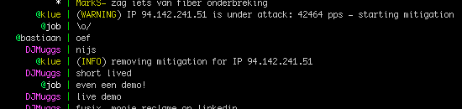
Immediate IRC notification in #coloclue

Slide 9
FastNetMon?
A high performance DoS/DDoS load analyzer built on top of multiple packet capture engines:
NetFlow v5, v9
IPFIX
sFLOW v5
Port mirror/SPAN capture with PF_RING (with ZC/DNA mode support need license), NETMAP and PCAP

Slide 10
Fastnetmon config
^{average_calculation_time = 5}
average_calculation_time_for_subnets = 20
ban_details_records_count = 100
^{ban_for_bandwidth = on}
^{ban_for_flows = off}
^{ban_for_pps = off}
^{ban_time = 60}
^{check_period = 1}
^{enable_ban = on}
enable_connection_tracking = off
^{enable_pf_ring_zc_mode = off}
^{enable_subnet_counters = off}
interfaces = p1p2,p2p1,p2p2.1003
^{max_ips_in_list = 10}
^{mirror_netmap = off}
^{mirror = on}
monitor_local_ip_addresses = on
networks_list_path = /etc/networks_list
notify_script_path = /usr/local/bin/notify_about_attack.sh
^{process_incoming_traffic = on}
^{process_outgoing_traffic = off}
^{sort_parameter = bytes}
^{threshold_flows = 3500}
^{threshold_mbps = 400}
^{threshold_pps = 20000}
white_list_path = /etc/networks_whitelist
/etc/networks_list:
94.142.240.0/21
185.52.224.0/22
195.72.124.0/22

Slide 11
“deal with it”
root@eunetworks-2:~# cat /usr/local/bin/notify_about_attack.sh | grep -v \#
email_notify=routers@coloclue.net
^{if [ "$4" = "unban" ]; then}
rm /etc/bird/blackholes/${1}.ipv4.conf
^{birdc configure}
echo "(INFO) removing mitigation for IP $1" | /usr/local/bin/klue.pl
^{exit 0}
^{fi}
^{if [ "$4" = "ban" ]; then}
cat | mail -s "FastNetMon: IP $1 blocked: ^{$2,} ^{$3 pps attack" $email_notify;}
cat << EOF > /etc/bird/blackholes/${1}.ipv4.conf
^{route ${1}/32 via "lo";}
route $(echo ${1} | sed 's/\.[0-9]*$/.0\/24/') via "lo";
^{EOF}
^{birdc configure}
echo "(WARNING) IP $1 is under attack: $3 pps - starting mitigation" | /usr/local/bin/klue.pl
^{exit 0}
^{fi}
if [ "$4" == "attack_details" ]; then
cat | mail -s "FastNetMon Guard: IP $1 blocked because $2 attack with power $3 pps" $email_notify;
^{fi}

Slide 12
Injecting into BIRD
# in /etc/bird/bird.conf
protocol static blackhole1 {
include "/etc/bird/blackholes/*.ipv4.conf";
}
template bgp ibgp { .. } # don’t tell iBGP neighbors about blackholes
protocol kernel { .. } # don’t push blackholes into FIB
…
export filter {
if proto = "blackhole1" then reject;
accept;
};
….
root@eunetworks-2:/etc/bird/blackholes# cat 1.ipv4.conf
route 94.142.241.51/32 via "lo"; # victim IP address
route 94.142.241.0/24 via "lo"; # draw traffic

Slide 13
filter ebgp_export_hibernia {
if ( is_coloclue_supernet() ) then {
accept; # coloclue space
}
else if ( (8283,2) ~ bgp_community ) then {
accept; # customer routes
}
else if proto = "blackhole1" then {
if (net.len = 32 && is_coloclue_more_specific()) then {
# selective blackhole - discard outside 1000km
bgp_community.add((5580,663));
accept;
}
else if ( net.len = 24 && is_coloclue_more_specific() ) then {
accept;
}
reject;
}
reject;
}

Slide 14
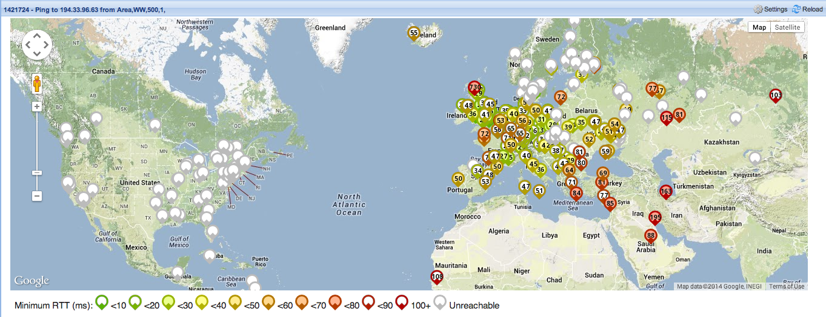
Selective blackholing effect:
Discard outside 1000 KM radius
Customer connects in Amsterdam, Netherlands
White dot means traffic cannot reach destination
Colored dot implies reachability

Slide 15
Tools
BIRD (for BGP) - http://bird.network.cz/
FastNetMon - https://github.com/FastVPSEestiOu/fastnetmon
&&
http://fastvpseestiou.github.io/fastnetmon/

Slide 16

Questions?

