Slide 1
A look at the state of mobile satellite Internet
Niels Raijer, Fusix Networks BV
NLNOG Day 2015

Slide 2
Who Am I
Owner & chief architect @ Fusix Networks
Providing networking services to those companies that need to speak BGP but don’t know how
Vice president @ NLNOG
Founder @ Coloclue
Actually M.Sc. Chem.Eng., but 1996 USENET & Linux dragged me into the world of IP
Notes:
Doing mobile satellite since 2006

Slide 3
Purpose of this talk
Make you aware of what some networks do with your beautiful content and why
Highlight some differences of mobile satellite networks as compared to regular ISPs
Ask for possible improvements – what else can we do to improve our customer experience (apart from requesting an upgrade to the speed of light)?

Slide 4
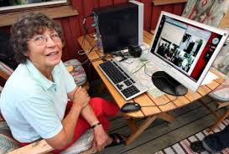
Your world
People’s mothers
have 40G Internet
at home

Slide 5
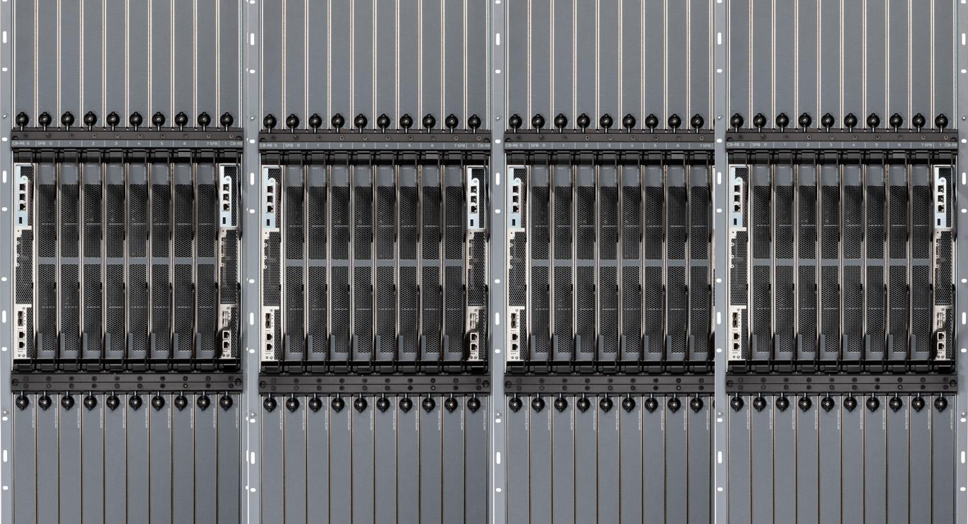
Your world
Juniper MX8080

Slide 6
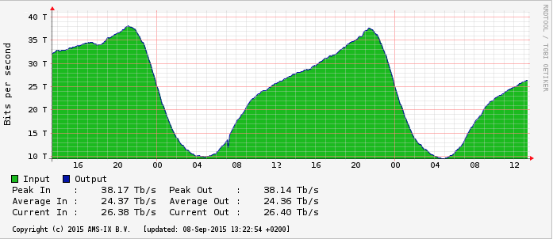
Your world
Ever-increasing
bandwidth graphs

Slide 7
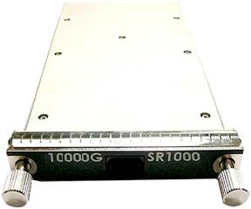
Your world
Fiber optics
that defy
Shannon’s law

Slide 8
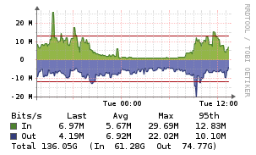
My world
A look at our AMS-IX port

Slide 9
My world
niels@core1.ams1> ping X.Y.Z.157 count 10
PING X.Y.Z.157 (X.Y.Z.157): 56 data bytes
64 bytes from X.Y.Z.157: icmp_seq=0 ttl=61 time=1644.416 ms
64 bytes from X.Y.Z.157: icmp_seq=1 ttl=61 time=845.648 ms
64 bytes from X.Y.Z.157: icmp_seq=2 ttl=61 time=802.387 ms
64 bytes from X.Y.Z.157: icmp_seq=3 ttl=61 time=1450.196 ms
64 bytes from X.Y.Z.157: icmp_seq=4 ttl=61 time=927.581 ms
64 bytes from X.Y.Z.157: icmp_seq=5 ttl=61 time=935.401 ms
64 bytes from X.Y.Z.157: icmp_seq=6 ttl=61 time=1005.581 ms
64 bytes from X.Y.Z.157: icmp_seq=7 ttl=61 time=971.354 ms
64 bytes from X.Y.Z.157: icmp_seq=8 ttl=61 time=817.182 ms
64 bytes from X.Y.Z.157: icmp_seq=9 ttl=61 time=1003.482 ms
--- X.Y.Z.157 ping statistics ---
10 packets transmitted, 10 packets received, 0% packet loss
round-trip min/avg/max/stddev = 802.387/1040.323/1644.416/266.133 ms

Slide 10
Mobile satellite
Our customers are typically Inmarsat Distribution Partners
This service is not very high speed & has a huge latency
But it works absolutely anywhere (OK, not if you are almost exactly on one of the poles)
So yes – the service sucks. But it is all they have
Traffic cost: multiple dollars per megabyte transferred
Notes:
There are more mobile satellite providers, such as Iridium, but we will focus on Inmarsat.

Slide 11
Inmarsat BGAN
BGAN = Broadband Global Area Network
Three flavors: land (=BGAN), maritime (=FBB), aero (=SBB)
Broadband = up to 492 kbit/s up & down
3G network – DPs have an APN with their own RADIUS servers for address assignment, traffic delivered from Inmarsat GGSN via IPSec tunnel
Uses L-band frequencies (= 1 – 2 GHz)
IPv6: No. IPv6. (Outside the lab, that is.)

Slide 12
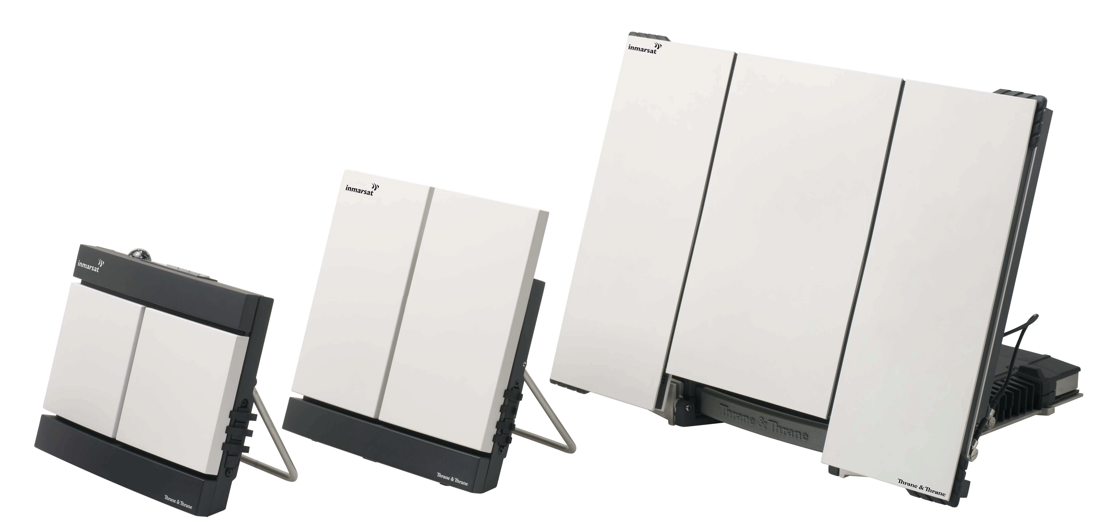
BGAN terminals
The end user equipment (User Terminal or UT) differs in size and shape depending on:
  Speed required (higher speeds need bigger antennae)
  Type of service
    BGAN = book-sized terminal that needs to be aimed at the satellite
    FBB = dome antenna with auto-aiming plus below decks equipment (BDE)
    SBB = omnidirectional antenna plus Line Replaceable Unit (LRU)

Slide 13
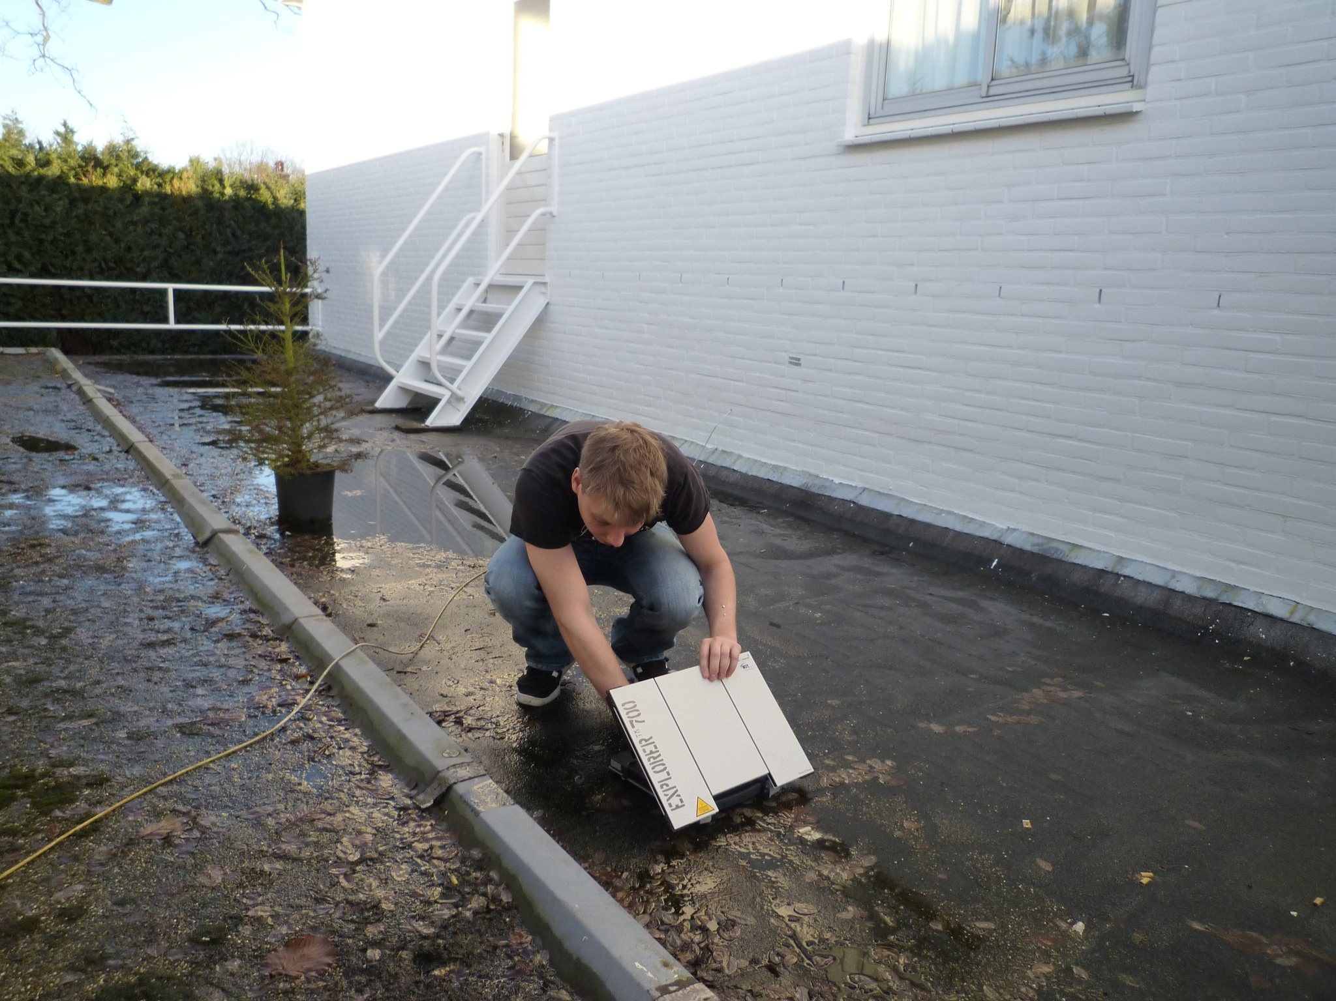

Slide 14
Inmarsat Global Express
Global Express is deployed as we speak
Speeds up to tens of megabits per second
Ethernet network with service delivery inside VLANs and routed subnets announced via BGP
Uses Ka-band frequencies (20 – 30 GHz). Sensitive to rain fade, uses BGAN as backup
IPv6: Yes. Or. Wait what? (Not even in the lab yet.)

Slide 15
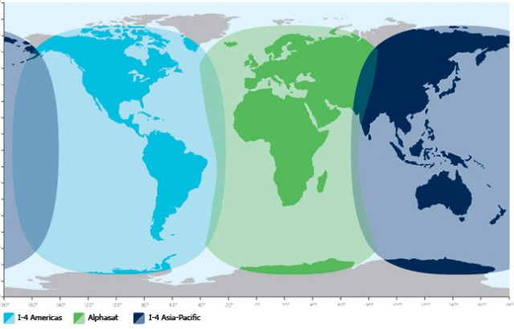
Geostationary
Both services use geostationary satellites
Satellites don’t seem to move when viewed from the earth
Explains non-coverage on the poles
Explains latency (36,000 km above equator)

Slide 16
Some of the typical stuff

Slide 17
General satellite pitfalls
Satellite people don’t have an IP background
Even today, services are still being sold that require ISDN dialup out of the LES instead of connecting to the Internet
Explaining what you need in order to run an IP network is difficult (24/7 NOC, abuse handling, data retention laws etc.)
Ecosystem developed of companies offering IP-based services as an alternative to satellite provider’s own service – not everyone expected that
Yes – even VOIP

Slide 18
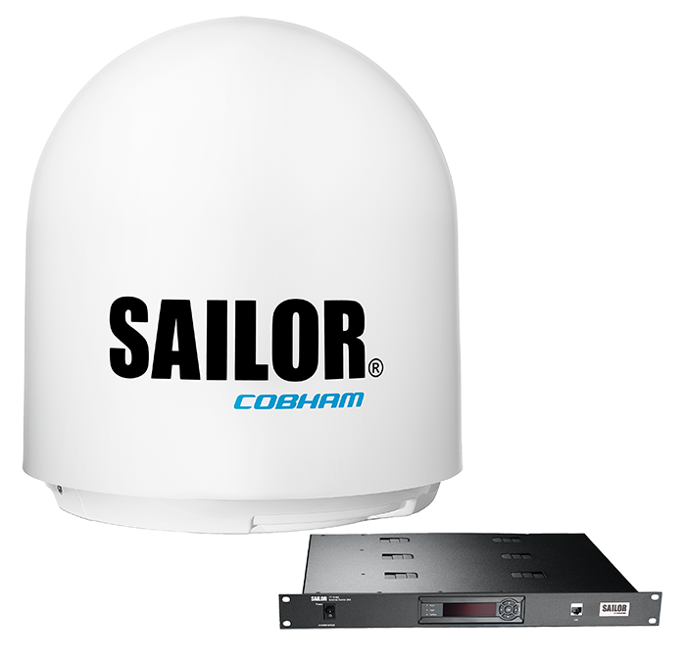
Maritime pitfalls
Vessel is usually away for months
Possibility to install / fix things when in port (which is short)
Captain’s job is to sail the vessel, not to fix his computer
Telephone calls are difficult and expensive

Slide 19
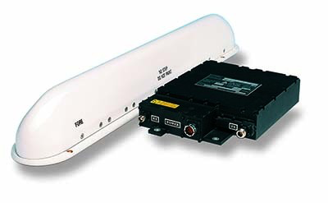
Aero pitfalls
In the private aircraft segment, the service just always has to work – you cannot predict when the user (presidents, sheiks) will need it
However, the aircraft is usually easily reachable for installations / fixes
VVIPs (= aircraft owners) expect to be able to walk on board and have everything just work, including phone calls, software updates, etc.

Slide 20
Unwanted traffic
Traffic is expensive, so end users will always try to reduce their bill
“I did not ask for that traffic” in case a user was pinged from outside
“No way that my computer sent all that traffic” in case a system is compromised
The more insight you give, the more the end user can ask for credit notes
Land-based firewall can block traffic to the customer
Land-based firewall can block traffic from the customer, but only on the land-based segment

Slide 21
Infected systems
Systems on board of a vessel are usually not near “normal” Internet for months
Software updates are not carried out while crew is at sea
Catch some infections via DNS but trying to find the actual end user (behind double NAT in many cases) is extremely difficult
09:41:58.990810 IP (tos 0x0, ttl 124, id 3950, offset 0, flags [none], proto UDP (17), length 61)
10.11.71.218.6014 > X.Y.Z.35.53: [udp sum ok] 55654+ A? hzmksreiuojy.nl. (33)
09:41:58.990857 IP (tos 0x0, ttl 64, id 40271, offset 0, flags [none], proto UDP (17), length 77)
X.Y.Z.35.53 > 10.11.71.218.6014: [bad udp cksum db8e!] 55654 q: A? hzmksreiuojy.nl.
1/0/0 hzmksreiuojy.nl. [40m9s] A 176.58.104.168 (49)
Notes:
176.58.104.168 = sinkhole.sidnlabs.nl

Slide 22
On-board firewall
In aero, there is usually a firewall on board
In maritime, traditionally there wasn’t (cost reasons) but this is slowly changing
The on-board firewall usually also contains a proxy / web cache / voucher system for crew welfare
With an on-board firewall, most of the “Unwanted Traffic Problem” is resolved

Slide 23
Geolocation
Service is absolutely, truly global after implementation of “Global IP”
Customer /32 moves with the customer using BGP
“I want a US-based IP address”
Google shows up in a completely random language

Slide 24
Acceleration & compression
TCP tweaks possible, TCP Accelerator service recommended to customers (splits the TCP connection in two)
Commercial products offer further acceleration and compression service
There are also web-mail like products that offer to view only the “headers”
And there are proxies that downsample images and block movies in order to save on data usage

Slide 25
Forced routing
Some countries require that traffic that originates from / is destined for end users in their territory, lands on an LES in their territory (USA)
Other countries require that traffic is routed through their country for inspection (Russia, China, Australia) – adds significantly to the latency
Others just require a copy of the traffic

Slide 26
Future developments

Slide 27
Developments
More and more content-based firewalling (necessary in order to be able to block Skype)
Content-based firewalls offering more and more reporting features (so customers can request more and more credit notes)
More forced routing countries
In GX, routed subnets allow much better abuse handling
Higher speeds despite physics
What further improvements are possible?

Slide 28
Conclusion
Mobile satellite Internet service is an “if it’s all that you have” proposition
Mobile satellite ISPs are still getting used to the idea of IP networking
End users are very hard to support properly
All kinds of services are deployed that ruin your beautiful content in order to keep speed up and cost low
The law has a thing or two to say, too

Slide 29
Thank you
niels@fusix.nl

