Slide 1
Escape from the data center
Lessons from a recovering manager
http://tinyurl.com/nlnog2015

Slide 2
The issue
In short, management thinks you are one or probably more of the following:
Unreliable
A lying bastard
Rude
Smelly
Dangerous

Slide 3
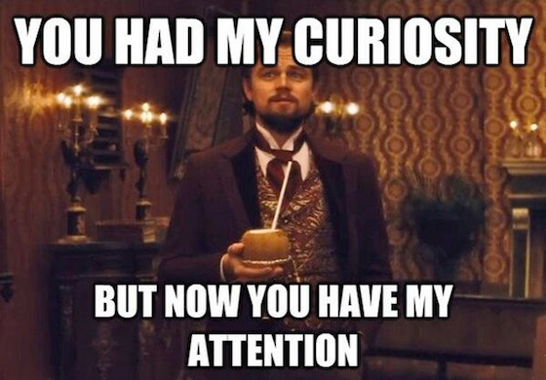

Slide 4
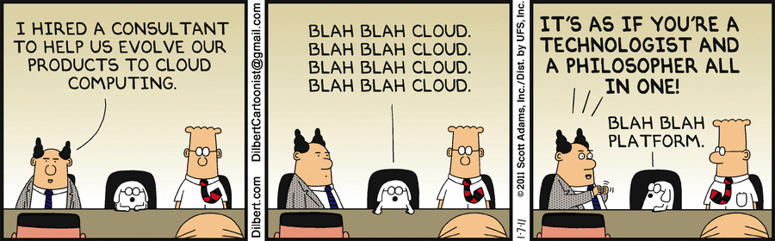

Slide 5

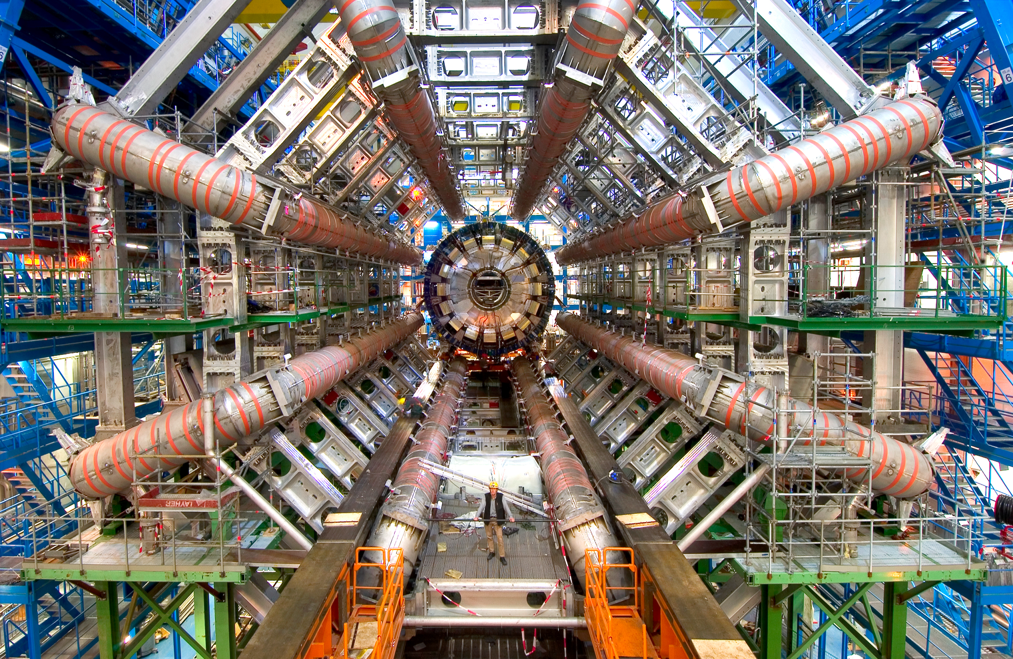
What they did in school / What you did

Slide 6

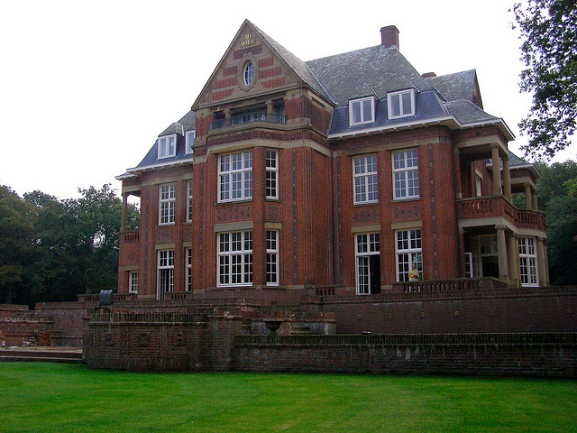



Slide 7


Their evening / Your evening

Slide 8









Notes:
Outline - thank you for inviting me, true honor - we NEED you

Slide 9

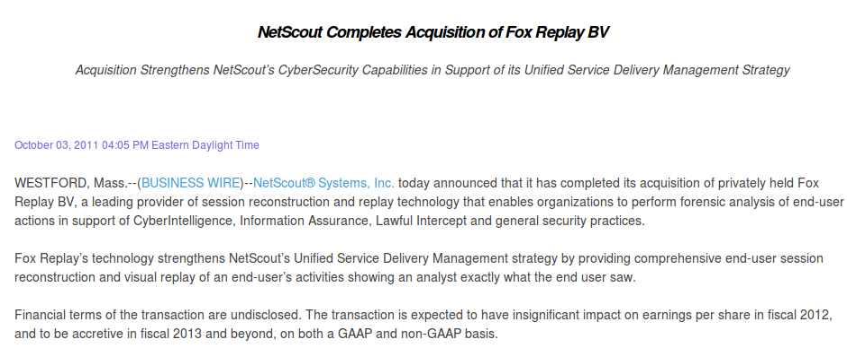

Slide 12
Actual code
I am here
Management,
Sales,
Marketing
Time

Slide 13
The issue
In short, management thinks you are one or probably more of the following:
Unreliable
A lying bastard
Rude
Smelly
Dangerous

Slide 14
Symptoms
My management buys million dollar stuff I could build as a shell script
Management team trusts vendor advertising more than they trust me
There is a push to outsource my department to people 10000km away???
Marketing/sales keeps trying to sell impossible things, why don’t they ask me?

Slide 15
Two possible diagnoses
My management is completely stupid and consists of idiots
Perhaps we as geeks did something wrong
I’m pretty sure it is more 2 than 1.

Slide 16
Mistakes we make
We need directl communications. We are not good with hints
  “don’t give me hints, give me requirements!”
Management layer is very good reading hints. They can see from your face that you think they are stupid.
They do communicate with hints, which we do not pick up!

Slide 17
Typical conversation
Management: “I discussed it with the techies and implied we were very unhappy with the user experience”
Techies: “Dunno, he had a long story about someone that said he saw a blank screen. I heard nothing we could work on”

Slide 18
THE VERY WORST MISTAKE WE MAKE
If you’ve ever said this, or know someone who said this: beat yourself up or your coworker
  Call me if you need help
Manager: long string of inane requirements
Techie: well you should not be wanting this anyhow
  The “Debian” or OpenBSD approach

Slide 19


Slide 20
Another big mistake: undesirable versus “impossible”
“They want us to use NAT on IPv4 instead of migrating to IPv6”
“$@#$@#%$”
“Ok, just tell them that it is impossible. Say the state is too much to keep track of”
…
Manager walks in with CGNAT sales guy & PoC you have to do

Slide 21
Everyone has sent this email. Don’t.
Project is going from bad to worse, bad decision after bad decision is taken
I CANNAE TAKE IT NO MORE
Send out 5 page email listing every mistake that has been made on the project
  Including dates at which you sent email predicting for each of them what would break
What did you expect? Thanks?!
Pro-tip: write the email, don’t send it

Slide 22

"Geordi La Forge: Yeah, well, I told the Captain I'd have this analysis done in an hour.
Scotty: How long will it really take?
Geordi La Forge: An hour!
Scotty: Oh, you didn't tell him how long it would *really* take, did ya?
Geordi La Forge: Well, of course I did.
Scotty: Oh, laddie. You've got a lot to learn if you want people to think of you as a miracle worker!"

Slide 23
Time/project management
The less a company understands what you are doing, the more tightly they want to manage it, including timing
“How many hours for multithreading the server?”
  http://bert-hubert.blogspot.nl/2014/02/how-many-hours-for-multithreading.html
In short - be smart about this. Do not pad or sandbag. Not wanting != will take months.

Slide 24
We actually do not communicate directly
Many examples:
  Guy X is an asshat and wrecks the team
  Everyone assumes management knows
    They don’t
Management decides to assign a single /128 to each subscriber
  Because we never told them how IPv6 works, assumed they already knew or would not understand anyhow (?!)

Slide 25
Judging books by their covers
Or… projects by their URL.
http://www.somebank.com/login.php3
  JESUS NO PLEASE NO
http://www.sourceforge.com/downloads/security-firewall.zip
  GO AWAY NOT CLICKING ON THAT. EVER.
.. does big presentation full of spelling errors, unreadable slides, t-shirt with holes

Slide 26
Big & growing gap
This situation is bad and getting worse
Outsourcing, offshoring & moving to the cloud means managers can be less and less technical.
And as we geeks get older, we frequently become even more hardcore in our beliefs
This can only end badly.

Slide 27
So.. all our fault?
No. Management frequently actually is not that smart or at least highly undereducated
But since they are with more and get valued better, it is up to us to change the situation
Be trustworthy partner, start educating people, be transparent about ‘do not want’ versus ‘will take long time’
Give suits some credit and they might return it!

Slide 28
Further reading
http://bert-hubert.blogspot.nl/2014/04/seen-that-sketch-expert-well-i-blame.html
http://bert-hubert.blogspot.nl/2014/02/how-many-hours-for-multithreading.html
http://tinyurl.com/nlnog2015

