Slide 1
SQA
RING: Network debugging never was easier
SQA: Blazing fast partial outage detection
Job Snijders
job@ntt.net

Slide 2
Agenda
How the RING came to be
Current state of the RING
RING SQA
What is it?
How to use it?
Invitation to join the RING

Slide 3
So, what’s this RING thing?
Metaphysical definition:
“Awesome network debugging platform”
Foundation:
Trust – I trust you with access to my resources, as you trust me with access to your resources

Slide 4
Participants from all walks of life, a random selection

Slide 5
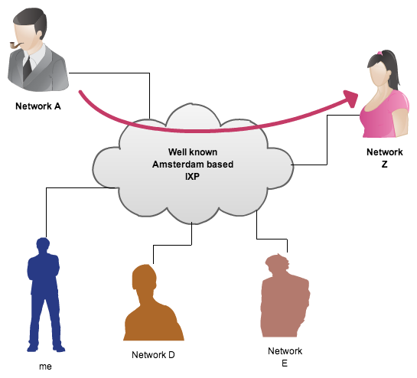
How did it start? (1/2)
In December 2010 a friend of mine had some
src/dst IP related problems

Slide 6
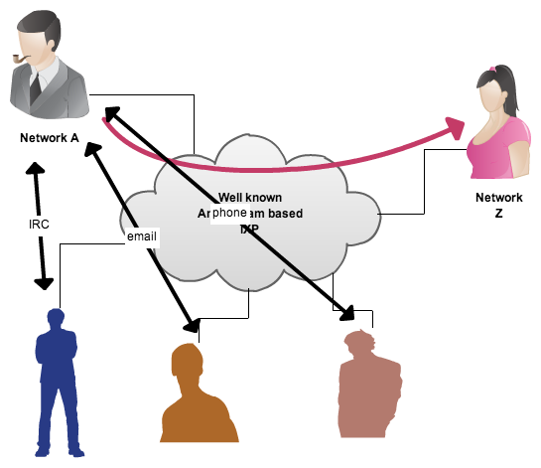
How did it start? (2/2)
He asked for help (pingsweep, traceroute, etc),
but this took time…

Slide 8
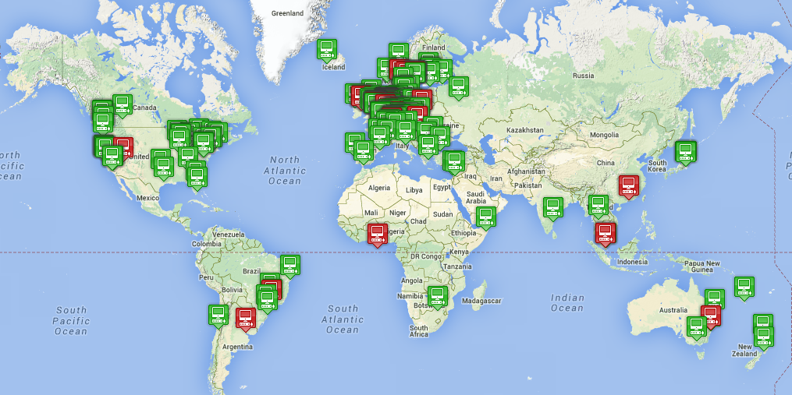
State of the RING – Sep ‘15
388 nodes | 46 countries
346 Autonomous Systems | Still growing!
November 2014

Slide 9
Other CLI uses
Use dig to check nameservers from 300 ASNs
Traceroute from 300+ nodes to your target
MTU testing between you and others
Port scanning
Debug L2/L3 load balancing issues
Anything!

Slide 10
RING SQA
A new partial outage detector dubbed “RING SQA” is available to all RING participants. The purpose of the tool is to detect outages as fast as possible that only affect a subset of all internet destinations.
(btw, nobody knows what SQA means… )

Slide 11
RING SQA high level
Detect outage
magic pixie dust
Really fast
Collect data
Emit alert! ALARMA! Sev 0! PANIC
Email / udp / execute shell script

Slide 12
How?
RING SQA probes all other nodes (v4 + v6) every 30 seconds to derive a baseline, this baseline is compared to the last 3 minutes of measurements.
If the median of the baseline is tripped for three consecutives minutes, an alarm is raised.

Slide 13
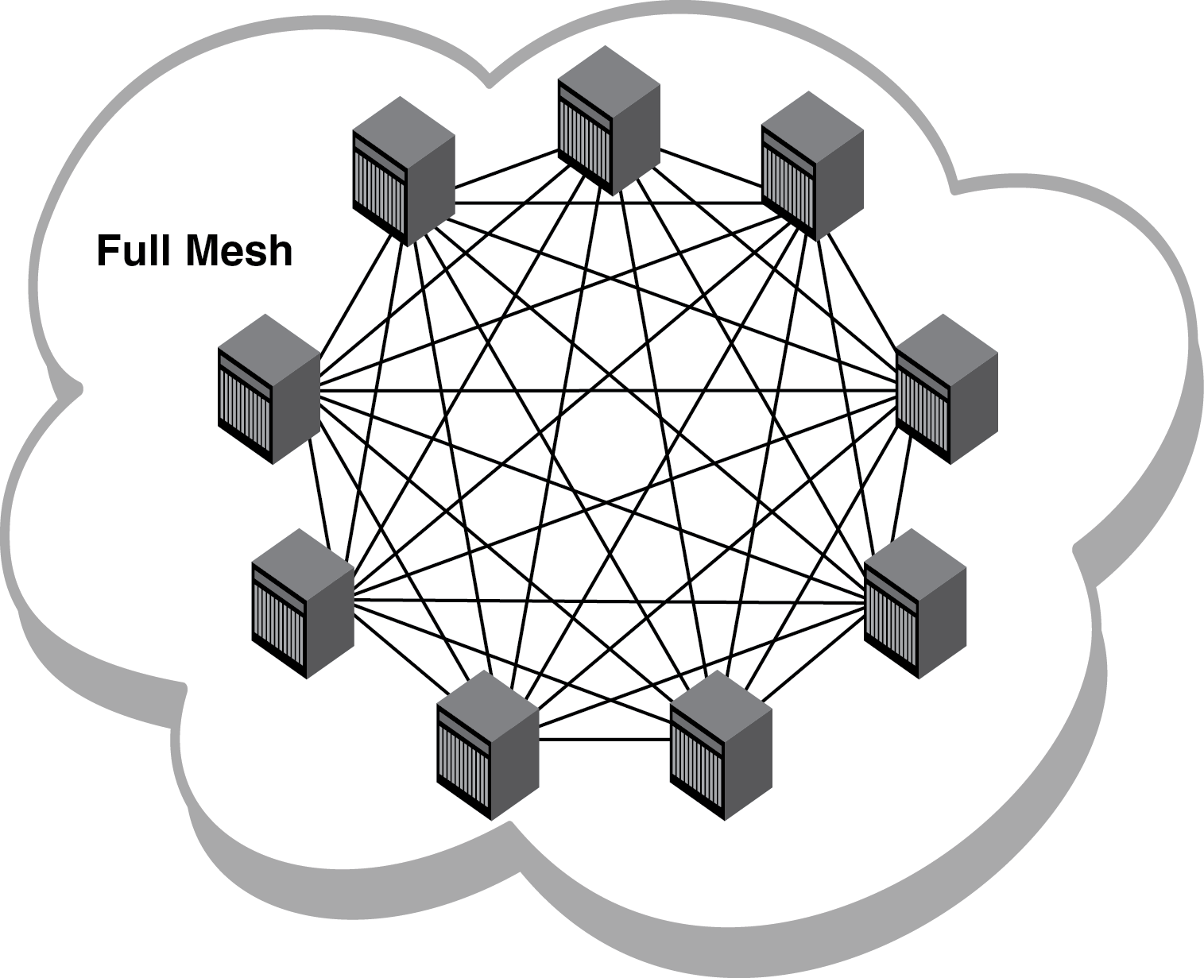
ANY TO ANY PROBING BABY!!!

Slide 14
Then what?
When an alarm is raised, three MTRs are immediately launched towards destinations that previously were reachable, but suddenly not anymore. The purpose of these traces is to provide an investigation starting point for your NOC.
All in all super fast outage detection. All participants are invited to use this system! Gratis! :-)

Slide 15
Nobody else offers this for free

Slide 16
From: sqa@companyname01.ring.nlnog.net
To: noc@ring_participating_company.org
Subject: RING ALERT raising ipv4 alarm - 16 new nodes down
Body:
Regarding: companyname01.ring.nlnog.net ipv4
This is an automated alert from the distributed partial outage
monitoring system "RING SQA".
At 2014-07-27 10:18:05 UTC the following measurements were analysed
as indicating that there is a high probability your NLNOG RING node
cannot reach the entire internet. Possible causes could be an outage
in your upstream's or peer's network.
The following nodes previously were reachable, but became unreachable
over the course of the last 3 minutes:
- itps01.ring.nlnog.net 128.65.97.93 AS42010 GB
- fullsave01.ring.nlnog.net 141.0.202.201 AS39405 FR
- globalaxs01.ring.nlnog.net 176.10.80.10 AS 9009 GB
- kwaoo01.ring.nlnog.net 178.250.209.33 AS24904 CH
- suretec01.ring.nlnog.net 185.8.92.17 AS199659 GB
swisscom01.ring.nlnog.net 193.247.170.254 AS 3303 CH
<snip>

Slide 17
As a debug starting point 3 traceroutes were launched right after
detecting the event, they might assist in pinpointing what broke:
trueinternet01.ring.nlnog.net AS 7470 (TH)
mtr -i0.5 -c5 -r -w -n 203.144.167.57
1.|-- 109.233.156.241 0.0% 6 0.5 0.5 0.5 0.6 0.0
2.|-- 109.233.156.1 0.0% 5 0.8 0.9 0.8 1.1 0.1
3.|-- 109.233.156.2 0.0% 5 0.8 0.8 0.8 0.9 0.0
4.|-- 64.209.88.33 0.0% 5 0.9 1.0 0.9 1.5 0.3
5.|-- 159.63.23.198 60.0% 5 265.1 264.9 264.7 265.1 0.3
6.|-- ??? 100.0 5 0.0 0.0 0.0 0.0 0.0
7.|-- ??? 100.0 5 0.0 0.0 0.0 0.0 0.0
8.|-- ??? 100.0 5 0.0 0.0 0.0 0.0 0.0
9.|-- ??? 100.0 5 0.0 0.0 0.0 0.0 0.0
10.|-- ??? 100.0 5 0.0 0.0 0.0 0.0 0.0
11.|-- 203.144.144.30 80.0% 5 297.4 297.4 297.4 297.4 0.0
12.|-- ??? 100.0 4 0.0 0.0 0.0 0.0 0.0
globalaxs01.ring.nlnog.net AS 9009 (GB)
mtr -i0.5 -c5 -r -w -n 176.10.80.10
1.|-- 109.233.156.241 0.0% 6 0.4 0.5 0.4 0.5 0.0
2.|-- 109.233.156.1 0.0% 5 0.9 1.8 0.7 5.3 1.9
3.|-- 81.201.115.41 0.0% 5 0.9 0.9 0.8 1.0 0.1
4.|-- 62.209.32.18 40.0% 5 1.3 1.2 1.2 1.3 0.1
5.|-- 80.81.192.165 0.0% 5 1.3 9.3 1.2 41.5 18.0
6.|-- 193.27.64.245 60.0% 5 191.9 108.1 24.3 191.9 118.5
7.|-- 193.27.64.66 80.0% 5 43.6 43.6 43.6 43.6 0.0
8.|-- ??? 100.0 5 0.0 0.0 0.0 0.0 0.0

Slide 18
An alarm is raised under the following conditions: every 30 seconds
your node pings all other nodes. The amount of nodes that cannot be
reached is stored in a circular buffer, with each element representing
a minute of measurements. In the event that the last three minutes are
1.2 above the median of the previous 27 measurement slots, a partial
outage is assumed. The ring buffer's output is as following:
<snip>
11 min ago 41 measurements failed (baseline)
10 min ago 41 measurements failed (baseline)
9 min ago 41 measurements failed (baseline)
8 min ago 41 measurements failed (baseline)
7 min ago 41 measurements failed (baseline)
6 min ago 41 measurements failed (baseline)
5 min ago 41 measurements failed (baseline)
4 min ago 41 measurements failed (baseline)
3 min ago 45 measurements failed (baseline)
2 min ago 66 measurements failed (raised alarm)
1 min ago 65 measurements failed (raised alarm)
0 min ago 65 measurements failed (raised alarm)

Slide 19
How to get SQA?
If you are already are a NLNOG RING participant:
Edit /etc/ring-sqa/alarm.conf
sudo restart ring-sqa4
sudo restart ring-sqa6
When you aren’t a NLNOG RING participant:
Join the NLNOG RING!

Slide 20
How to use it?
Integrate RING SQA with your NOC workflow!
Investigate every alert, so far zero false positives.
Things we did see:
Transit provider outage
IXP Maintenance (DE-CIX DE couple of times)
DDoS attacks
Broken VM setups
So… Put a NLNOG RING node in all your major hubs!

Slide 21
How to join?
Requirements
1 machine (virtual is fine)
1 IPv4 and 1 IPv6 address
Fresh install of Ubuntu 12.04 (64 bit)
You must be present in the DFZ with own ASN
Fill in application form on https://ring.nlnog.net/
Mega easy!
Gratis!

